Slide 1


Leveraging the transcriptome for the early detection of prostate cancer
Arul M Chinnaiyan, M.D., Ph.D.
Scott A. Tomlins, M.D., Ph.D.
EDRN BDL

Slide 2
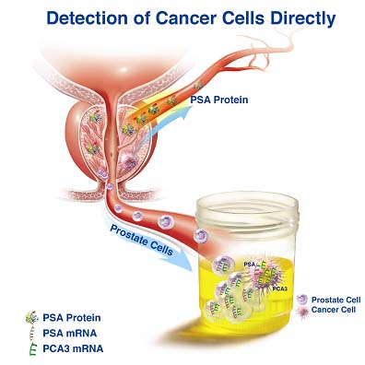
MiPS= Mi Prostate Score
(PCA3+ TMPRSS2-ERG + urinary PSA+ serum PSA)
Test will be employed in our Team Projects
(MRI-Biomarker and Upgrading Study)

Slide 3
Project Overview
Identify and validate novel prostate cancer and aggressive prostate cancer specific transcriptomic biomarkers
Determine the utility of prognostic transcriptomic tissue based biomarkers
Determine the utility of diagnostic transcriptomic urinary based biomarkers

Slide 4
Project Overview
Identify and validate novel prostate cancer and aggressive prostate cancer specific transcriptomic biomarkers
Determine the utility of prognostic transcriptomic tissue based biomarkers
Determine the utility of diagnostic transcriptomic urinary based biomarkers

Slide 5
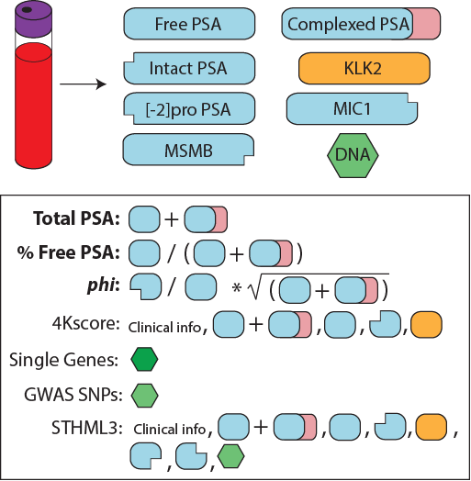
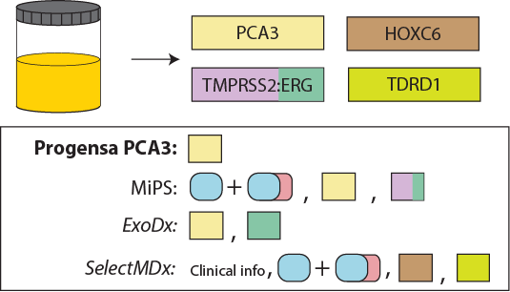
We have PCa early detection tests
None specifically use markers of aggressive prostate cancer
Notes:
Numerous early detection assays for prostate cancer. None specifically use markers of aggressive prostate cancer

Slide 6
We have PCa early detection tests
None specifically use markers of aggressive prostate cancer
Notes:
We have previously described the development and validation of MiPS, which incorpates serum PSA, and urine T2:ERG and PCA3 assessed by TMA from post-DRE whole urine. MiPS improves upon serum PSA or PCPT risk calculator for predicting the presence of cancer and high grade cancer on biopsy

Slide 7

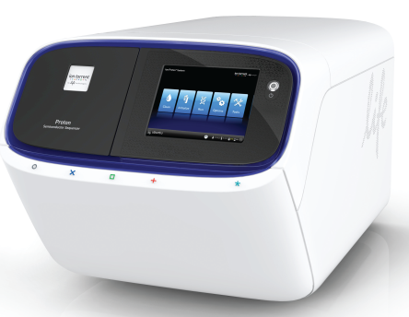
Multiplex RNAseq
Ampliseq RNA
(RT, multiplex PCR,
Ligate adaptors/barcode)
Isolate RNA
(and DNA)
NGS
Potential advantages
<1-10ng FFPE or urine RNA vs. >>10ng qRT-PCR for many targets
Multiplexing is easier by sequencing than most qRT-PCR
Digital data (sequence information)
Combinatorial priming for gene fusions/splice variants
Notes:
In our proposal, we sought to leverage multiplexed assessment of the prostate cancer transcriptome through Multiplexed targeted RNAseq from both tissues and urine.

Slide 8
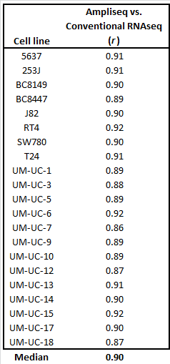
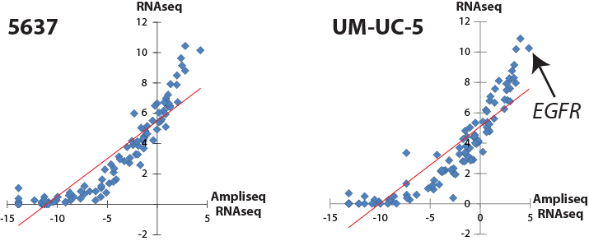
Correlation vs. RNAseq
21 bladder cancer cell lines
Bladder cancer targeted RNAseq panel
Standard RNAseq (UMHSCC sequencing core)
Hovelson et al. European Urology 2018
Notes:
In other systems, we have shown that this approach is highly correlated to gold standard transcriptome quantification.
We assessed RNA from 21 bladder cancer cell lines by a targeted RNA seq panel and standard illumina RNAseq. Median pairwise comparison of normalized target gene expression (targeted rna seq) vs. target gene FPKM (Illumina) was 0.90. Plots of from two cell lines are shown.

Slide 9
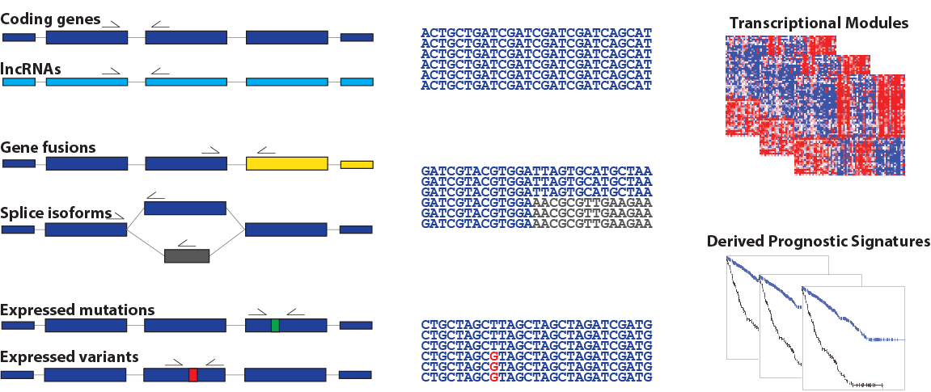
306 transcript targeted RNAseq assay
Diagnostic genes
Subtyping genes (all ETS fusions)
AR splice variants
NePC genes
lncRNAs
Expressed mutations
Decipher
Oncotype DX
Prolaris (CCP)
Salami et al., Manuscript submitted.
Notes:
We developed a 306 transcript multiplexed targeted RNAseq applicable to minute FFPE tissue specimens that assesses multiple important transcriptomic biomarkers in prostate cancer.

Slide 10
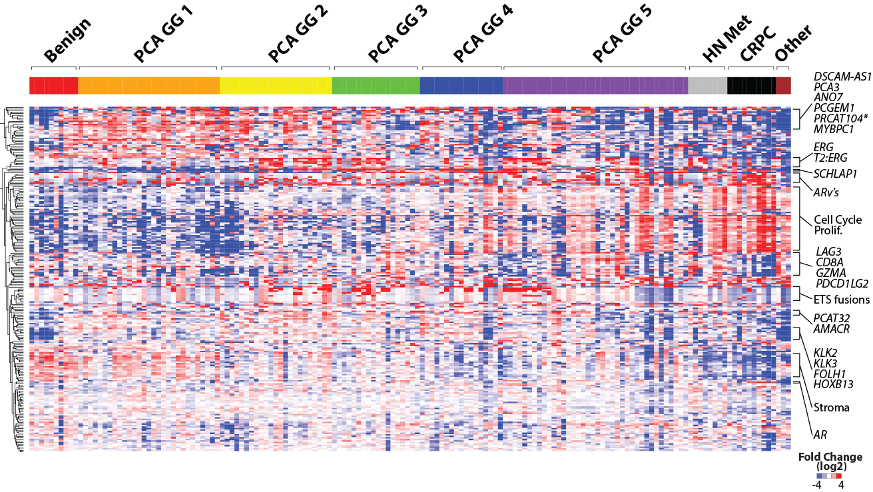
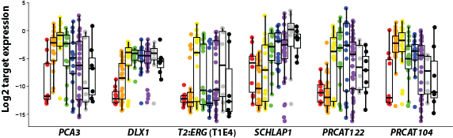
Notes:
When applied to a large compendium of prostate tissues (from benign prostate tissue through CRPC), we see expected expression of transcript modules (e.g. Cell cycle/proliferation increasing with grade and progression) as well as validation of amplicon for single gene markers (shown on the bottom).

Slide 11
Notes:
These include potentially prognostic lncRNAs, such as SCHLAP1, the most prognostic single transcript biomarker identified to date in Pca.

Slide 12
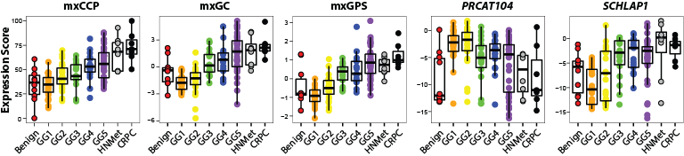
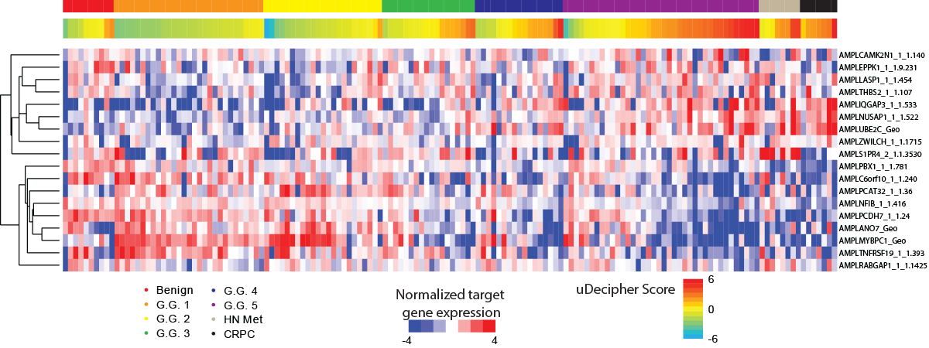
Polaris
Decipher
Oncotype Dx
Notes:
CCP - Prolaris, GPS - Oncotype Dx and GX - Decipher

Slide 13
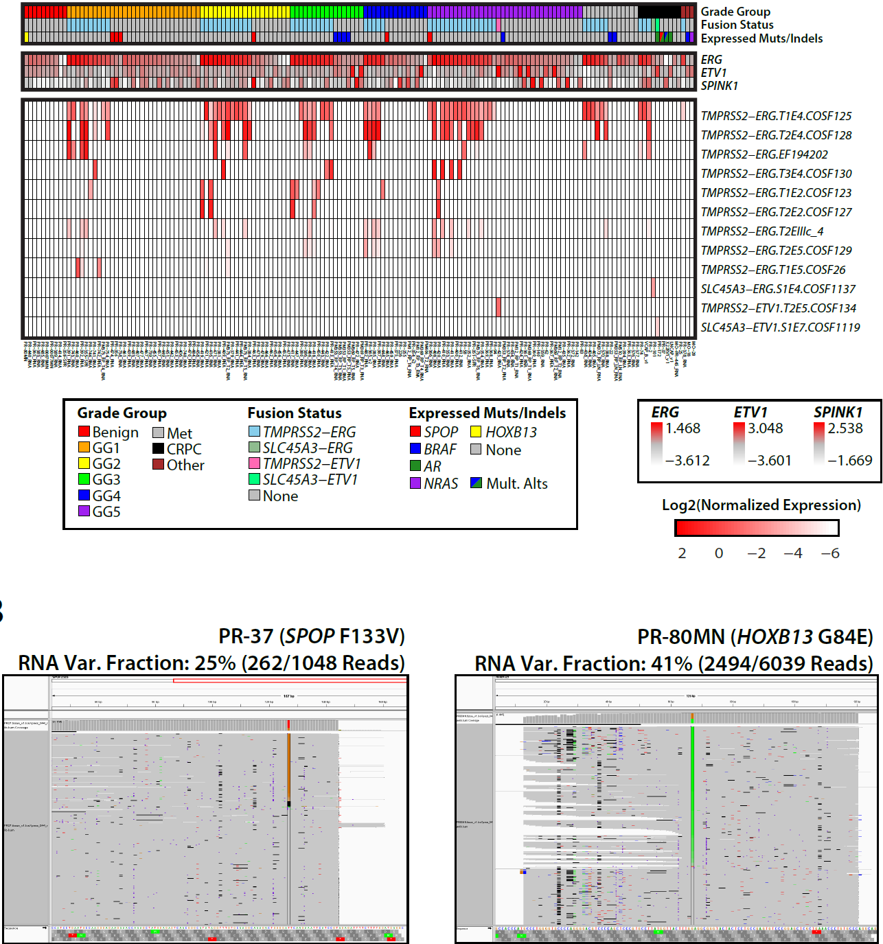
Notes:
The combinatorial priming also allows us to detect multiple gene fusions (top panel), which was validated using orthogonal qRT-PCR data.
Also can read out expressed mutations (SPOP shown on bottom, far right) and variants (e.g. HOXB13 p.G84E) from the sequenced transcripts. These were also validated with DNA sequencing and 100% concordant

Slide 14
Notes:
Showing most prostate cancer foci express more than one T2:ERG splice variant, consistent with earlier qRT-PCR studies, even though T2:ERG(T1E4) is the most common and the only isoform assessed in MIPS.

Slide 15
306 transcript targeted RNAseq assay (Tissue)
84 transcript targeted RNAseq assay for urine (MiPS-NGS)
TMPRSS2:ETS (fusions, many isoforms)
PCA3, SChLAP1, other lncRNAs
KLK3, other PCa genes, AR splice isoforms
Expressed variants/mutations (HOXB13, SPOP)
Notes:
Based on the tissue panel, we designed a smaller 84 transcript targeted RNAseq assay for urine (uMiPS)
Important transcript classes are listed.

Slide 16
MiPS-NGS development
~90% informative rate with optimized extraction
Same post-DRE whole urine sample as PCA3/MiPS
Highly reproducible
r of raw reads = 0.96 (range 0.84-1.00)
Confirmed expression of key targets via qRT-PCR
Identified additional prostate specific urine housekeeping genes beyond PSA (KLK3)
Notes:
Uses same whole urine post-DRE specimen as MiPS and PCA3. Compatible with archied samples stored in GenProbe medium
Highly reproducible including end to end from separate urine aliquots
Used qRT-PCR to confirm expression of MiPS transcripts
Have identified additional normalizer genes
SLIDES FOR THESE ARE AFTER THE ACKNOWLEDGEMENTS IF NEEDED

Slide 17
Can MiPS-NGS replace MiPS?
Can NGS for TMPRSS2:ERG, PCA3 and KLK3 replace transcription mediated amplification assessment of the same markers?
MiPS-NGS on banked urine samples from men who underwent clinical MiPS (n=20)
Replaced TMA with NGS derived values for above biomarkers in the clinical models
Notes:
First sought to determine if this assay can replace MiPS (T2:ERG and PCA3 normalized to urine KLK3[PSA])
Ran uMiPS on separate urine aliquots form 20 men who had previous clinical MiPS testing
Used exact same logistic regression models as clinically used for MiPS, but for uMiPS used NGS values for TMPRSS2:ERG, PCA3 and KLK3

Slide 18
MiPS vs. MiPS-NGS risk scores
r = 0.74
Benign. 30 negative biopsy
cores. Fusion-negative
Notes:
Correlation of MiPS and uMiPS scores. Outlier sample indicated value had much lower uMiPS than MiPS score. Patient had 30 core negative biopsy with MRI guidance. Potential falsely low urine PSA value by MIPS?
Overall highly concordant

Slide 19
Can MiPS-NGS replace and supplement MiPS?
Archived urine samples from
66 men with no cancer/Gleason score 6 (GG1) on bx/RRP
43 men with Gleason score ≥ 4+3=7 (GG3) on bx/RRP
Diagnostic performance of MiPS (but using NGS) vs. serum PSA alone
Trained and tested new MiPS based logistic regression models
Trained on 2/3 cohort (n=73), tested on remaining 1/3 (n=36)
Random forest variable selection model used to build 29 transcript regularized logistic regression model
Trained on 2/3 cohort (n=73), tested on remaining 1/3 (n=36)
Notes:
Used extreme design cohort to assess potential diagnostic performance and identify additional transcripts that may contribute beyond T2:ERG and PCA3.
Applied uMIPs and uMIPShg models to the whole cohort, since those models were already trained.
Used Random forest variable selection model used to build a 29 transcript regularized logistic regression model. Separate training and testing cohorts.

Slide 20
Random forest selected 29 targets
T2:ERG
TDRD1
T2:ERG
T2:ERG
SCHLAP1
T2:ERG
T2:ERG
ARLNC1
ERG
T2:ERG
T2:ERG
SCHLAP1
GG>=3
B9/GG1
PRCAT104
T2:ERG
T2:ERG
T2:ERG
T2:ERG
T2:ERG
Notes:
Expression of normalized target gene expression for the 29 markers selected by random forest model are shown in benign/grade group 1 (red) vs. high grade (blue) across the whole cohort.

Slide 21
Performance of 29 transcript model
Training (n=73)
Testing (n=36)
AUC
AUC
Serum PSA
MiPS
MiPS-NGS
29 trans model
0.670
0.714
0.831
0.899
Serum PSA
MiPS
MiPS-NGS
29 trans model
0.625
0.757
0.714
0.812
Notes:
AUCs from serum PSA, MiPS but with NGS data (green), new trained/tested uMIPS model, and the 29 transcript model.

Slide 22
Summary
Developed a post-DRE, whole urine-based targeted RNAseq assay for PCa early detection
Highly correlated to current clinically validated assay assessing T2:ERG and PCA3 (MiPS)
Improves upon the performance of serum PSA
Likely additional value in multigene model
NGS platform allows for evolution of content

Slide 23
Research Highlights
MiPS is offered as a CLIA/CAP test. PCA3 is FDA approved.
Established MiPS-NGS assay (as the nextgen test)
Discovered/characterized novel lncRNA biomarkers (PCAT14 (Neoplasia 2016), ARLNC1 (Nature Genetics 2018), and THOR (Cell 2017))
Identified CDK12 a biomarker for sensitivity to immune checkpoint inhibitors (Cell 2018)
Wu, Cieslik, Robinson et al, Cell 2018

Slide 24
Challenges
Issues with Commercial Partner (Hologic/Gen-Probe) for urine PCA3 and T2-ERG assays
Requirement of post-DRE not ideal (need more sensitive assays)
Advent of prostate MRI
While early diagnosis is possibly with a urine test, developing a test that picks up aggressive prostate cancer is the key
Outlook/Future Plans
Establish MiPS NGS as the new urine MiPS test (will be used as part of EDRN CORE project)
Refine content of MiPS NGS
Carry out MiPS-NGS validation studies as part of the EDRN.
Identify a new commercial partner to develop and market MiPS and MiPS-NGS

Slide 25
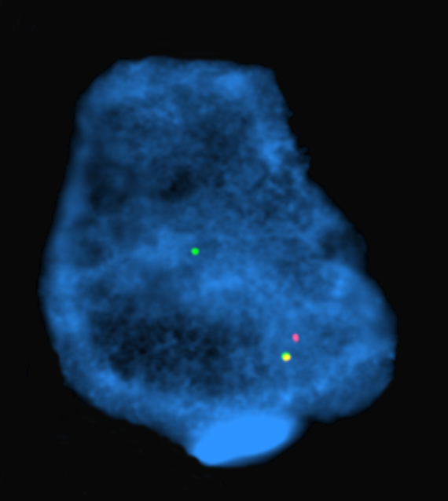







Acknowledgements
Collaborators
MCTP
UMHS
Pete Nelson (Univ. Washington)
Nathalie Rioux-Leclercq (Rennes Hospital)
Shahrokh Shariat (Med. Univ. of Vienna
Mark Rubin (WCMC)Pete Nelson (FHCRC)
Karen Knudsen (TJU )
Seth Sadis (ThermoFisher)
Ryan Dittamore (Epic Biosciences) Gert Attard (Royal Marsden)
ThermoFisher Ampliseq R&D Team
Andi Cani
Kevin Hu
Sumin Han
Daniel Hovelson
Albert Liu
Komal Kunder
John Wei
Javed Siddiqui
Simpa Salami
Ganesh Palapattu
Todd Morgan

Slide 26
Challenges
Co-PI, Scott Tomlins recruited to industry (however we have maintained 5% effort at U-M)
Issues with Commercial Partner (Hologic/Gen-Probe) for urine PCA3 and T2-ERG assays
Requirement of post-DRE not ideal (need more sensitive assays)
Advent of prostate MRI
While early diagnosis is possibly with a urine test, developing a test that picks up aggressive prostate cancer is the key
Patents, Licenses, and International Collaborations
Secured PCA3 license from Hologic; T2-ERG IP returned to U-M (considering new commercial partners)
MiPS in the U-M CLIA Pathology labs as offered as urine test
U-M has secured a supply contract from Hologic for T2-ERG urine assay reagents
International collaborations with institutions in China are under discussion
Outlook/Future Plans
Establish MiPS NGS as the new urine MiPS test (will be used as part of EDRN CORE project)
Refine content of MiPS NGS
Carry out MiPS-NGS validation studies as part of the EDRN.
Identify a new commercial partner to develop and market MiPS and MiPS-NGS

Slide 27
Publications (acknowledging EDRN)
Merdan S, Tomlins SA, Barnett CL, Morgan TM, Montie JE, Wei JT, Denton BT. Assessment of long-term outcomes associated with urinary prostate cancer antigen 3 and TMPRSS2:ERG gene fusion at repeat biopsy. Cancer. 2015 November 15;121(22):4071-9.
Udager AM, DeMarzo AM, Shi Y, Hicks JL, Cao X, Siddiqui J, Jiang H, Chinnaiyan AM, Mehra R. Concurrent nuclear ERG and MYC protein overexpression defines a subset of locally advanced prostate cancer: Potential opportunities for synergistic targeted therapeutics. Prostate. 2016 Jun;76(9):845-53.
Shukla S, Zhang X, …., Bui HH, Siddiqui J, Jing X, Cao X, Dhanasekaran SM, Feng FY, Chinnaiyan AM, Malik R. Identification and Validation of PCAT14 as Prognostic Biomarker in Prostate Cancer. Neoplasia. 2016 Aug;18(8):489-99.
Mani RS, Amin MA, Li X, …, Chinnaiyan AM. Inflammation-Induced Oxidative Stress Mediates Gene Fusion Formation in Prostate Cancer. Cell Reports 2016 Dec 6;17(10):2620-2631.
Wang X, Qiao Y, … Chinnaiyan AM. Development of Peptidomimetic Inhibitors of the ERG Gene Fusion Product in Prostate Cancer. Cancer Cell. 2017 Apr 10;31(4):532-548.e7.
Blattner M, Liu D, Robinson BD, Huang D, Poliakov A, Gao D, Nataraj S, Deonarine LD, Augello MA, Sailer V, Ponnala L, Ittmann M, Chinnaiyan AM, Sboner A, Chen Y, Rubin MA, Barbieri CE. SPOP Mutation Drives Prostate Tumorigenesis In Vivo through Coordinate Regulation of PI3K/mTOR and AR Signaling. Cancer Cell. 2017 Mar 13;31(3):436-451.
Robinson DR, Wu YM, … , Chinnaiyan AM. Integrative clinical genomics of metastatic cancer. Nature. 2017 August 17;548(7667):297-303.
Hosono Y,… , Chinnaiyan AM. Oncogenic Role of THOR, a Conserved Cancer/Testis Long Noncoding RNA. Cell. 2017 December 14;171(7):1559-1572.e20.
Zhang Y, Pitchiaya S, … , Chinnaiyan AM. Analysis of the androgen receptor-regulated lncRNA landscape identifies a role for ARLNC1 in prostate cancer progression. Nature Genetics. 2018 June;50(6):814-824.
Quigley DA, … , Chinnaiyan AM, Maher CA, Small EJ, Feng FY. Genomic Hallmarks and Structural Variation in Metastatic Prostate Cancer. Cell. 2018 Jul 26;174(3):758-769.e9.
Wu YM,… PCF/SU2C International Prostate Cancer Dream Team, Robinson DR, Chinnaiyan AM. Inactivation of CDK12 Delineates a Distinct Immunogenic Class of Advanced Prostate Cancer. Cell. 2018 Jun 14;173(7):1770-1782.e14.

Slide 28
Publications (acknowledging EDRN)
Merdan S, Tomlins SA, Barnett CL, Morgan TM, Montie JE, Wei JT, Denton BT. Assessment of long-term outcomes associated with urinary prostate cancer antigen 3 and TMPRSS2:ERG gene fusion at repeat biopsy. Cancer. 2015 November 15;121(22):4071-9.
Udager AM, DeMarzo AM, Shi Y, Hicks JL, Cao X, Siddiqui J, Jiang H, Chinnaiyan AM, Mehra R. Concurrent nuclear ERG and MYC protein overexpression defines a subset of locally advanced prostate cancer: Potential opportunities for synergistic targeted therapeutics. Prostate. 2016 Jun;76(9):845-53.
Shukla S, Zhang X, …., Bui HH, Siddiqui J, Jing X, Cao X, Dhanasekaran SM, Feng FY, Chinnaiyan AM, Malik R. Identification and Validation of PCAT14 as Prognostic Biomarker in Prostate Cancer. Neoplasia. 2016 Aug;18(8):489-99.
Mani RS, Amin MA, Li X, …, Chinnaiyan AM. Inflammation-Induced Oxidative Stress Mediates Gene Fusion Formation in Prostate Cancer. Cell Reports 2016 Dec 6;17(10):2620-2631.
Wang X, Qiao Y, … Chinnaiyan AM. Development of Peptidomimetic Inhibitors of the ERG Gene Fusion Product in Prostate Cancer. Cancer Cell. 2017 Apr 10;31(4):532-548.e7.
Blattner M, Liu D, Robinson BD, Huang D, Poliakov A, Gao D, Nataraj S, Deonarine LD, Augello MA, Sailer V, Ponnala L, Ittmann M, Chinnaiyan AM, Sboner A, Chen Y, Rubin MA, Barbieri CE. SPOP Mutation Drives Prostate Tumorigenesis In Vivo through Coordinate Regulation of PI3K/mTOR and AR Signaling. Cancer Cell. 2017 Mar 13;31(3):436-451.
Robinson DR, Wu YM, … , Chinnaiyan AM. Integrative clinical genomics of metastatic cancer. Nature. 2017 August 17;548(7667):297-303.
Hosono Y,… , Chinnaiyan AM. Oncogenic Role of THOR, a Conserved Cancer/Testis Long Noncoding RNA. Cell. 2017 December 14;171(7):1559-1572.e20.
Zhang Y, Pitchiaya S, … , Chinnaiyan AM. Analysis of the androgen receptor-regulated lncRNA landscape identifies a role for ARLNC1 in prostate cancer progression. Nature Genetics. 2018 June;50(6):814-824.
Quigley DA, … , Chinnaiyan AM, Maher CA, Small EJ, Feng FY. Genomic Hallmarks and Structural Variation in Metastatic Prostate Cancer. Cell. 2018 Jul 26;174(3):758-769.e9.
Wu YM,… PCF/SU2C International Prostate Cancer Dream Team, Robinson DR, Chinnaiyan AM. Inactivation of CDK12 Delineates a Distinct Immunogenic Class of Advanced Prostate Cancer. Cell. 2018 Jun 14;173(7):1770-1782.e14.

Slide 29
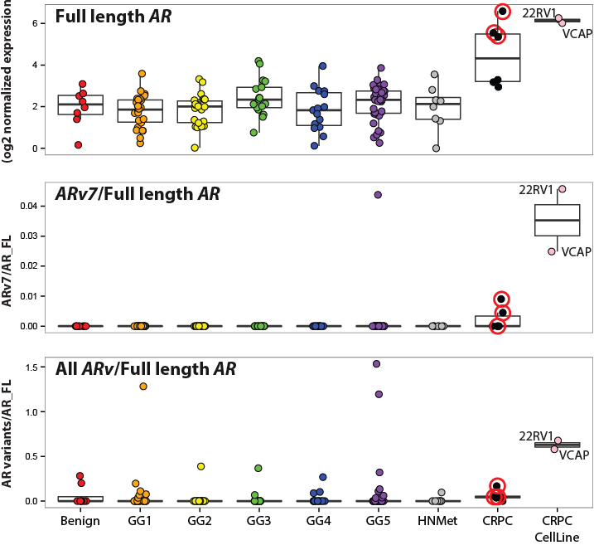

Slide 30
Notes:
CCP - Prolaris, GPS - Oncotype Dx and GX - Decipher

Slide 31
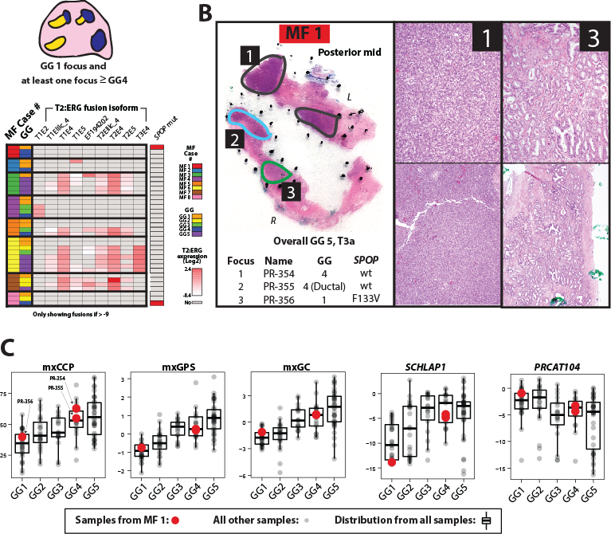

Slide 32
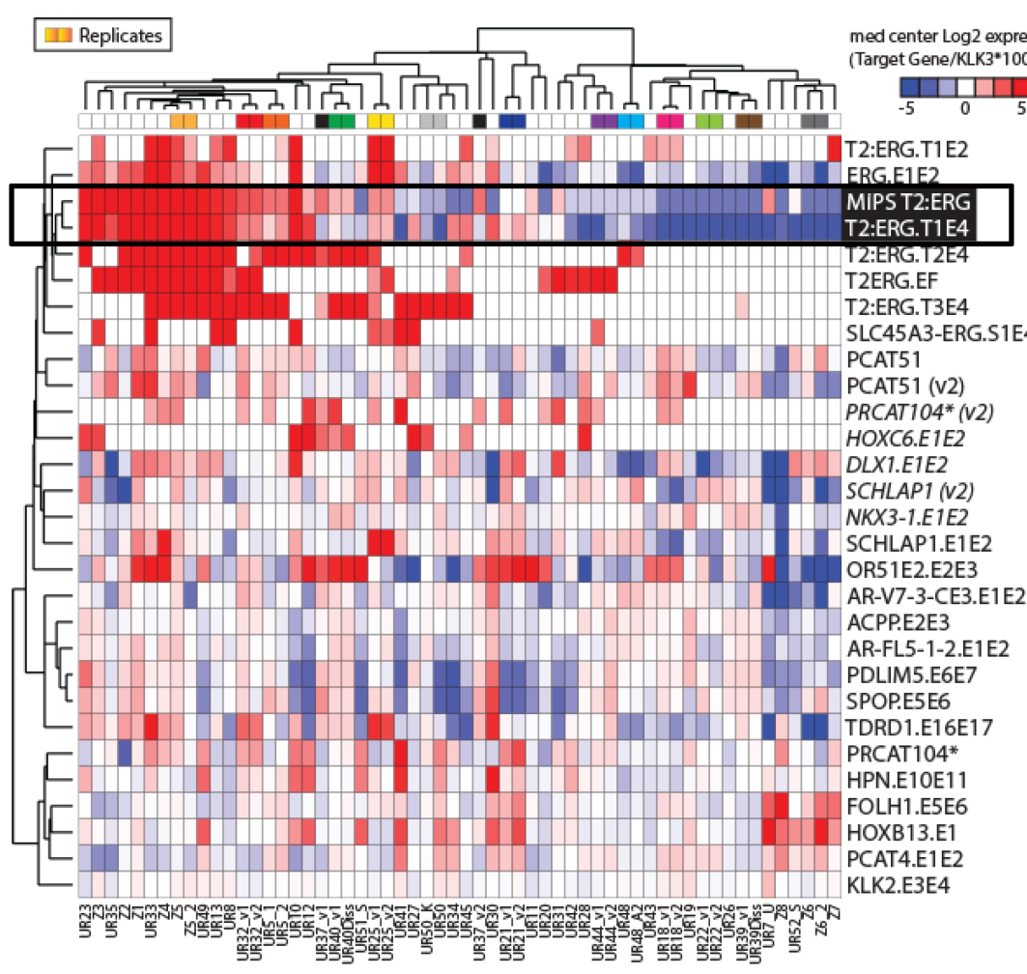
PCa urine RNA NGS assay
uMiPS_v1
High concordance with MiPS (r=0.83)
T2:ERG T1E4 not always most
common isoform
Paired samples cluster together,
median r=0.99
(range 0.77-0.99)

Slide 33
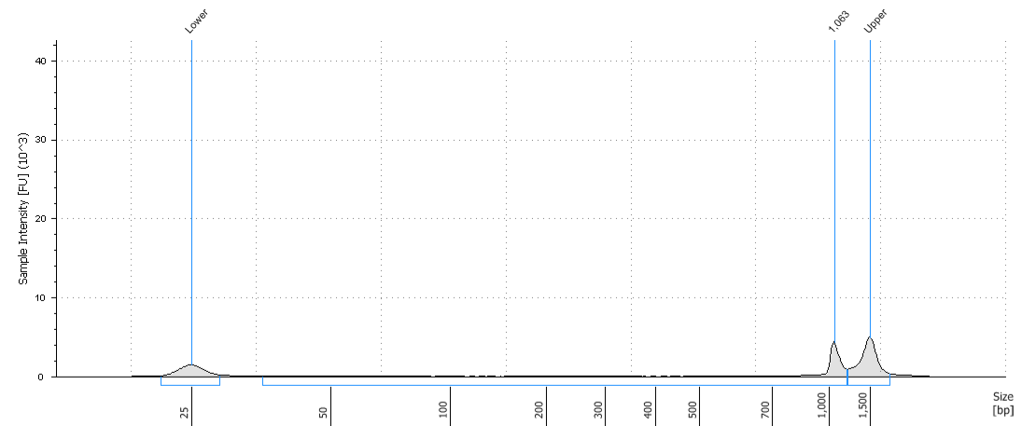
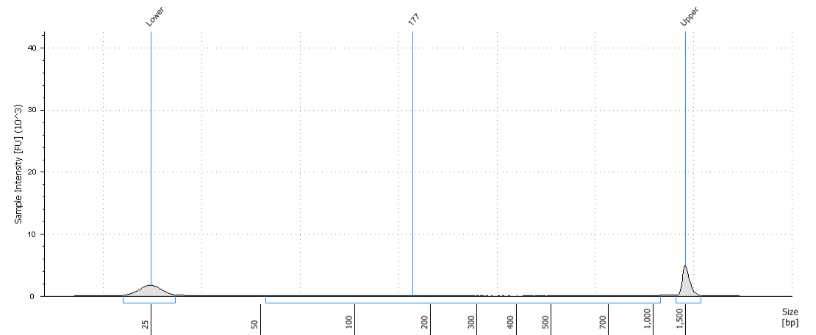
Assay technical parameters and reproducibility
Untreated
DNAse - treated
DNA contamination
uMiPS_v2
High quality reproducible sequencing
DNase treatment does not affect read count in sample with low DNA contamination
Pearson mean r = 0.96 (range 0.84-1.00)
r=0.95
Current informative sample rate >90%

Slide 34
uMiPS_v2 Concordance with MiPS
PCA3 Score
T2:ERG_T1E4 Score
Sequencing
r = 0.85
r = 0.96
MIPS
MIPS
log2 transformed
MiPS and Sequencing assays are highly concordant

Slide 35
MiPS hg vs. MiPS-NGS hg risk scores
r = 0.81
Benign. 30 negative biopsy
cores. Fusion-negative
Notes:
Correlation of MiPShg and uMiPShg scores. High grade is greater than Gleason score 6.

Slide 36
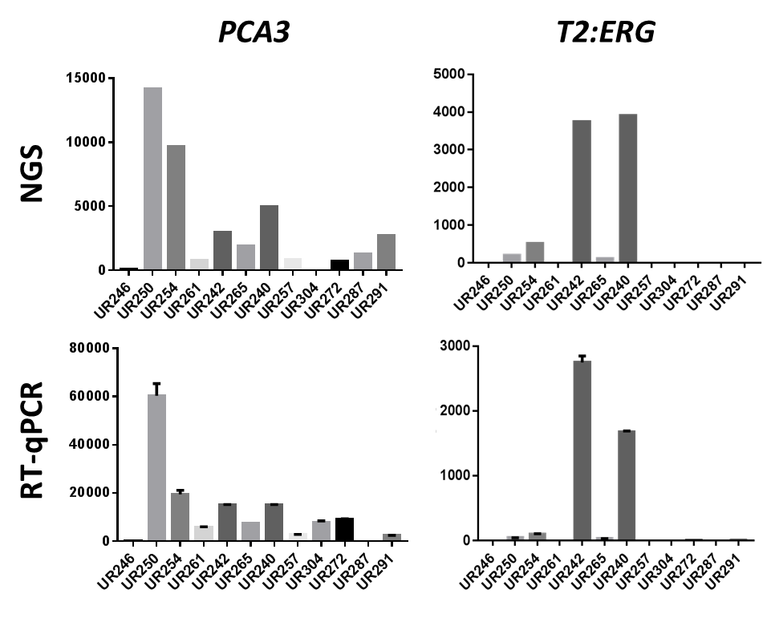
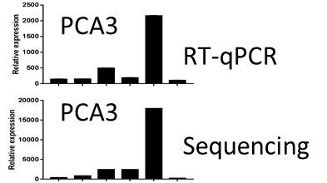
RT-qPCR assay

Slide 37
Extreme Design Cohort: Benign/GG1 vs. GG 3, 4, 5
Equally Expressed Transcripts
KLK2 Score
PCAT4 Score
250
ns
ns
200
100
(x 1000)
150
50
100
Benign/GG 1 GG 3,4,5
Benign/GG 1 GG 3,4,5
Expression of “housekeeping” genes not associated with tumor grade

Slide 38
Extreme Design Cohort: TMPRSS2:ERG
T2:ERG_T1E4 Score
T2:ERG_All Score
p=0.07
4000
p=0.07
400
3000
300
2000
200
100
1000
0
0
Benign/GG 1 GG 3,4,5
Benign/GG 1 GG 3,4,5
Additional T2:ERG isoforms may be clinically useful

Slide 39
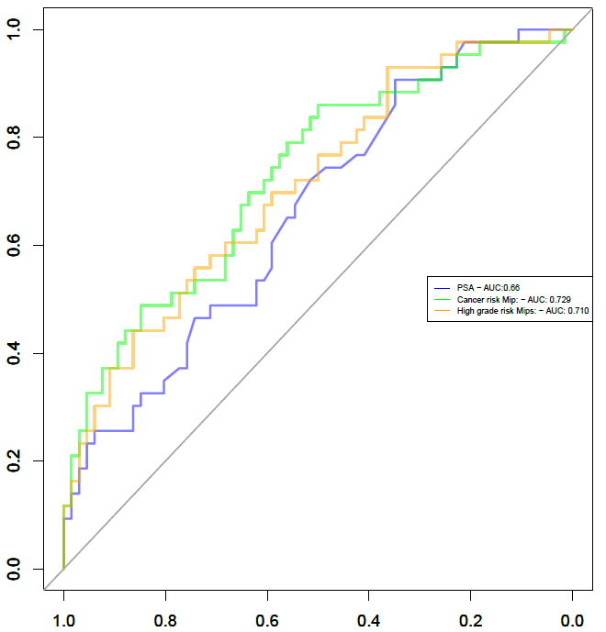
Performance of MiPS/MiPS-NGS hg
Ex design cohort (n=109)
AUC
Serum PSA
MiPS
MIPShg
0.660
0.729
0.710
using clinical MiPS models but uMIPS NGS quantified KLK3, TMPRSS2:ERG, and PCA3 values
Notes:
AUCs from serum PSA and uMIPS models

