Slide 1
Breast Cancer Detection Consortium
MPI
Jeffrey R. Marks, Duke University
Cha-Mei Tang, Creatv Microtech
UO1 CA214183
Funding: 9/2016

Slide 2
Breast Cancer Diagnosis
>1.6 million breast biopsies/year in US
230,000 invasive and 60,000 non-invasive cancers detected
Mammography has ~20% positive predictive value at ~80% negative predictive value
  But mammograms are feature rich
Increasing PPV modestly while retaining high NPV could eliminate a substantial number of biopsies

Slide 3
Study Design – Breast Cancer Diagnostic Setting
Detection of Breast Abnormality through Screening Mammo or Breast Exam
Further Diagnostic Imaging – Magnification Views and/or Ultrasound
Needle Core Biopsy – Subject Enrollment (Blood and Baseline Data Collected)
Pathology Diagnosis → Ground Truth Recorded
Blood Processing (Cell Tubes to Creatv, Other Components Stored at Duke)
Track Benign Conditions over Time for Cancer Events
Image Feature Extraction (Duke, yrs 2-5)
CAML Assay (Creatv Microtech, Real-Time Analysis)
Immunosignaturing (ASU, Performed in Large Batches in yrs 4 and 5)
CA125 and TP53 Autoantibody (Duke, Performed in Large Batches, yrs 4 and 5)
Blinded
Classification Based on Retrospective Training Sets
Classification Based on Training Set
Classification Based on Training Sets
Classification Based on Training and Validation Sets
Test Combined Predictions on ~30% of Prospective Subjects - Unblinding
Validate Optimal Combined Predictor on Remainder of Prospective Subjects
n=1050, 2016-2021

Slide 4
Radiologists are the Gatekeepers for Breast Cancer Detection
Almost all breast biopsies are performed with image guidance – therefore the detection of the cancer is entirely dependent upon the imaging and radiologist’s interpretation/identification of the images
For image analysis, focusing on the area identified by the radiologist and ultimately biopsied is the most logical approach
CAD was never adopted - it attempted to aid the radiologist in identifying abnormal regions, not determining benign from malignant

Slide 5
Mammographic Abnormalities
There are three types of abnormal findings that trigger a biopsy: masses, calcifications, and architectural distortions – combinations of these within a single image are common
Masses and calcifications are the most common with distortions accounting for 6% of noted abnormalities
  Distortions are the most difficult to evaluate and may account for a number of false negative findings, i.e., early changes associated with cancer
USPSTF data on FFDM (2016) – 400K women, 0.75% cancer (within 12 months of screening), 12% FP (biopsied) and 0.1% FN (missed cancer by FFDM)

Slide 6
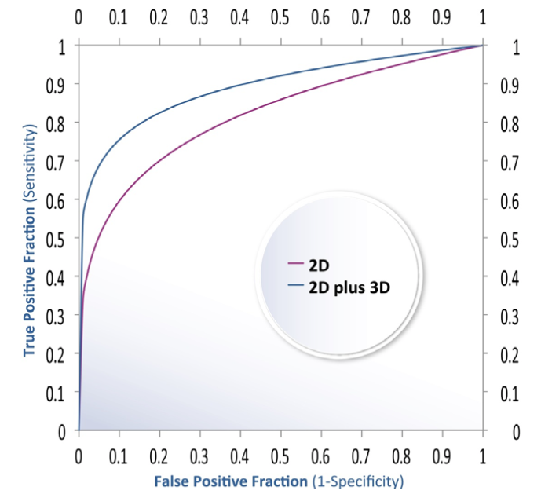
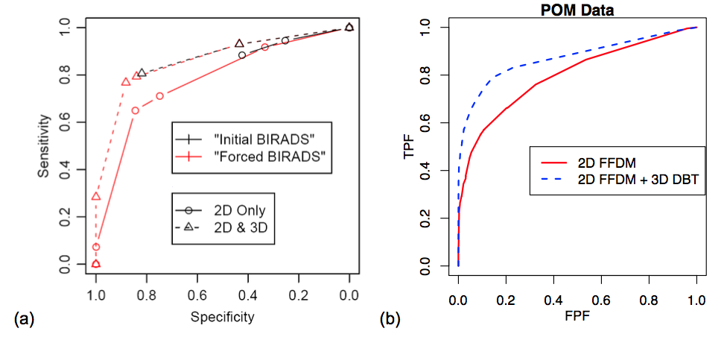
ROC analysis
FDA trial for Hologic breast tomo (2D+3D) vs. mammo (2D)
  Many years, highly unusual amount of scrutiny, many repeated analyses
  all results were concordant, regardless of BI-RADS vs. POM scale or fitted vs. empirical curve
  fitted POM empirical BI-RADS empirical POM
P080003 Hologic Selenia Dimensions 3D System FDA Executive Summary, 2010

Slide 7
Radiology Goals
Create manually annotated dataset of images to be shared with research community
Use image dataset to develop machine learning algorithms to assist radiologists in detection and/or classification of breast cancer
Use radiology report text to guide machine learning algorithms to automatically detect and annotate vast numbers of cases, which can be used to create next generation machine learning algorithms

Slide 8
Radiology Workflow
Subject selection
Downloading
De-identification
Curation
Annotation
identify subjects for study from EHR
automate process for retrieval
remove PHI from DICOM headers
sort and rename files
create lesion masks
Image Analysis Training and Validation
  machine learning of masses and calcs

Slide 9

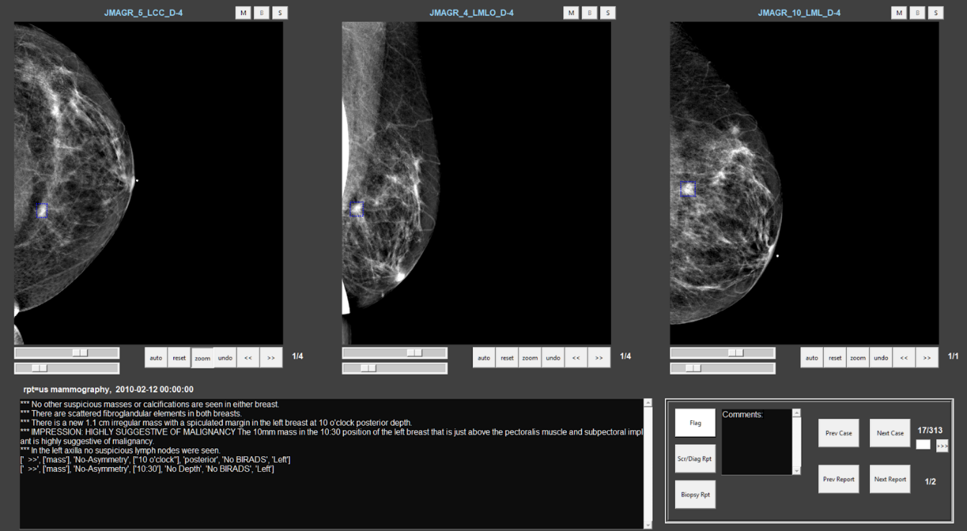
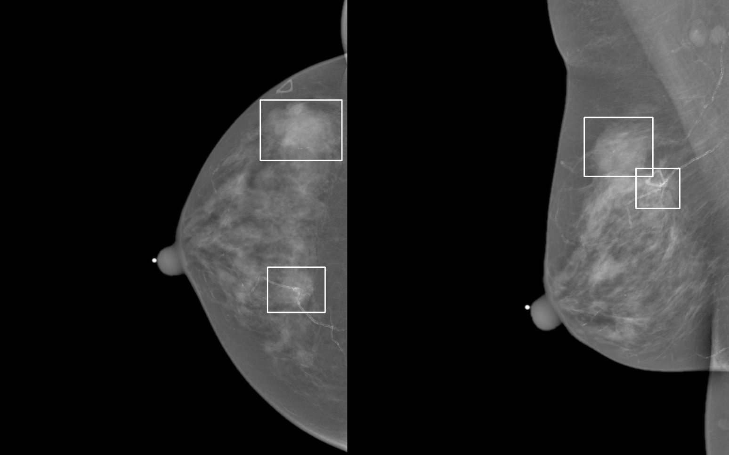
Radiology Workflow
Expert Annotation
Annotation
  Created custom graphical user interface (GUI)
  Pre-loads many cases to streamline radiologist workflow, just hit “next”
  Sorts images into order (screen, Dx, Bx), shows only Bx side
  Allows viewing adjustments (zoom, window-level, etc.)
  Displays computer-filtered report text as quick guide, option to display all related reports in full
  Radiologist marks cases using color-coded boxes
  Markings translated into mask images
Notes:
Background – collage of already annotated cases
Upper right – GUI for annotation
Lower right – example for one case

Slide 10
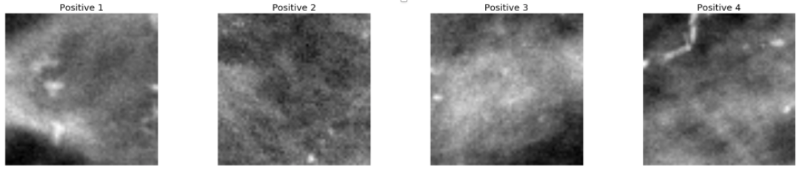
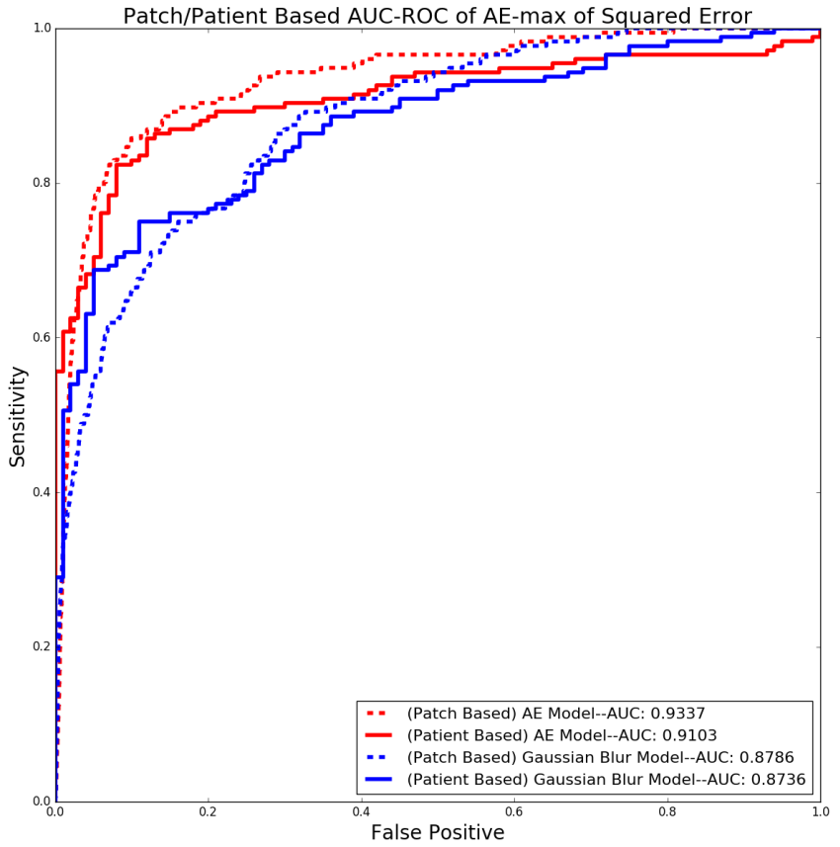
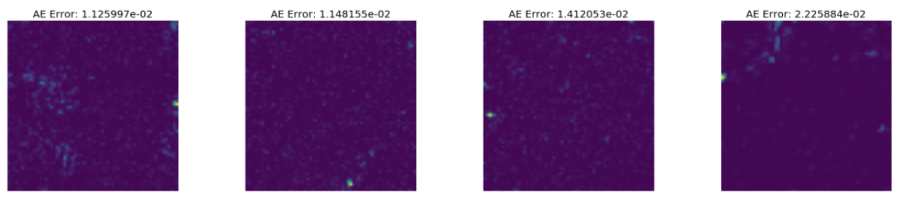
Calcification detection
Unsupervised “one-class classification” or “anomaly detection” by deep autoencoder
Trained on only normal FFDM, outperforms basic computer vision model trained on normal and cancers
Refining to see if good enough to act as front-end calc detector
Model output cancer patches

Slide 11
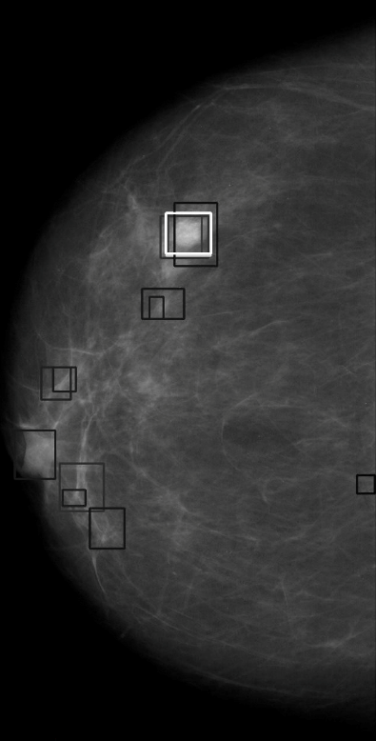
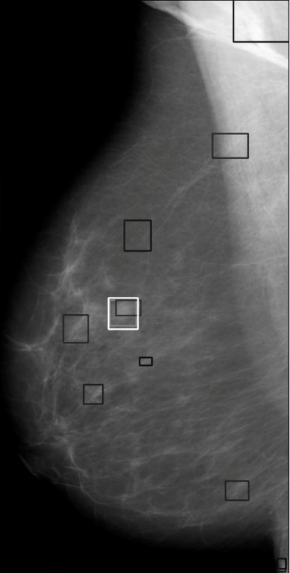
Mass detection
Deep learning model: “Single shot” detection, based on “You only look once (YOLO) v2”*
Detects suspicious regions and provides detection confidence and probability
Baseline model with single view only, improved by including both CC and MLO views
Preliminary results based on public, screen-film mammo database (DDSM), now adapting to Duke FFDM cases
* Redmon et al., “You Only Look Once: Unified, Real-Time Object Detection,” CVPR 2016

Slide 12
Radiology Progress Report
1023 retrospective cases with blood samples
  313 cases with visible masses
    Some are ultrasound only, or missing mammo images
  198 cases manually labeled by radiologist
    437 FFDM images + 245 additional mag views
Automated lesion detection
  Developing calcification and mass detection algorithms
  based on deep learning
    Leverage tremendous ability of cutting edge algorithms from “AI” research
    Avoids previous “handcrafted” approaches that require manual selection and merging of image features, which often don’t generalize to new datasets

Slide 13
Unique Prospective Study on BI-RADS 4
BI-RADS | Total | Benign | DCIS | Invasive | %Cancer (DCIS+Inv)
4A | 350 | 335 | 6 | 9 | 4.3%
4B | 250 | 209 | 19 | 22 | 16.4%
4C | 160 | 59 | 21 | 80 | 63.1%
5 | 152 | 18 | 4 | 130 | 88.2%
Total | 912 | 621 | 50 | 241 | 32.0%
Duke Series
BI-RADS | Total | Benign | Cancer (DCIS+Inv) | % Cancer
4A | 337 | 309 | 28 | 8.3%
4B | 122 | 93 | 29 | 23.8%
4C | 38 | 17 | 21 | 55.3%
4(unspecified) | 90 | 65 | 25 | 27.8%
5 | 77 | 16 | 61 | 79.2%
Total | 664 | 500 | 164 | 25.0%
Moffitt Series

Slide 14
Prospective Study Accrual
As part of Network Collaborative Project, Duke and Moffitt enrolling subjects with SOP and centralized data collection instruments (DMCC)
Targeted accrual is 1050 subjects through first half of year 5 (2021)
Duke began accrual Feb 2017 (n=263)
Moffitt began accrual Sept 2017 (n=120)
Two CellSave tubes shipped overnight to Creatv Microtech for rare cell detection

Slide 15
CAML Concordance Between 2 Tubes of Blood (n=150)
CAML Performance in Pilot Study (n=41)
CAML in Tube 2
True Positive Rate
AUC=0.78
False Positive Rate
CAML in Tube 1

Slide 16

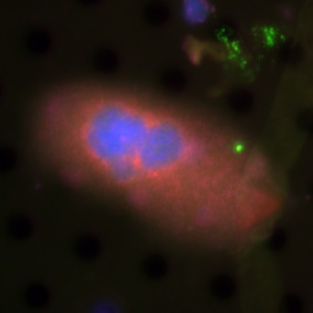
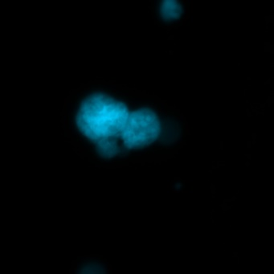
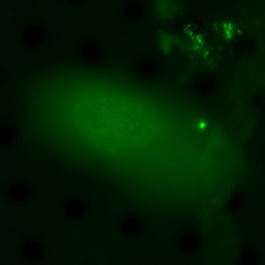
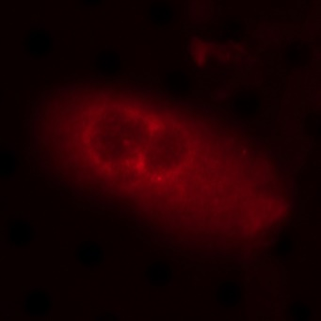
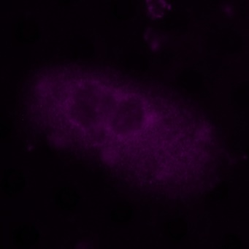
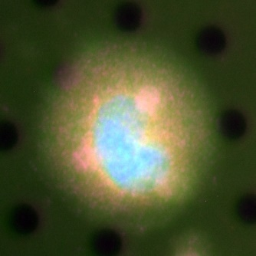
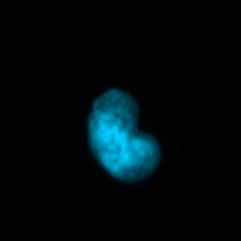
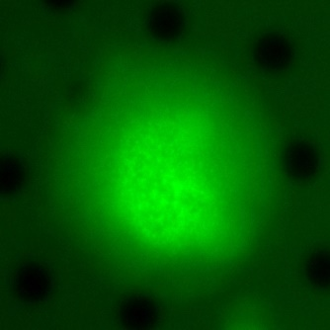
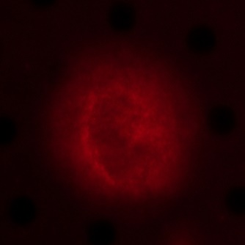
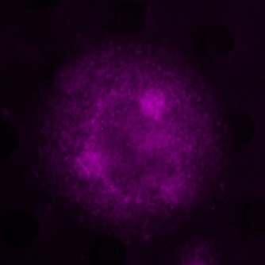
Examples of Cancer Associated Macrophage Like Cells from a Breast Patient
Merged
DAPI
Cytokeratin
CD31
CD45
90 um
CAML
10 µm
60 um
CAML
15 µm

Slide 17
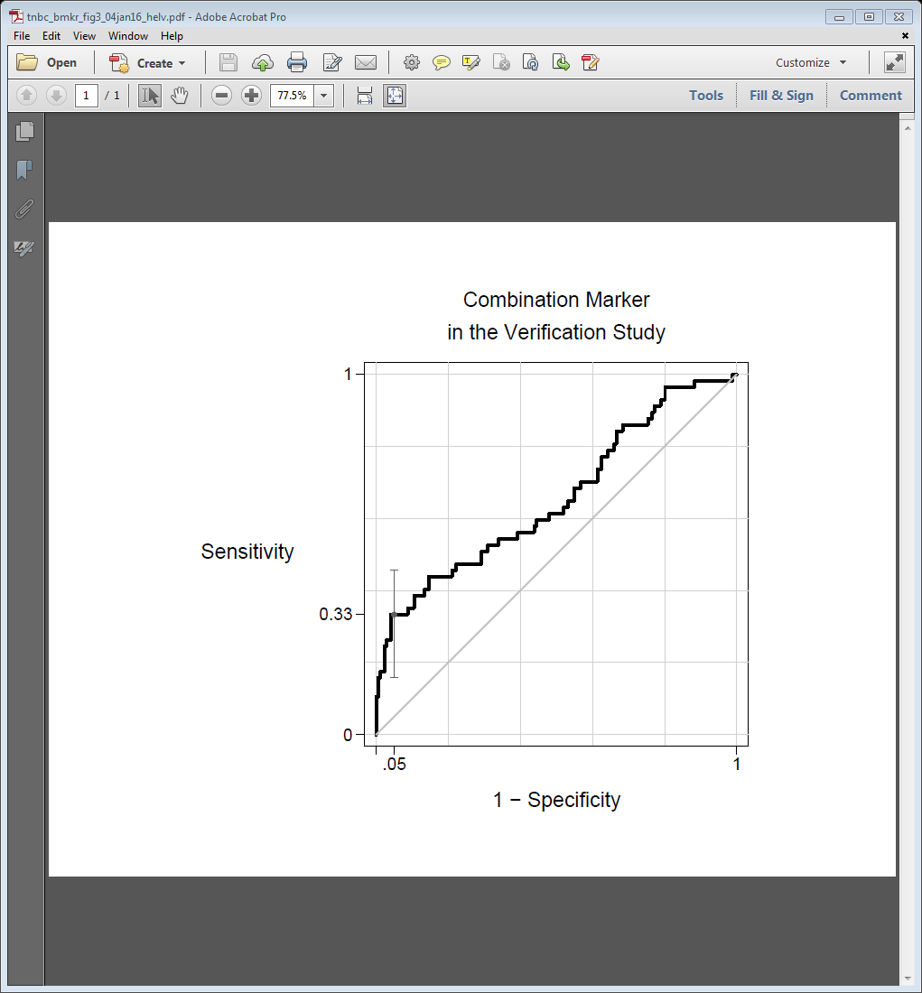
Additional Analytes in Diagnostic Samples
CA125+TP53 AAB in Triple Negative
Immunosignaturing with Frameshift Peptides

Slide 18
Research Highlights and Publications
Unique approach and analyte applied to breast cancer detection: BI-RADS 4 and CAML/rare cell detection
Integration of imaging and blood based biomarkers
Development of deep learning approaches to detect and classify masses and calcifications
Adams DL, Adams DK, Alpaugh RK, Cristofanilli M, Martin SS, Chumsri S, Tang CM, Marks JR: Circulating cancer-associated macrophage-like cells differentiate malignant breast cancer and benign breast conditions. 2016. Cancer Epidemiology, Biomarkers & Prevention. 25(7):1037-1042.
Shi, B., L. J. Grimm, M. A. Mazurowski, J. A. Baker, J. R. Marks, L. M. King, C. C. Maley, E. S. Hwang and J. Y. Lo (2018). "Prediction of Occult Invasive Disease in Ductal Carcinoma in Situ Using Deep Learning Features." J Am Coll Radiol 15(3 Pt B): 527-534.
Saha, A., M. R. Harowicz, E. H. Cain, A. H. Hall, E. S. Hwang, J. R. Marks, P. K. Marcom and M. A. Mazurowski (2018). "Intra-tumor molecular heterogeneity in breast cancer: definitions of measures and association with distant recurrence-free survival." Breast Cancer Res Treat.

Slide 19
Challenges and Help Needed for Project
Breast cancer already has an approved and widely implemented early detection strategy that has been demonstrated to reduce disease specific mortality
As with prostate cancer, the pendulum is swinging towards the realization that there is “over diagnosis” but unlike prostate cancer, there is very little resistance to the diagnostic procedure – therefore, even with improved performance, new tests will have a serious hurdle to overcome
  Ductal carcinoma in situ (DCIS) is at an inflection point with respect to over diagnosis
Useful disease specific biomarkers are still in short supply

Slide 20
Outlook and Plans
Our site is on track to meet the goals of the project as initially proposed
Addition of Moffitt to our prospective collection removes the possibility of single site bias
The prospective collection and blinded analysis of rare cell detection pushes definitive findings to year 5
At that point, it will be appropriate to incorporate vetted biomarkers from other sources

Slide 21
Team Project - Breast Imaging and Blood Resource
Initially approved in May 2017, now approved for multi-year
Collaboration with Moffitt (John Heine), Duke/Creatv, JPL, and DMCC
Two components
  Retrospective cohort of women undergoing breast cancer diagnosis with blood and imaging available (n=1000)
  Prospective cohort where rare cell detection is also performed (n=390/1050)
Images to be annotated and deposited at JPL
Serum/plasma to be made available

Slide 23
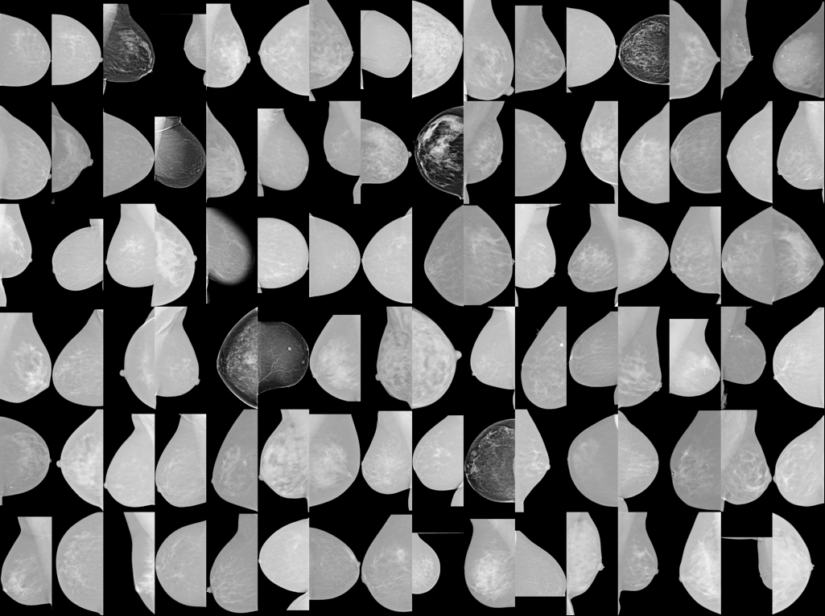
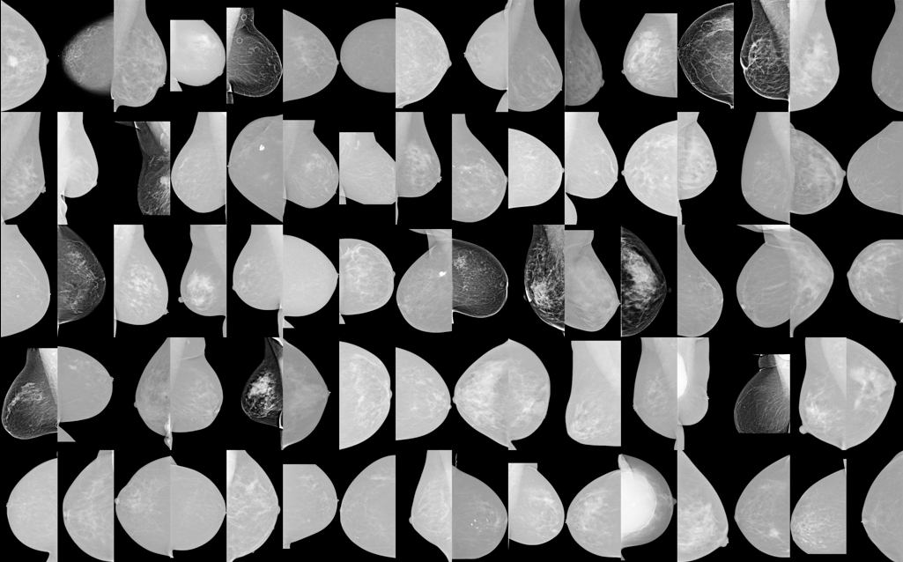
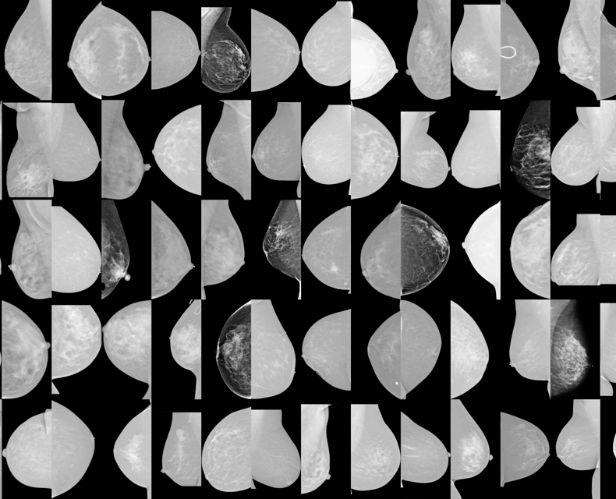
Radiology workflow
Selection
  Cases identified from Bx cases with blood sample
  Augmented by general Bx cases to provide additional training and testing needed for machine learning
Downloading
  Custom script mimic PACS workstation to auto download images
  Convert to common file formats when necessary
Curation
  Identify screen vs. diagnostic exams
  Sort into folders
  Apply consistent file naming convention

Slide 24
Radiology workflow
De-identification
  Modify PHI in DICOM header files (hundreds of lines)
  maintain integrity of multiple images in each subject/exam
0002,0002 Media Storage SOP Class UID: 1.2.840.10008.5.1.4.1.1.1.2
0002,0003 Media Storage SOP Inst UID: 1.2.840.113619.2.227. xxxxxxx
0002,0010 Transfer Syntax UID: 1.2.840.10008.1.2.1
0002,0012 Implementation Class UID: 1.2.276.0.7230010.3.0.3.6.1
0002,0013 Implementation Version Name: OSIRIX_361
0002,0017 ---: GEPACS
0008,0005 Specific Character Set: ISO_IR 100
0008,0008 Image Type: ORIGINAL\PRIMARY\
0008,0016 SOP Class UID: 1.2.840.10008.5.1.4.1.1.1.2
0008,0018 SOP Instance UID: 1.2.840.113619.2.227. xxxxxxx
0008,0020 Study Date: xxxxxxx
0008,0021 Series Date: xxxxxxx
0008,0022 Acquisition Date: xxxxxxx
0008,0023 Image Date: xxxxxxx
0008,0030 Study Time: 131714.000000
0008,0031 Series Time: 131747.000000
0008,0032 Acquisition Time: 132011.000000
0008,0033 Image Time: 132016.000000
0008,0050 Accession Number: xxxxxxx
0008,0060 Modality: MG
0008,0064 Conversion Type: WSD
0008,0068 Presentation Intent Type: FOR PRESENTATION
0008,0070 Manufacturer: GE MEDICAL SYSTEMS
0008,0080 Institution Name: Duke Breast Imaging
0008,0081 Institution Address: 200 Trent
Durham NC 27710
0008,0090 Referring Physician's Name: xxxxxxx
0008,1010 Station Name: xxxxxxx
0008,1030 Study Description: MM SCREENING DIGITAL BILAT
0008,103E Series Description: MM SCREENING DIGITAL BILAT
0008,1090 Manufacturer's Model Name: Senographe Essential VERSION ADS_53.30
0008,1110 Referenced Study Sequence:
0008,1150 Referenced SOP Class UID: 1.2.840.10008.3.1.2.3.1
0008,1155 Referenced SOP Instance UID: 1.2.124.113532.152.16.194. xxxxxxx
0008,1150 Referenced SOP Class UID: 1.2.840.10008.3.1.2.1.1
0008,1155 Referenced SOP Instance UID: 1.2.124.113532.152.16.194. xxxxxxx
0008,2112 Source Image Sequence:
0008,1150 Referenced SOP Class UID: 1.2.840.10008.5.1.4.1.1.1.2.1
0008,1155 Referenced SOP Instance UID: 1.2.840.113619.2.227. xxxxxxx
0028,135A ---: YES
0008,0100 Code Value: T-04000
0008,0102 Coding Scheme Designator: SNM3
0008,0104 Code Meaning: BREAST
0009,0010 ---: GEIIS
0010,0010 Patient's Name: xxxxxxx
0010,0020 Patient ID: xxxxxxx
0010,0021 Issuer of Patient ID: 001SE8:20050423:211030546:052024
0010,0030 Patient's Birth Date: xxxxxxx
0010,0040 Patient's Sex: F
0010,1000 Other Patient IDs: null null
0010,1010 Patient's Age: xxxxxxx
0010,1040 Patient's Address: xxxxxxx
0018,0015 Body Part Examined: BREAST
0018,0060 kVp: 31

Slide 25
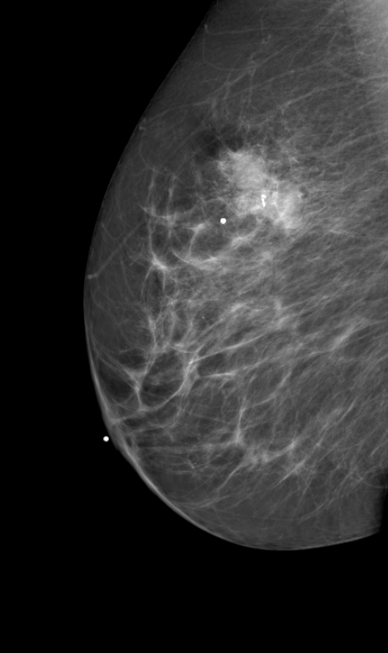
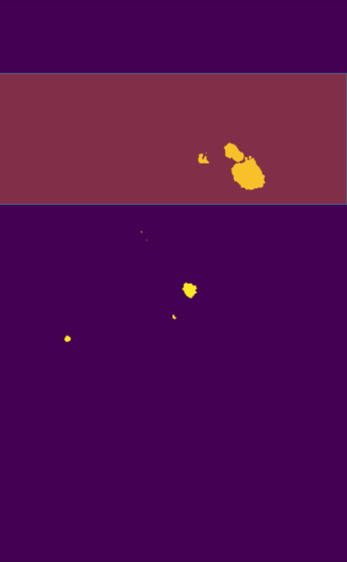
Semi-automated Lesion Masking Based on Radiology Report

Slide 26
Annotation for Example 1: 2D Mammogram
Notes:
oval (BI-RADS boundary description) 4A mass with circumscribed margins (BIRADS margin description) with equal density (BIRADS density of the mass description)

