Slide 1
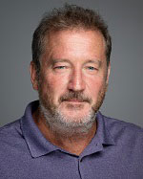
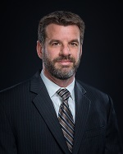
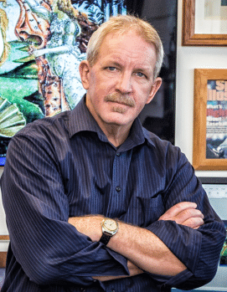

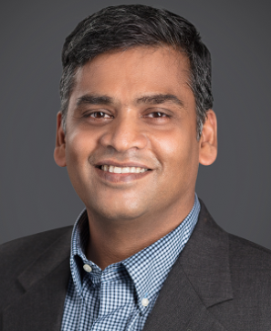



Moffitt's Imaging Biomarker Validation Center (MIBVAC): Applying Radiomics in Early Detection of Lung Cancer
September 5, 2018 – 33rd EDRN Steering Committee Meeting – Cambridge, MA
Aim 1: Breast Cancer
John Heine, PhD
Aim 2: Lung Cancer
Matt Schabath, PhD
Bob Gillies, PhD
Core Project: Prostate
Bob Gillies, PhD
Yoga Balagurunathan, PhD
matthew.schabath@moffitt.org
@matthewschabath

Slide 2

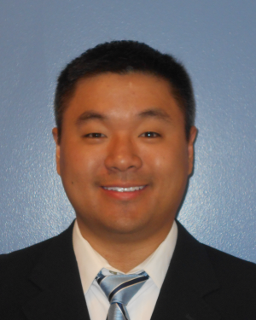
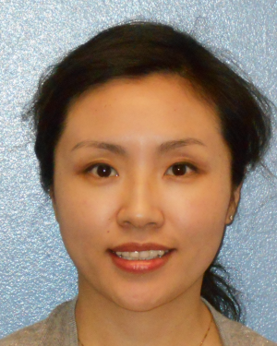
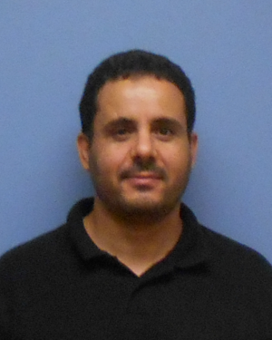
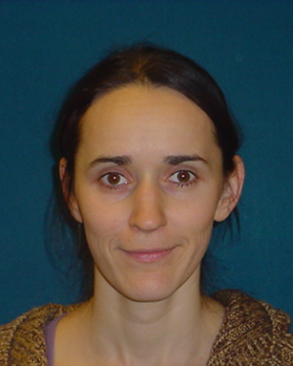
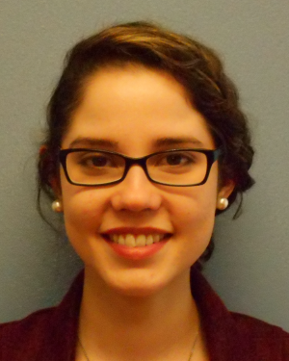

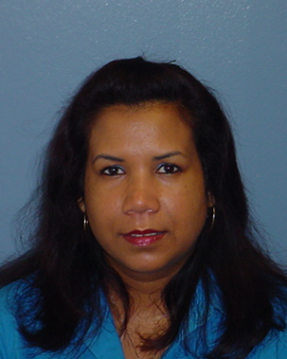
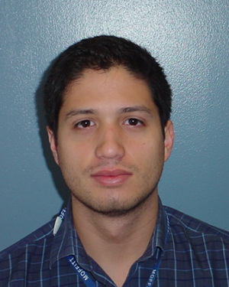
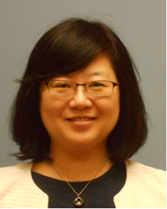
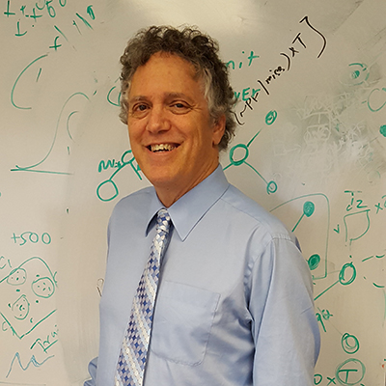
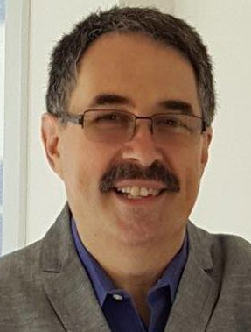

Lung Cancer Team Members
Ilke Tunali
PhD Candidate
Wei Mu, PhD
Postdoctoral Fellow
Daniel K. Jeong, MD
Radiologist
Jin Qi, MD
Research Radiologist
Mahmoud Abdallah
Imaging Scientist
Olya Stringfield, PhD
Imaging Scientist
Ada Sulbaran
Study Coordinator
Iffat Alam
Study Coordinator
Shamanie Tirbene
Data Manager
Alberto Garcia
Imaging Data Coordinator
Hong Lu, MD
Research Radiologist
Larry Hall, PhD
Computer Scientist
Dmitry Goldgof, PhD
Computer Scientist
Albert Guvenis, PhD
Computer Scientist

Slide 3
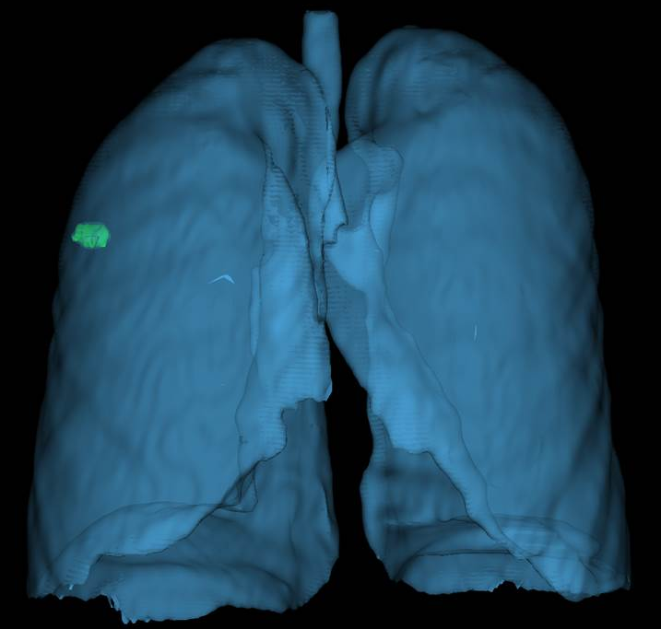
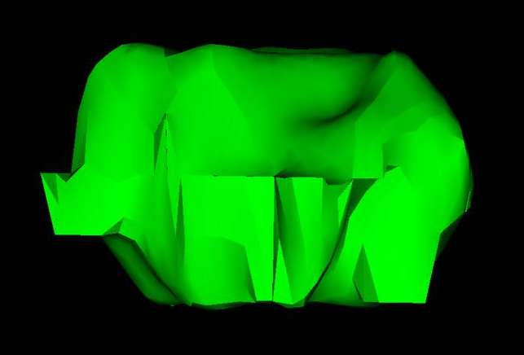
Radiomics: The conversion of standard-of-care images to mineable data
Deep Learning Features (>1000s)

Slide 4
iRadiomics:
Integration of imaging, clinical data, and -omics

Slide 5
Radiomics and Overdiagnosis in Lung Cancer Screening
To characterize indolent vs. aggressive lung cancers, we utilized two metrics:
Multi-window CT radiomics and volume doubling time
Conventional radiomics and survival outcomes (PFS)
Figures adapted from Detterbeck (2012)
and Bevers et al (2015)

Slide 6
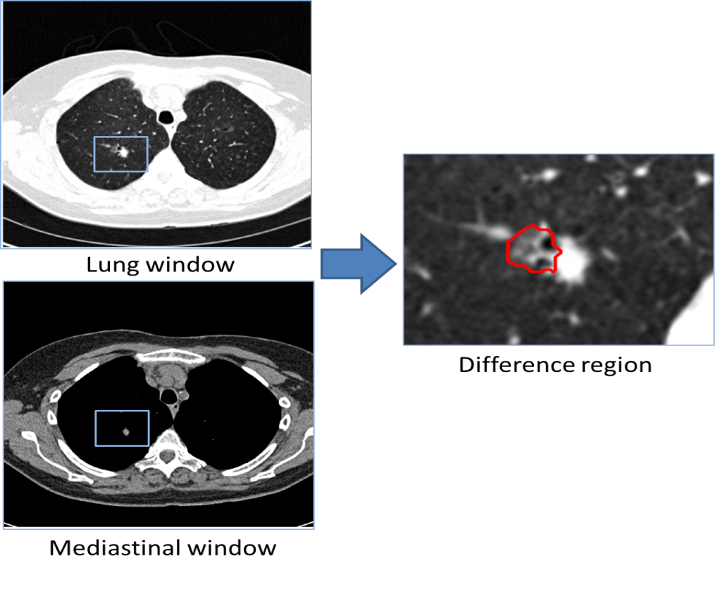
Radiomics from Multi-window CT
Motivation for this comes from clinical radiology which commonly cycles between both windows for diagnostic evaluation
Question: Do radiomics from lung window mask, difference area mask, or combination of both differentiate indolent vs. aggressive growing tumors?
Two tumor masks (standard lung window & mediastinal window) are imported into MATLAB
Difference region between the two windows is generated and then radiomic features are extracted

Slide 7
VDT (Volume Doubling Time)
VDT used to classify tumor growth behavior
VDT(s) calculated across screening intervals:
VDT
Patient #1 at baseline:
Positive screen
Time
Patient #1 at T1:
Lung Cancer Diagnosis
VDT
VDT
Patient #2 at baseline:
Positive screen
Time
Patient #2 at T1:
Positive Screen
Time
Patient #2 at T2:
Lung Cancer Diagnosis
Indolent/slow-growing LCs: VDT >= 400 days
Aggressive/fast-growing LCs: VDT < 400 days
Ti = interval time between two scans
V₀ = volume of the first scan
V_{i} = volume of the second scan.

Slide 8
Most Informative Radiomics Only Models
Lung Window |  |  |  |  | Difference Area |  |  |  | Combination
 |  | β | Odds Ratio (95% CI) | p |  | β | Odds Ratio (95% CI) | p |  | β | Odds Ratio (95% CI) | p
LW_F8 |  | 0.005 | 1.01 (1.00-1.01) | .004 | DA_F8 | 0.01 | 1.01 (1.00-1.02) | <.001 | LW_F44 | 13.15 | 5.14×10⁵ (1.11-2.37×10⁵) | .020
LW_F87 |  | -0.29 | 0.75 (0.60-0.93) | <.001 | DA_F87 | -0.24 | 0.78 (0.64-0.96) | <.001 | LW_F311 | 7.97 | 2903 (1.66-5.06×10⁶) | .030
LW_F311 |  | 7.93 | 2770 (3.9-1.99×10⁶) | .016 | DA_F286 | -0.12 | 0.89 (0.78-1.00) | .042 | DA_F8 | 0.009 | 1.01 (1.00-1.01) | .003
 |  |  |  |  | DA_F311 | 7.31 | 1499 (1.34-1.7×10⁶) | .038 | DA_F87 | -0.24 | 0.78 (0.63-0.98) | .005
 |  |  |  |  |  |  |  |  | DA_F296 | -0.18 | 0.83 (0.70-0.99) | .017
AUC | 0.799 |  |  |  | 0.819 |  |  |  | 0.846
ACC | 81.33% |  |  |  | 82.00% |  |  |  | 84.00%
SPEC | 66.67% |  |  |  | 61.54% |  |  |  | 79.49%
SEN | 86.49% |  |  |  | 89.19% |  |  |  | 85.59%

Slide 9
Most Informative iRadiomics Models
Lung Window |  |  |  | Difference Area |  |  |  | Combination
 | β | Odds Ratio (95% CI) | p |  | β | Odds Ratio (95% CI) | p |  | β | Odds Ratio (95% CI) | p
Radio_LL | 0.87 | 2.40 （1.38-4.16） | <.001 | Radio_DA | 0.88 | 2.42 （1.45-4.03） | <.001 | Radio _Comb | 0.91 | 2.49 （1.46-4.22） | <.001
Gender | 0.87 | 2.38 （0.91-6.22） | .073 | Gender | 0.93 | 2.54 （0.95-6.81） | .055 | Gender | 0.80 | 2.23 （0.85-5.84） | .008
Age | NA | NA | NA | Age | 0.078 | 1.08 （0.99-1.18） | .076 | Age | NA | NA | NA
COPD | 36.99 | 1.16×10¹⁶ （0-5.20×10⁵⁶） | .018 | COPD | 37.72 | 2.41×10¹⁶ （11.0-1.17×10⁵⁷） | .006 | COPD | 38.71 | 6.53×1016 （12.0-6.87×10⁵⁷） | .017
AUC | 0.808 |  |  | 0.828 |  |  |  | 0.855
ACC | 84.00% |  |  | 82.67% |  |  |  | 84.67%
SPEC | 58.97% |  |  | 64.10% |  |  |  | 76.92%
SEN | 92.79% |  |  | 89.19% |  |  |  | 87.39%

Slide 10
Combining radiomics from the lung mask and the difference mask exhibited improved capability to differentiate between indolent vs. aggressive growing tumors
iRadiomics (integrating clinical and radiomics) yielded the best model

Slide 11
Conventional Radiomics Differentiate Overdiagnosis Defined by Survival Outcomes

Slide 12
Early Stage Lung Cancers Detecting by Lung Cancer Screening
RAS (Radiomic Association Study)
26 significant features (univariable) narrowed down to a model of 5 features
CART generated three patient groups from 3 of the 5 features
1.00
Log-rank P < 0.001
0.75
PFS Probability
0.50
0.25
RGRD mHR = 8.53 (1.64 – 44.3)
Orientation mHR = 0.20 (0.07 – 0.57)
Laws mHR = 4.01 (1.44 – 11.4)
RGRD mHR = 8.53 (1.64 – 44.3)
Orientation mHR = 0.20 (0.07 – 0.57)
Laws mHR = 4.01 (1.44 – 11.4)
0.00
0
12
24
36
48
60
72
Months
Low RDRG
High RDRG/High Orientation
High RDRG/Low Orientation/Low Laws
High RDRG/Low Orientation/High Laws

Slide 13
Impact of Screening History on Outcomes
Among patients with baseline positive screens
Identified a vulnerable subset of early stage LCs that have outcomes similar to late stage disease
Accounting for screening history can better discriminate aggressive vs. indolent LCs
Incident LCs diagnosed following a T0 positive screen
Incident LCs diagnosed following a T0 negative screen
Incident LCs diagnosed following a T0 positive screen
Among patients with baseline negative screens
Incident LCs diagnosed following a T0 negative screen

Slide 14
Defining Semantic Features Using Deep Learning Features
Deep Learning Features (>1000s)

Slide 15
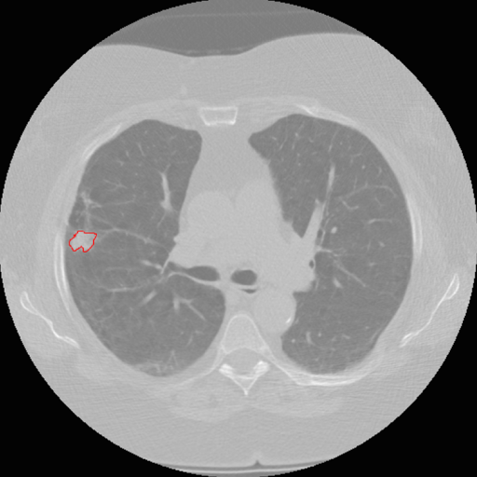
Define Semantic Features by Deep Learning Features
Semantics features are robust for risk assessment, diagnostics, and prognostication
Usually perform better than quantitative features/radiomics
Disadvantage: require to be manually read by experienced radiologists
Question: Can we use Deep Learning Features to characterize semantics?
Approach:
Semantic features (20) used in prior publications from our group
Deep Features were generated from pre-trained CNNs:
Vgg-s architecture trained on the ImageNet dataset (4096 features)
Our own CNN which was trained on lung nodule images (1024 features)
Bounding box was placed around the nodule to
completely fit the ROI/nodule:

Slide 16
Defining Semantic Features Using Deep Learning Features

Slide 17
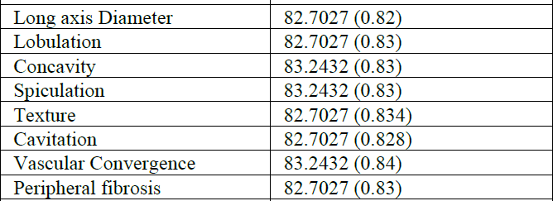
Results
All Deep Features (Vgg-s and CNN) could correctly classified 13 semantic features as an ensemble with an accuracy of 83.78% (AUC 0.837)
To obtain the same original classification performance:
Features from Vgg-s correctly classified 8 semantic features: accuracy = 83.78%
Features from CNN correctly classified 4 semantic features: accuracy = 83.78%
Classification performance of the best individual 8 semantic features
Number of Deep Features to represent a semantic feature varied from 57 to 3350
Compelling evidence Deep Features has translational utility in characterizing radiologist-defined semantic features
Since semantic features are robust, Deep Feature-defined sematics could be deployed in real-time
Semantic Feature Accuracy (AUC)

Slide 18
Predicting Nodule Malignancy using a CNN Ensemble Approach

Slide 19
Predicting Nodule Malignancy using a CNN Ensemble Approach
Used baseline (T0) nodules to predict cancer at follow-up (T1/T2)
Training: 85 LCs and 176 nodule+ controls
Test: 85 LCs and 152 nodule+ controls
Compared:
Conventional Radiomics
Transfer Learning
Three Convolutional Neural Networks (CNN) for the Ensemble
Conventional Radiomics
219 features (size, texture, GLCM, etc.)
Feature Selector: Symmetric Uncertainty
Classifier: Random Forests
Results: Accuracy of 76.79% (AUC = 0.81 AUC) with 10 features
Deep Features
Features already described
Feature Selector: Symmetric Uncertainty
Classifier: Random Forests
Results: Accuracy of 75.1% (AUC = 0.74 AUC) with 15 features

Slide 20
Convolutional Neural Networks (CNN)
Data augmentation on training cohort: 15 degree rotation and flipping (horizontally and vertically)
70% of the augmented data was used for training and 30% for validation
Cohort 2 was used to test the best validated model from above
Accuracy:
CNN architecture 1: 75.1% (AUC 0.82)
CNN architecture 2: 75.5% (AUC 0.86)
CNN architecture 3: 76.0% (AUC 0.87)

Slide 21
Ensemble Approach
Three subsets of classifiers were created for different ensembles
Subset 1: 3 CNN architectures
Subset 2: Best CNN model, Radiomics, and Transfer Learning Models
Subset 3: All 5 models
An ensemble approach significantly enhances the ability to predict which lung nodules will be diagnosed as lung cancer
Accuracy of predicting a baseline nodule will become malignant in 2 years is nearly 90% with an AUC of 0.96
 | Subset 1 | Subset 2 | Subset 3
Accuracy | 86.91 | 83.96 | 89.02
P-value for compared to 76.79% from traditional features | P < 0.05 | P < 0.05 | P < 0.05
AUC | 0.94 | 0.93 | 0.96
P-value for compared to AUC 0.87 of CNN architecture 3 | P < 0.05 | P < 0.05 | P < 0.05

Slide 22
Reproducibility and stability of radiomic features extracted from peritumoral regions of lung lesions

Slide 23
Peritumoral regions of lung lesions
Features commonly extracted within the tumor region (ROI)
Emerging evidence that peritumoral features can capture important information such as tumor microenvironment
Questions
How far from the tumor border?
Which features are stable and reproducible?
Lung mask vs. no lung mask?

Slide 24
Approach
Generated peritumoral masks by natural extensions of tumor delineations
Outside lung parenchyma was masked
Extracted 269 conventional radiomics
0-3 mm
Tumor Region
0-6 mm
0-9 mm
0-12 mm

Slide 25
Approach
Calculated concordance correlation coefficient (CCC) values of features between different algorithms and different seed points
For each algorithm, 3 different seed points/initiation parameters were used
Separate analyses were conducted for lung mask and no lung mask

Slide 26
Peritumoral regions can be captured and quantified by conventional radiomics
Subsets of features are stable from tumor border out to 12 mm from the border
Laws and Wavelets appear to be consistently unstable
Within each segmentation algorithm, different IPs tended to be stable for intensity-based and texture features

Slide 27
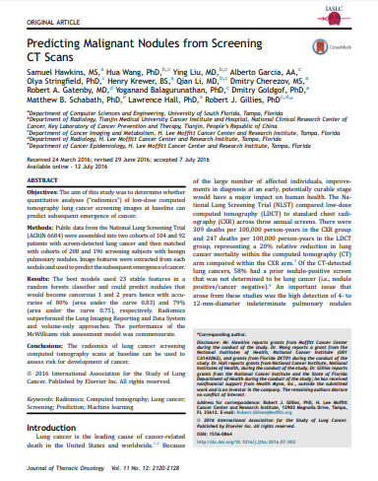
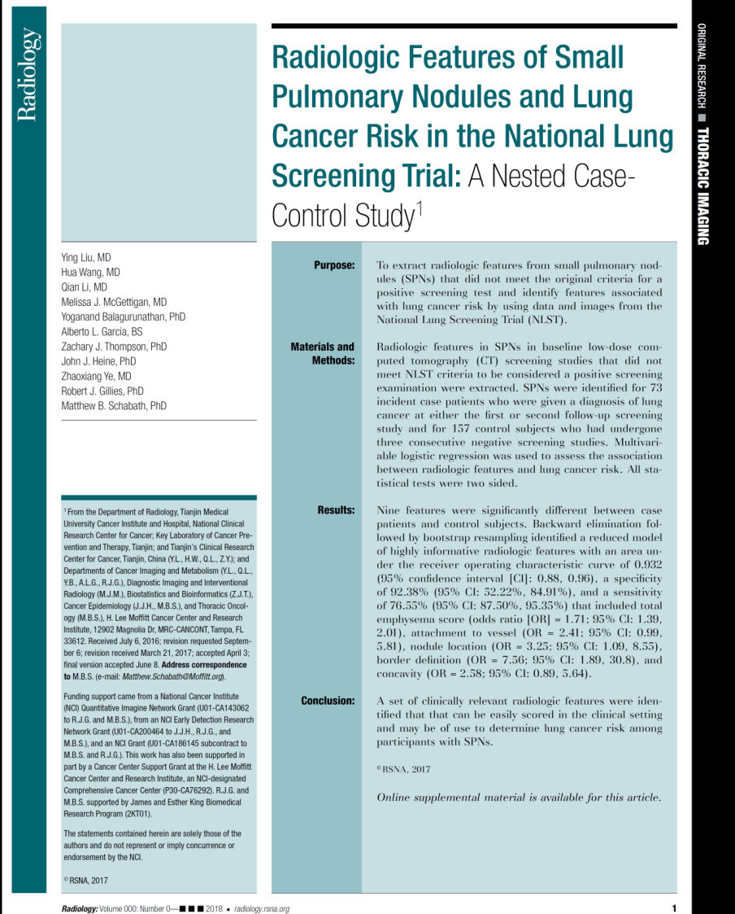
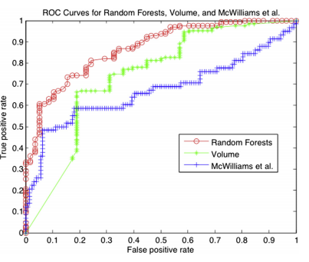
1a. Highlights
1.00
0.75
Sensitivity
0.50
Demographics Only
Area under ROC curve = 0.613
Features Only
Area under ROC curve = 0.928
0.25
Features and Demographics
Area under ROC curve = 0.936
0.00
0.00
0.25
0.50
0.75
1.00
1 - Specificity

Slide 28
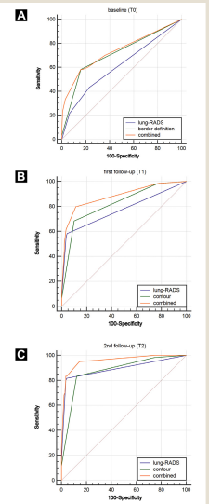
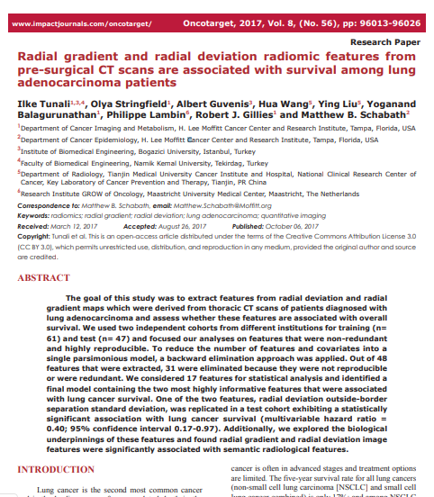
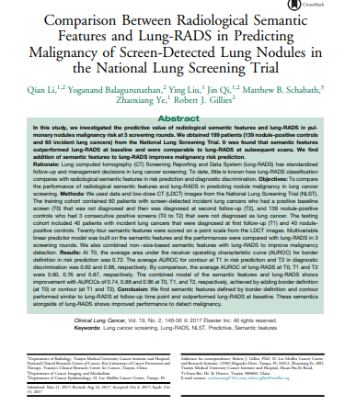
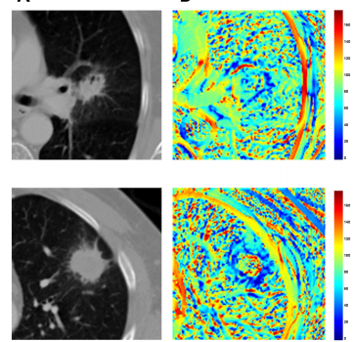
1b. Highlights

Slide 29
2a. Future Directions
Overdiagnosis
Combine VDT and PFS and use Deep Learning to characterize nodule growth dynamics
Risk Prediction
Assess impact of peritumoral features on risk prediction…AND overdiagnosis (and treatment response, e.g., IO)
peritumoral features vs tumor?
Deep learning to define semantics
Validate in additional datasets
Compare DL-defined semantics vs. conventional semantic features for risk assessment and overdiagnosis
Incidental Pulmonary Nodules

Slide 30
Prospective Recruitment
2b. Future Directions
Curation Efforts
IO therapy
LungRads 3A/4
Adeno
Cohorts
Squamous
Cohort
NLST
GGO
Study
Millennium
Lung cancer screening (LCS)
Incidental pulmonary nodules (IPN)
Includes 1600 retrospective pts

Slide 31
3. Pitfalls and Problems
Plenty of internal datasets, lack of external validation cohorts
Not enough integration (iRadiomics) of imaging and the various -omics
Segmentation is a bottleneck
Curating images (and data) is timely and tedious

Slide 32
New Infrastructure: Radiology Reading of the Future

Slide 33
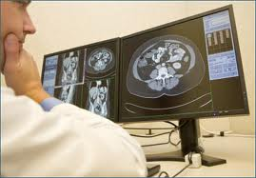
Current Radiology Reading Room
Annotate
Patient Chart
Archive
Local PACS

Slide 34
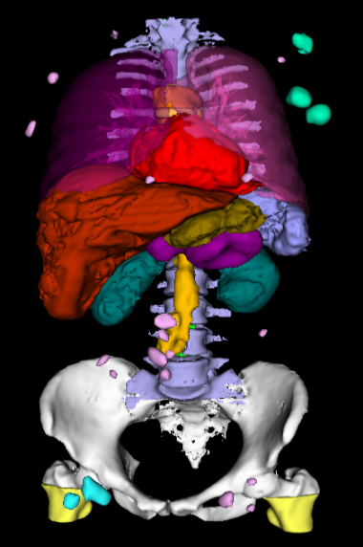
Radiology Reading Rooms of the Future Present
Annotate
Patient Chart
Archive
Local PACS
In the Radiology Reading Room of the Future, the role of the Radiologist will include:
Identification of the VOIs
Approve of Segmentation
Auto (or semi)
segmentation
Genomic Data
dbase
Medical Data
Mining & decision support
Radiomic
Data
Extract
features

Slide 35
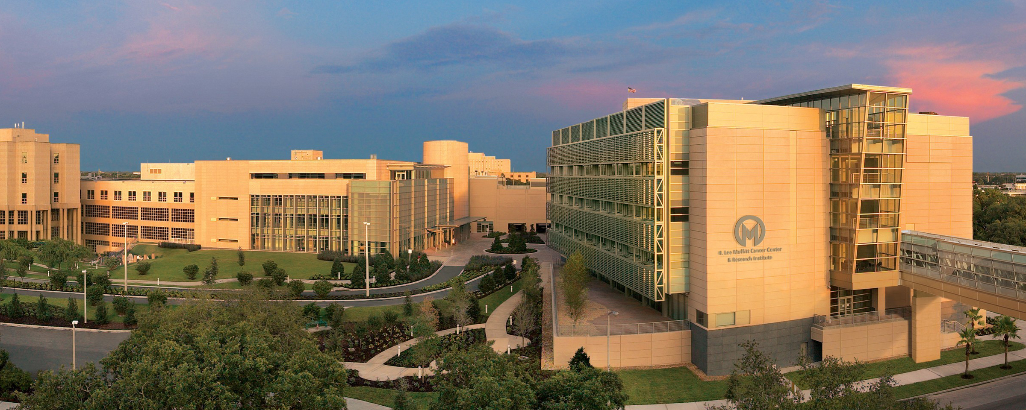
Thank you

