Slide 1
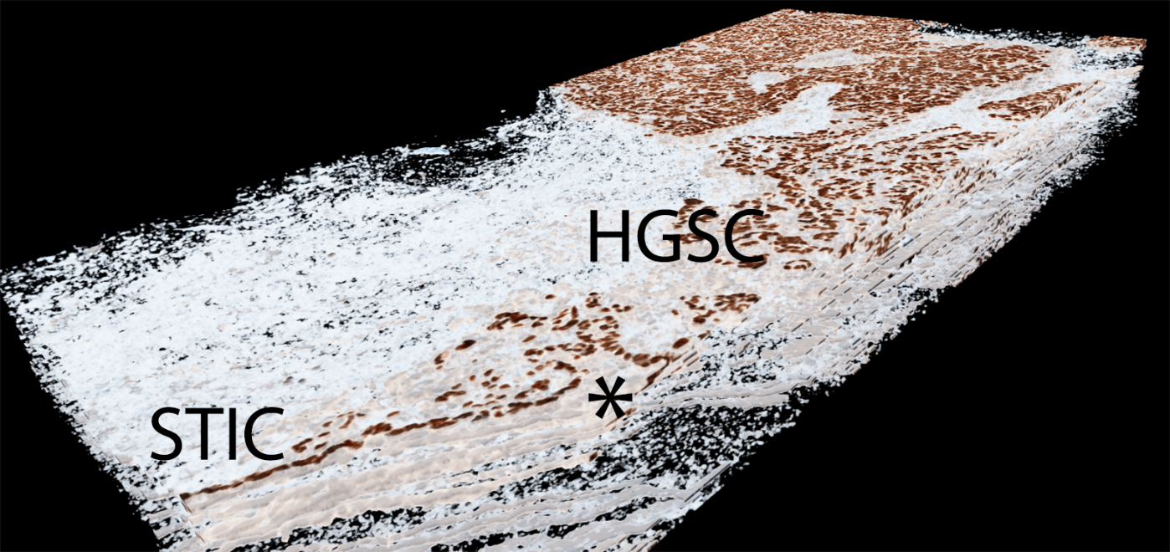
PapSEEK, PapDREAMing
& Proteomics for early detection
Ie-Ming Shih & Zhen Zhang
Johns Hopkins University
EDRN SC meeting
September 5, 2018
Notes:
The rapidly expanding HGSC may destroy the tubal habitat, leading to the extinction of extant precursor species and these cancer cells may disseminate onto the tubal surface, mimicking an intraepithelial lesion, obscuring the reconstruction of genetic landscape inherent to tumor evolution of HGSC.

Slide 2
New data on ovarian precursor lesions
PapSEEK review
Methylation markers (PapDREMing )
Protein biomarkers

Slide 3




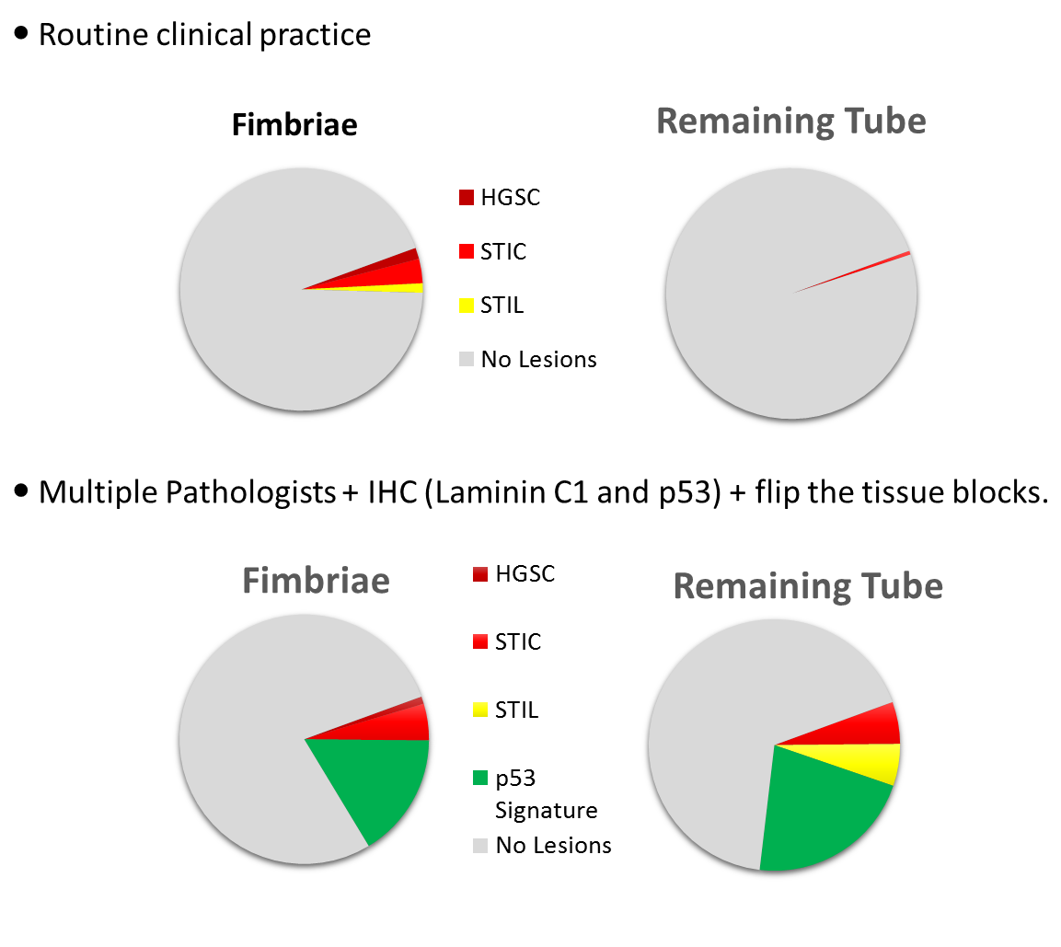
DoD Ovarian Cancer Consortium for Early Detection
Tubal lesions in BRCA1/2 carriers
HGSC/STIC = 6.6%
Flip over
LMC1 IHC
Pathologists
HGSC/STIC = 16.6%
p53 Signature = 37.8%
Cancer Prev Res, in press

Slide 4
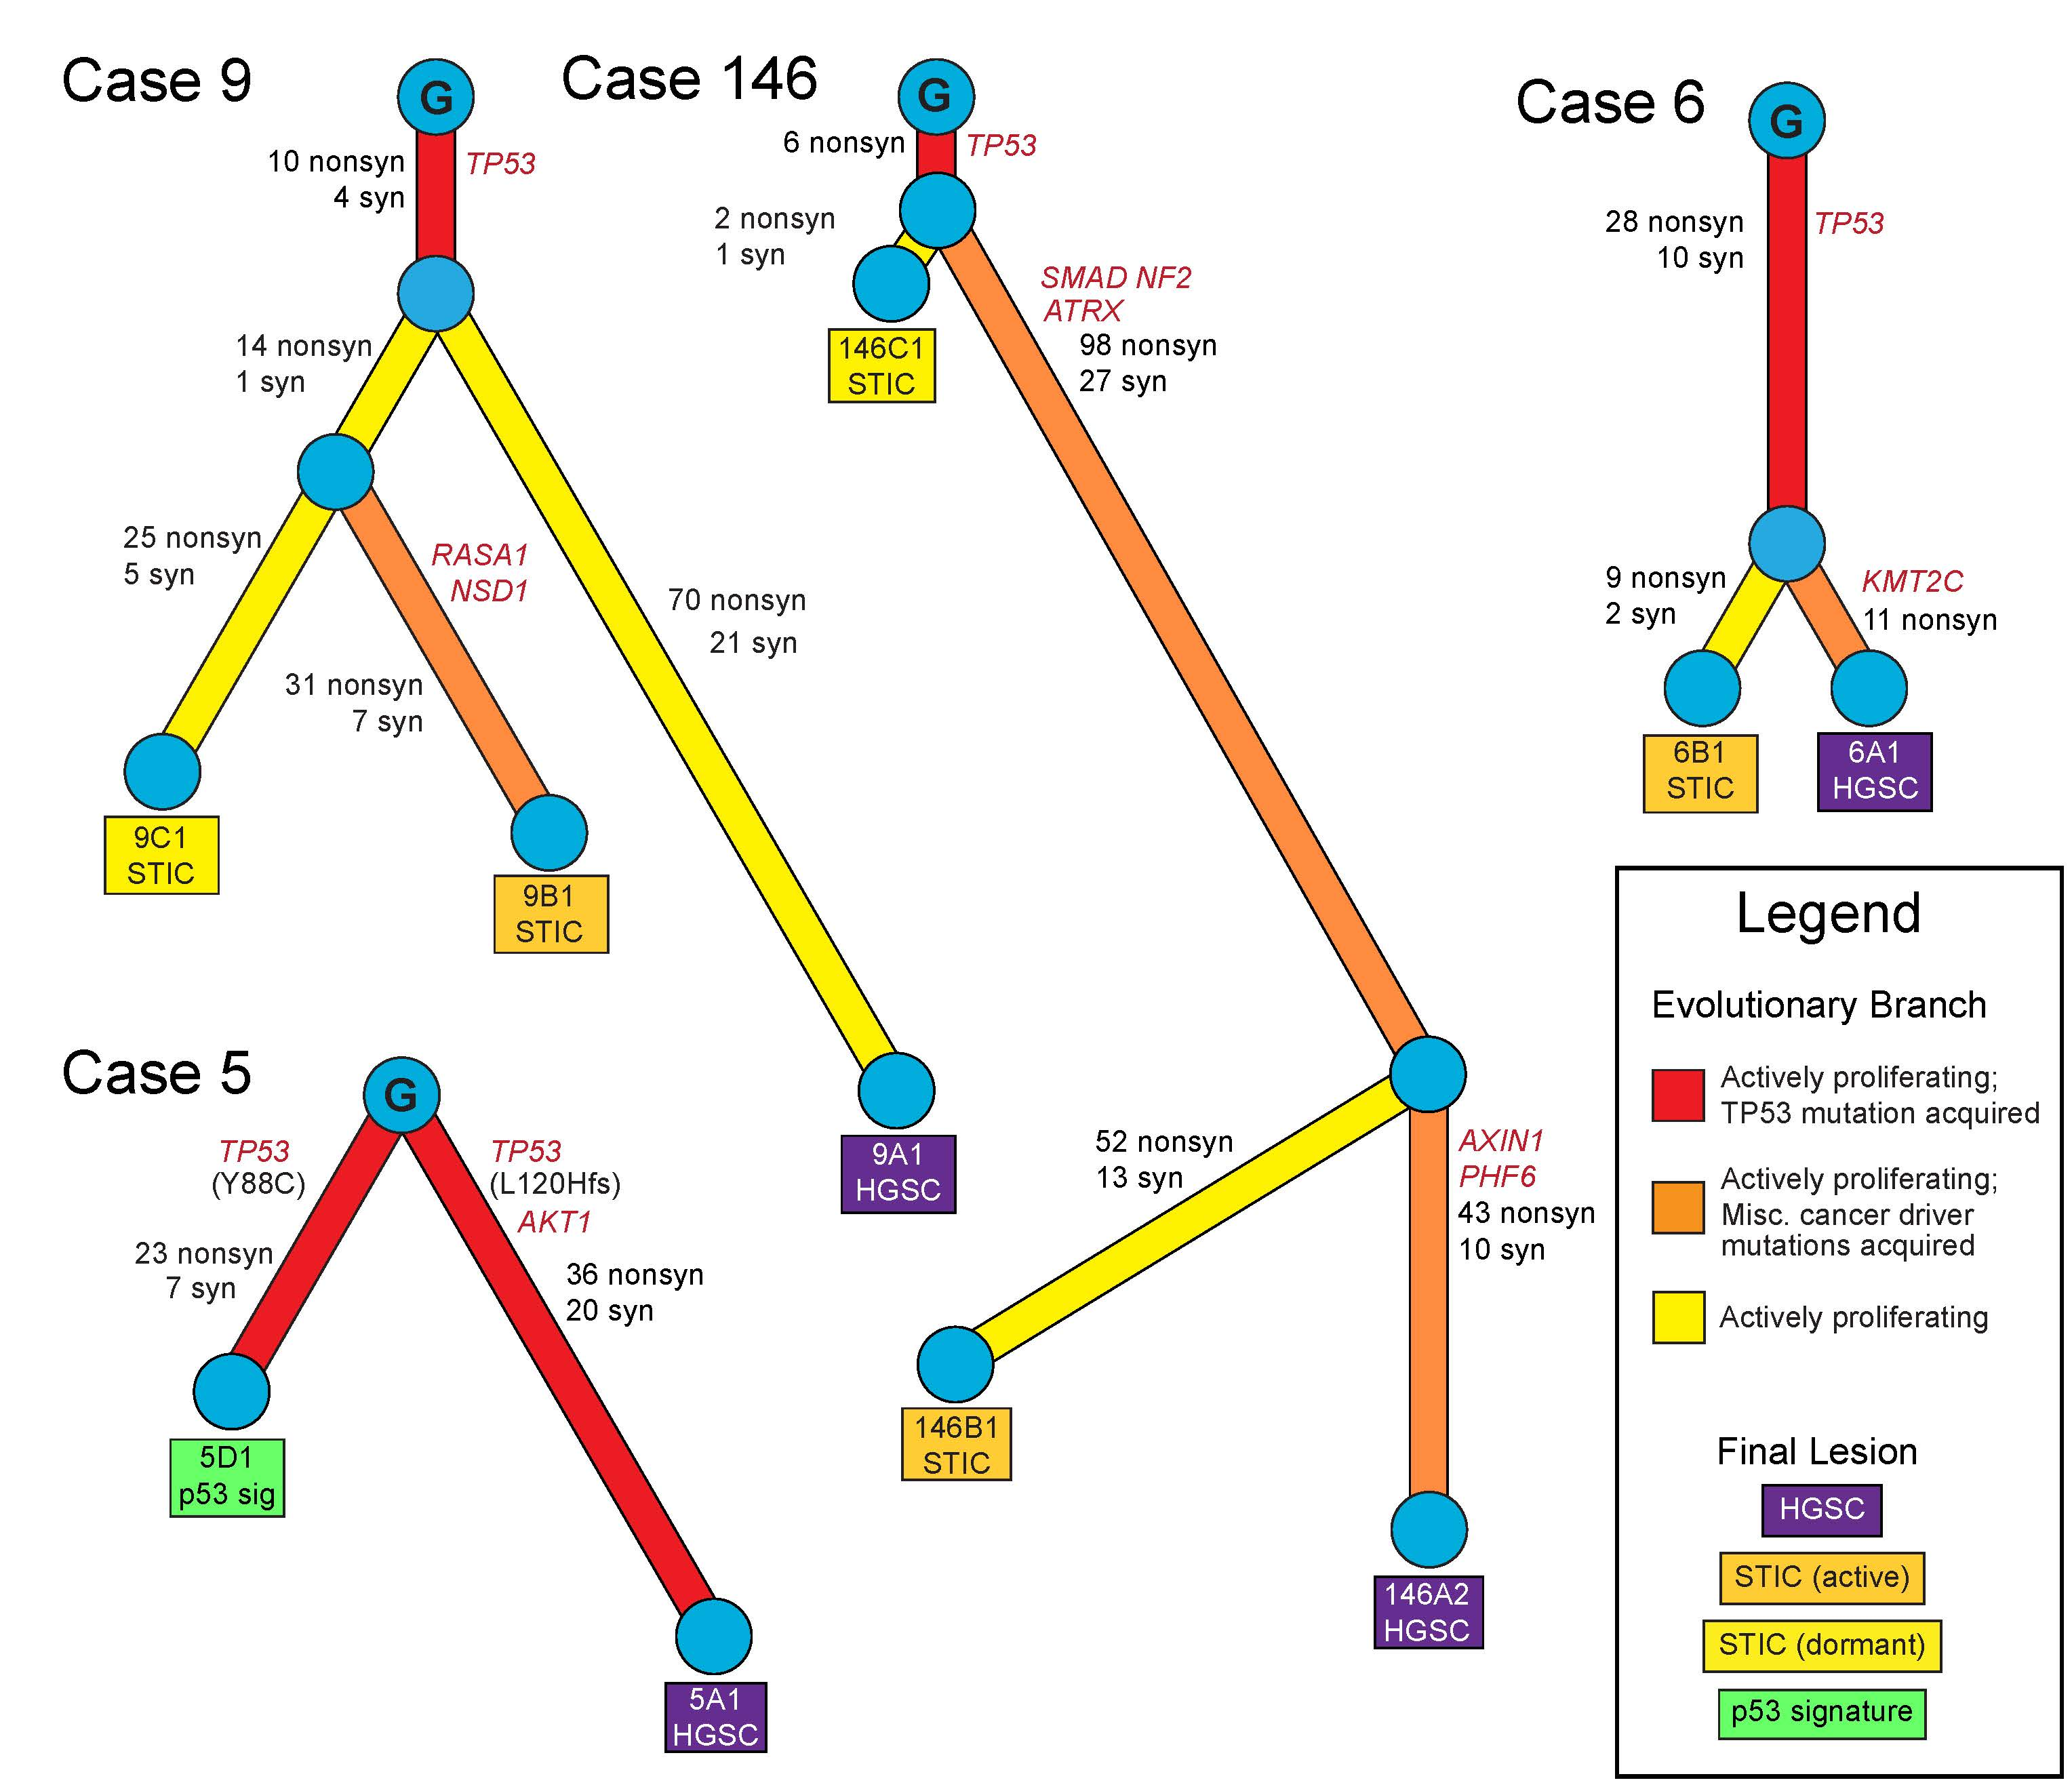
J Pathol, in press
Notes:
Figure 4: Evolutionary history of concurrent STIC and high-grade serous carcinoma from the same cases. The phylogenetic tree shows the number of shared and private somatic mutations for each lesion, as well as the cancer driver mutation shown in red font. Circles marked with G indicate the ancestral clone.
phylogenetic tree

Slide 5













N= 382 EMCA
N= 245 OVCA
N= 83
Pap brush
+
63%
Pap brush Plasma
55% early-stage
75% late-state
82%
34%
44%
79% early-stage
92% late-state
34% early-stage
34% late-state
N= 714 Healthy Normal
1.3%
Sci Transl Med, 2018

Slide 6
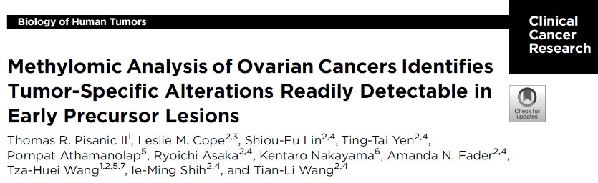
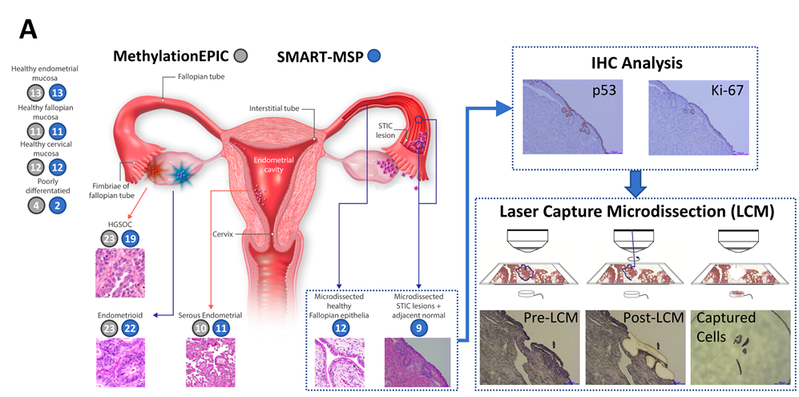
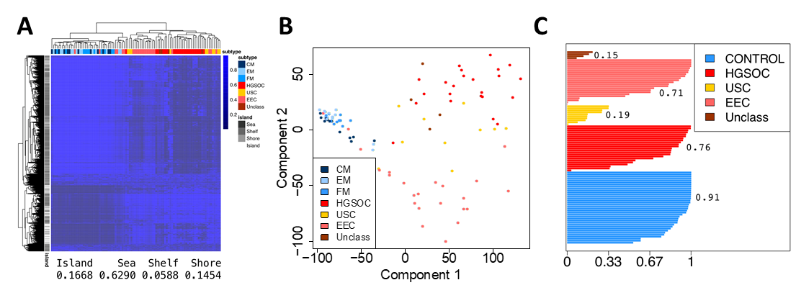
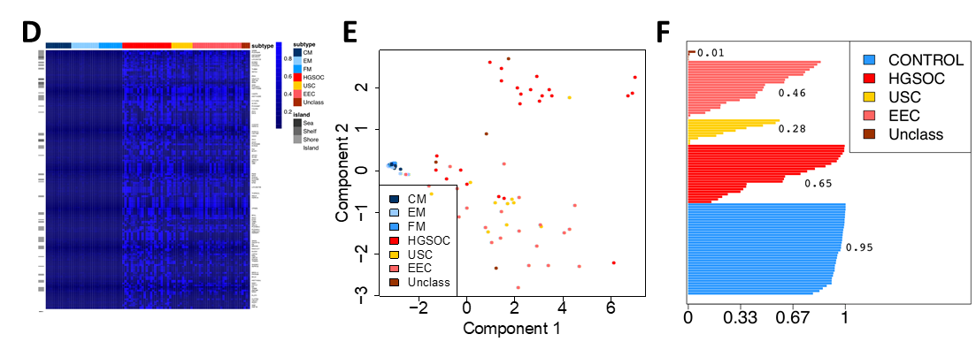
Clin Cancer Res, 2018
(TR Pisanic II, …, TH Wang, IM Shih, TL Wang)
Top 5000 DMRs 91 high-confidence DMRs
Notes:
Fig. 1. Discovery and Validation of Methylation Biomarkers for HGSOC. (A) Illustration of general anatomical locations, histology and number of each sample type used in this study, which utilized both genome-wide (MethylationEPIC) and locus-specific (SMART-MSP) methylation assessment techniques. Fresh-frozen tumor tissues and normal mucosae were used for discovery and analytical validation of select differentially-methylated regions (DMRs). Nine pairs of FFPE STIC and adjacent, morphologically-normal epithelia as well as fallopian epithelia from 12 cancer-free women were processed by LCM and evaluated for the presence of methylation within validated DMRs. Fig. 2. Identification of highly-specific HGSOC differential-methylation by genome-wide MethylationEPIC BeadChip Analysis. (A) Methylation heatmap showing unsupervised clustering of the top 5000 differentially-methylated probes as determined by MethylationEPIC BeadChip analysis the discovery cohort of 96 gynecological tissue samples. Sample types are indicated by colored bars on top. Shown below are the relative proportion of probes in each respective CpG-context. (B) Multidimensional analysis of the top 5000 DMRs, showing highly similar methylomes of healthy gynecological mucosae that are readily distinguishable from the majority of malignant tissues. (C) Plot of relative strength of intra-sample type clustering. Each bar and number represent one sample and the average, respectively, fraction of neighboring points that belong to the same type. The three nearest neighbors were used to evaluate each sample. Healthy fallopian tube, endometrial and cervical tissues were treated as a single subtype for this analysis. (D) Methylation heatmap, (E) multidimensional analysis and (F) intra-sample type clustering of the 91 “high-confidence” DMRs identified by the selective bioinformatics criteria. Overall, the regions of heavy, highly HGSOC-specific methylation are identified, resulting in tightened clustering among healthy tissues.

Slide 7
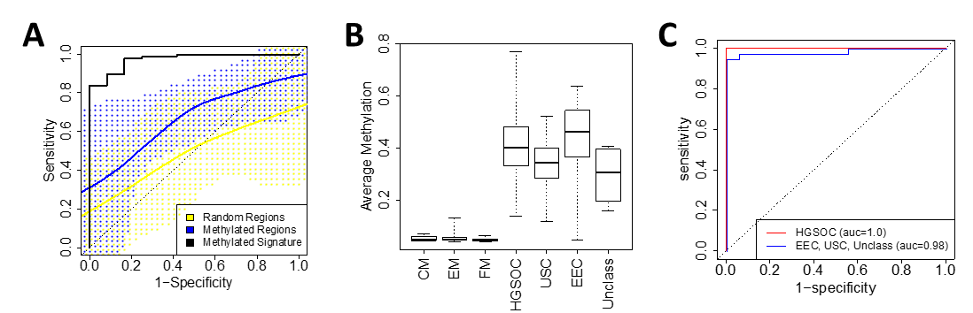
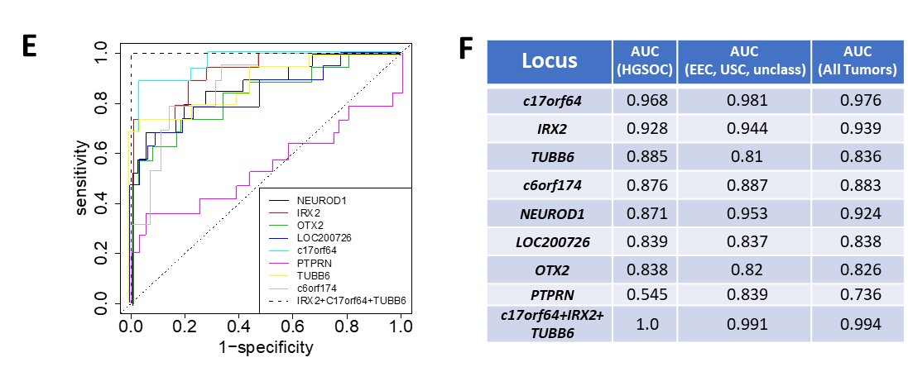
16 CpG sits
16 high-conf DMRs
100 random
CpG sits
Top 3 DMRs (IRX2, c17orf64, TUBB6)
Notes:
Fig. 3. Validation of identified high-confidence DMRs. (A) ROC curve analysis of the 16 CpG probes located in the high-confidence DMRs identified in our study that are also included on the 27K array used to evaluate DNA methylation in TCGA HGSOC samples. A smoothed representation of the ROC curves for each of these sites is shown in blue, against a yellow background representing ROC curves for 100 randomly selected CpG sites. The ROC curve for a signature created by averaging methylation levels over all 16 differentially methylated sites is shown in black. Blue and yellow lines show an average ROC curve for each group, calculated by LOESS. (B) Average composite methylation levels and (C) ROC curves (as determined by EPIC BeadChip analysis) of the eight high-confidence DMRs assayed by SMART-MSP in the validation cohort. (D) Violin plots of percent methylated reference (PMR) values for the eight DMRs in each of the gynecological sample types as determined by their respective SMART-MSP assay in the second, 90-patient, cohort. (E) ROC curves showing the performance of each DMR-assay as well as the collective performance of the top 3 DMRs (IRX2, c17orf164, TUBB6) for discrimination of HGSOC from all healthy mucosae samples. (F) ROC AUC values for each of the DMR-Assay for discrimination of HGSOC and other cancer types from all healthy mucosae.

Slide 8
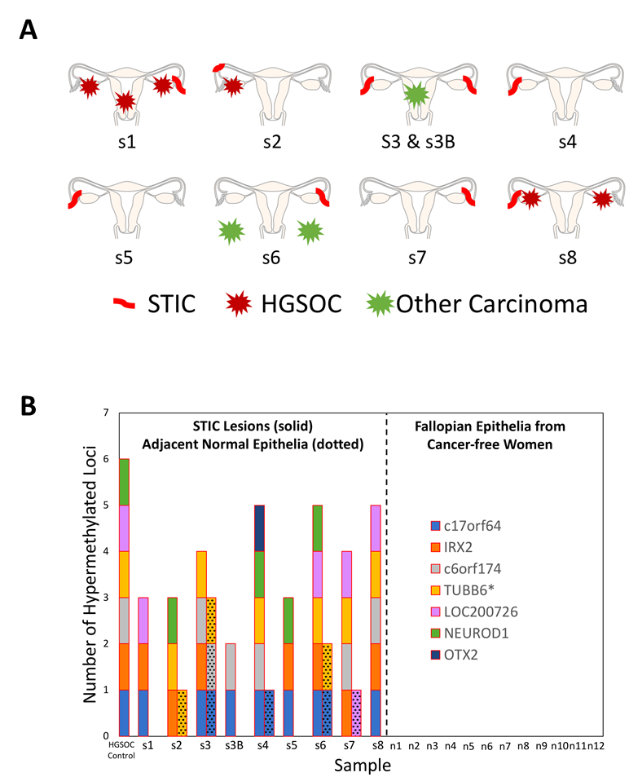
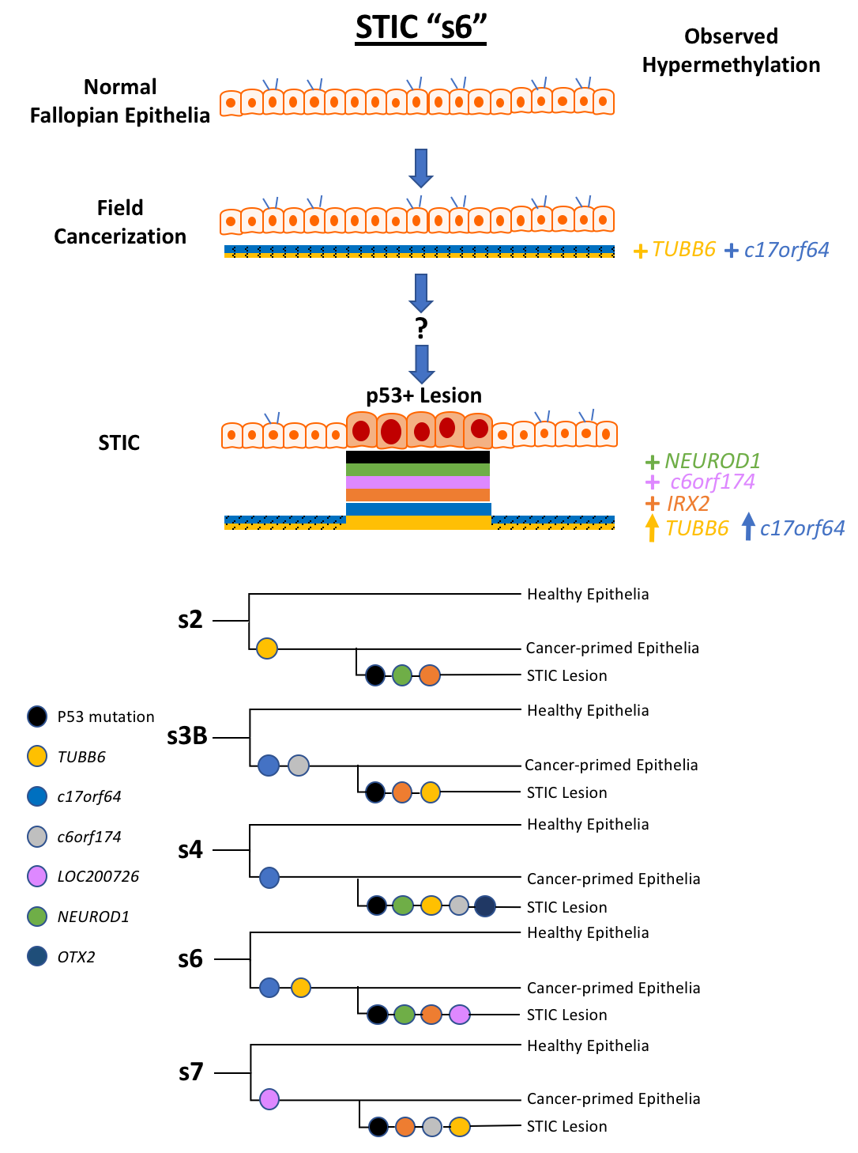
Notes:
Fig. 4. Assessment of hypermethylation in laser-capture microdissected STIC and normal fallopian tube epithelia. (A) Anatomical diagrams showing the approximate locations of each STIC sample, as well as any associated tumors. Adjacent normal epithelial samples were taken from unspecified locations within the corresponding fallopian tube. (B) Hypermethylated loci detected in STIC (solid bars) and respective adjacent normal (dotted bars) laser-capture microdissected fallopian tube epithelia. No hypermethylated DMRs were detected in any of the 12 fallopian tube epithelial samples from cancer-free women. *Over PMR threshold
Supplementary Fig. S1. Working Model of Epigenetic Field Cancerization and STIC evolution. (A) Prior to formation of the s6 STIC lesion, fields of morphologically-normal but epigenetically-distinct populations of cancer-primed epithelia, characterized accumulation of hypermethylation at select loci (TUBB6 and c17orf64), emerge by positive-selection within the fallopian tube. In a yet unknown sequence of events, subclonal populations of cancer-primed epithelia emerge that have acquired TP53 mutations and additional epimutations (IRX2, c6orf174, NEUROD1) that lead to dysplastic expansion and the development of the respective STIC lesion. (B) Proposed phylo- genetic and epigenetic relations of epithelia in which hypermethylation was detected in both the STIC lesion and adjacent normal epithelia within the same fallopian tube.

Slide 9
Protein biomarker panel/IVDMIA to complement genetic analyses of DNA in liquid biopsy samples
Zhen Zhang, Ie-Ming Shih
EDRN SC meeting, 090518

Slide 10
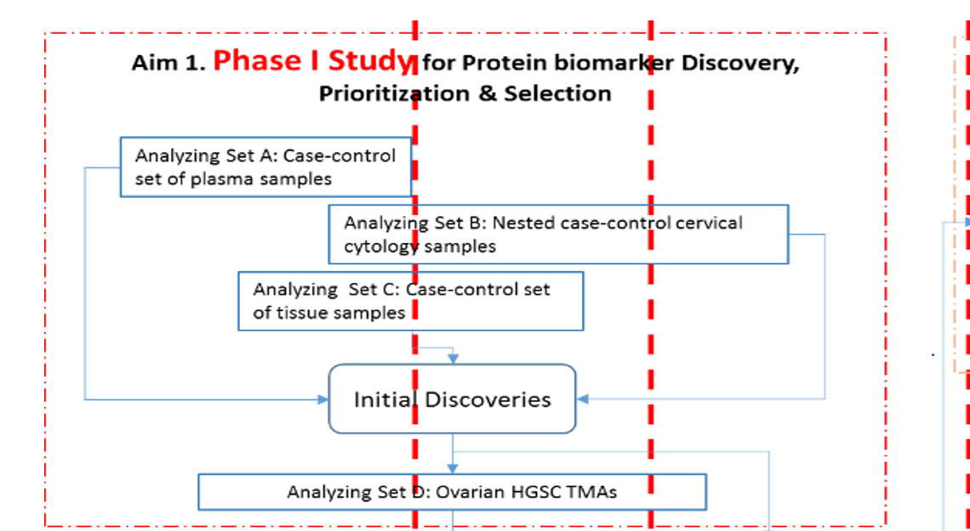
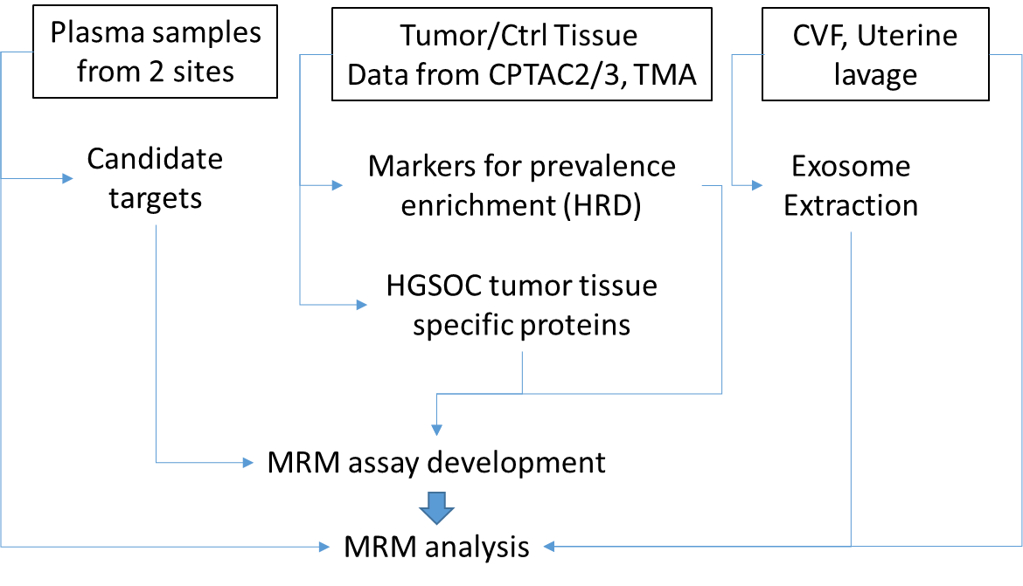
Approaches
Number/volume of specimens with ctDNA and PapGene results.
Protein yields in CVF samples.
Analytical performance of assay platform.
Cost.

Slide 11
DIA LC-MS/MS analysis of plasma samples
(Ce Wang, Ryan Cho, Jin Song, Hui Zhang)
JHU (IM Shih, TL Wang) n=49, plasma samples (27 cases, 22 benign controls)
NYU (D Levine) n=35, both plasma and serum (10 cases, 25 controls) – in process.
DIA: Improved analytical reproducibility.
  search engines used database from DDA analysis of pool from 8 samples. In process of generate individual DDA database for paired DIA search.
  Will be reanalyzed with depletion of high-abundance proteins.

Slide 12
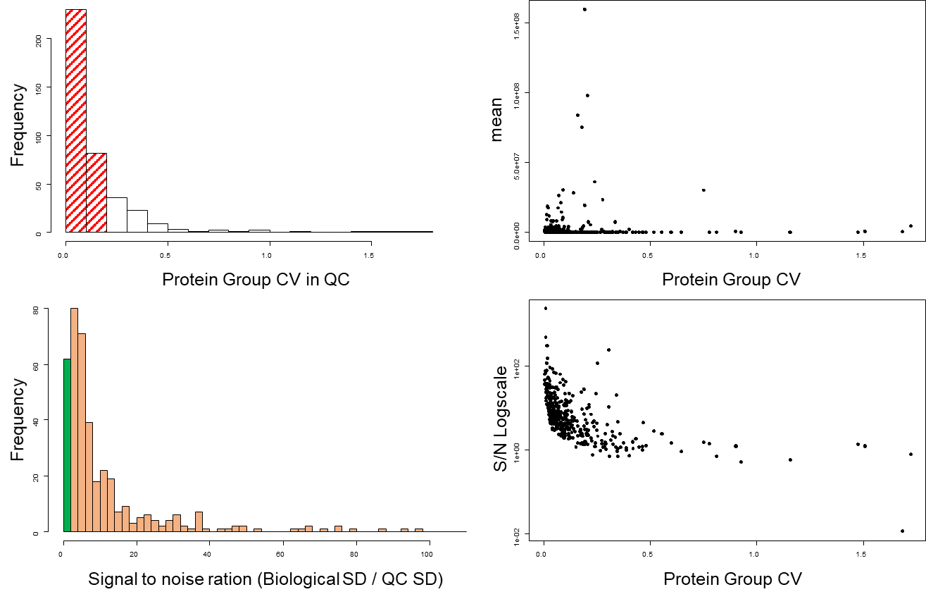
Very good analytical quality of DIA/SWATH data

Slide 13
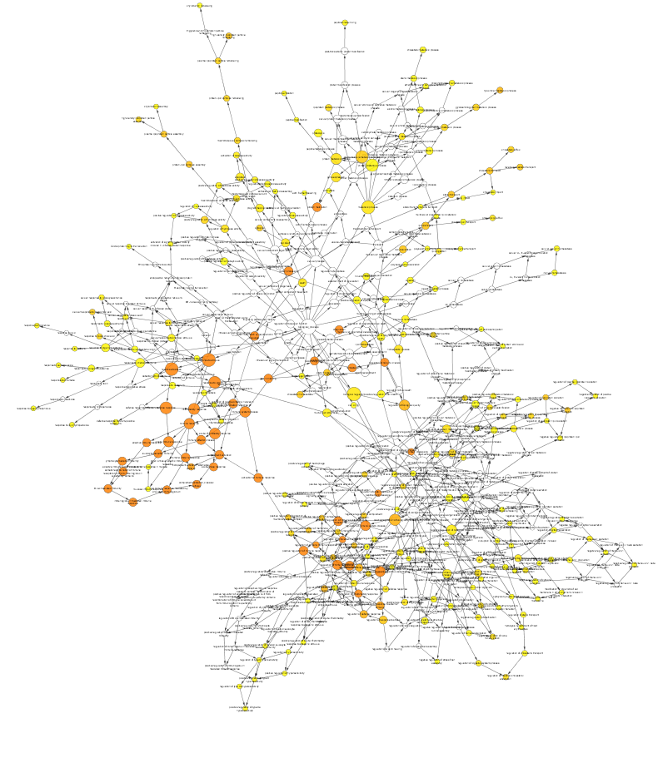
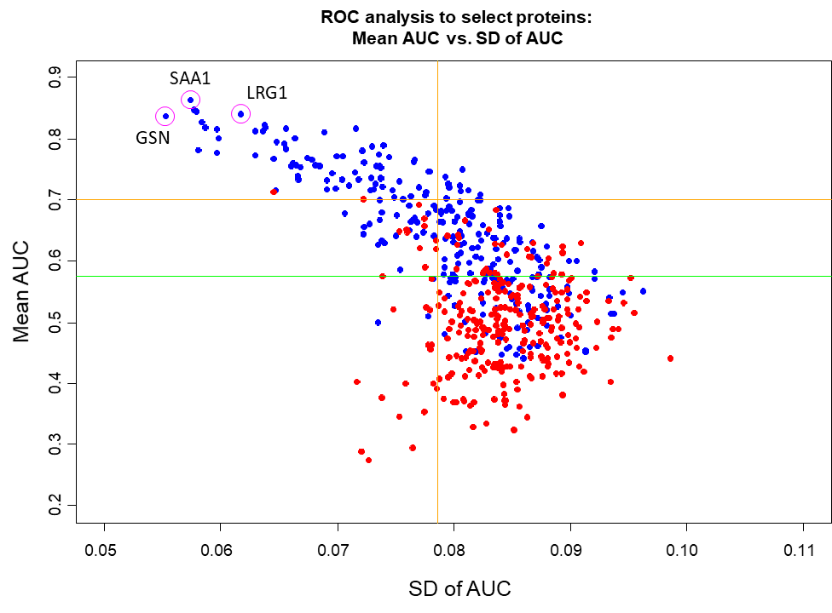
Candidate selection: bootstrap ROC against null from permutation analysis
Notes:
Immune Netw. 2017 Apr;17(2):121-127. doi: 10.4110/in.2017.17.2.121. Epub 2017 Apr 20.
Augmented Serum Amyloid A1/2 Mediated by TNF-induced NF-κB in Human Serous Ovarian Epithelial Tumors.
We found that SAA1/2 was significantly expressed in tumor tissues, but no or trace expression levels in normal tissues. TNF was also significantly upregulated in ovarian tumor tissues compared to normal tissues. Moreover, TNF significantly increased SAA1/2 levels in human ovarian cancer cell lines, OVCAR-3 and SKOV-3, in a time-dependent manner. Since the SAA1 promoter contains two nuclear factor (NF)-κB sites, we examined whether TNF regulates SAA1 promoter activity. Deletion analysis revealed that the proximal NF-κB site (-95/-85) played a critical role in regulating TNF-induced SAA1 promoter activity. Within 2 h after intraperitoneal injection of lipopolysaccharide, a product known to stimulate release of TNF, SAA preferably localized to ovarian epithelial cells and the thecal-interstitial layers compared to granulosal cell layers. Based on Gene Expression Omnibus (GEO) database, SAA1/2 and TNF were dominantly expressed in advanced grade ovarian cancer. Taken together, the accumulation of SAA1/2 in ovarian cancer could be mediated by TNF-induced NF-κB activation.
PNAS October 7, 2014 111 (40) 14442-14447 Cell fate regulation by gelsolin in human gynecologic cancers

Slide 14
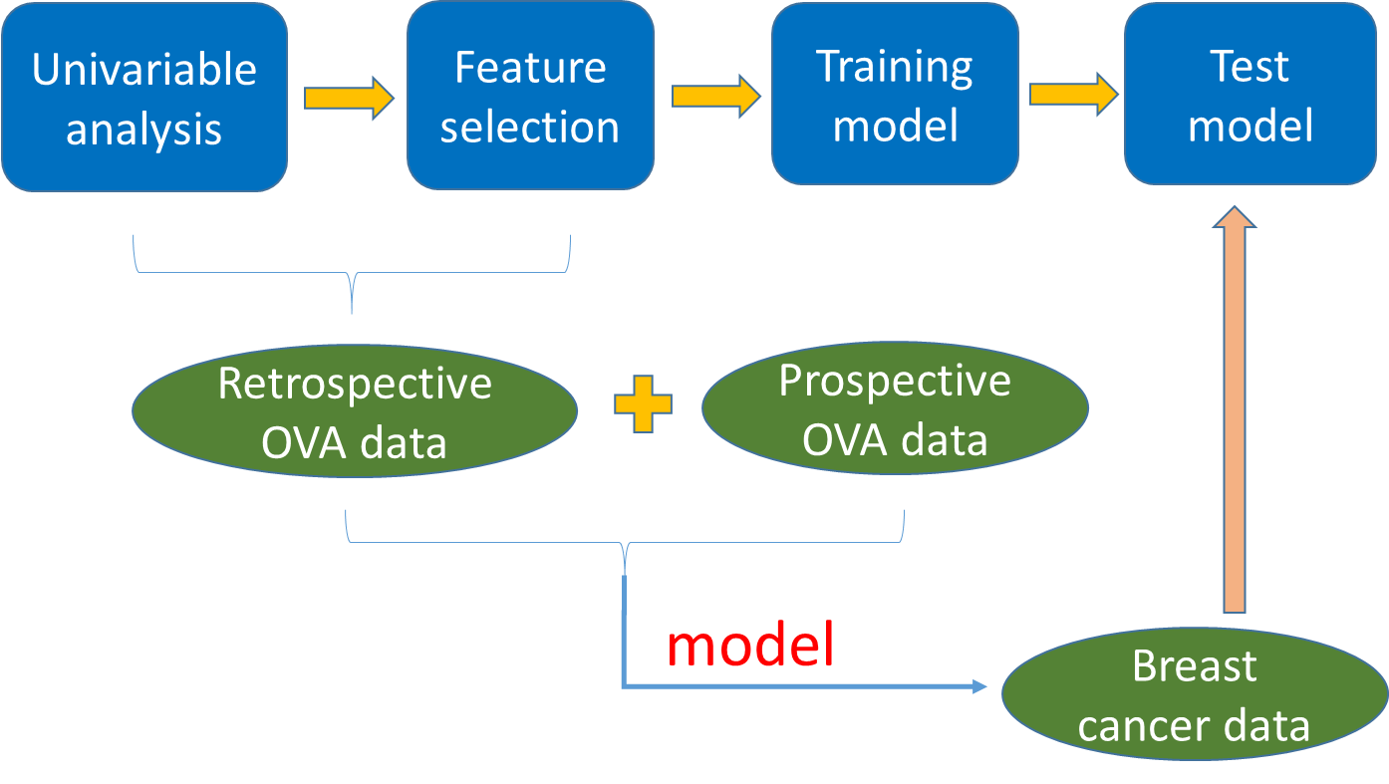
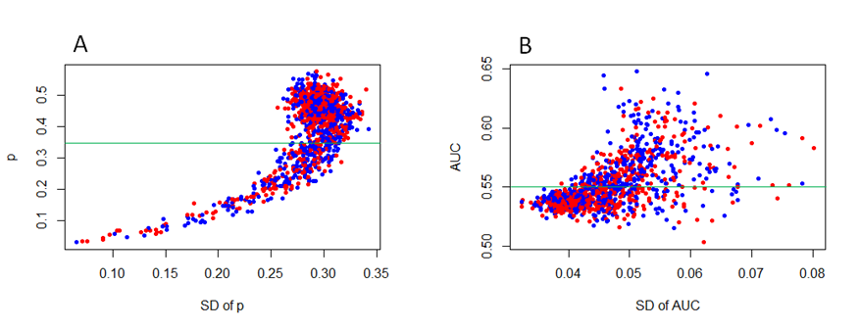
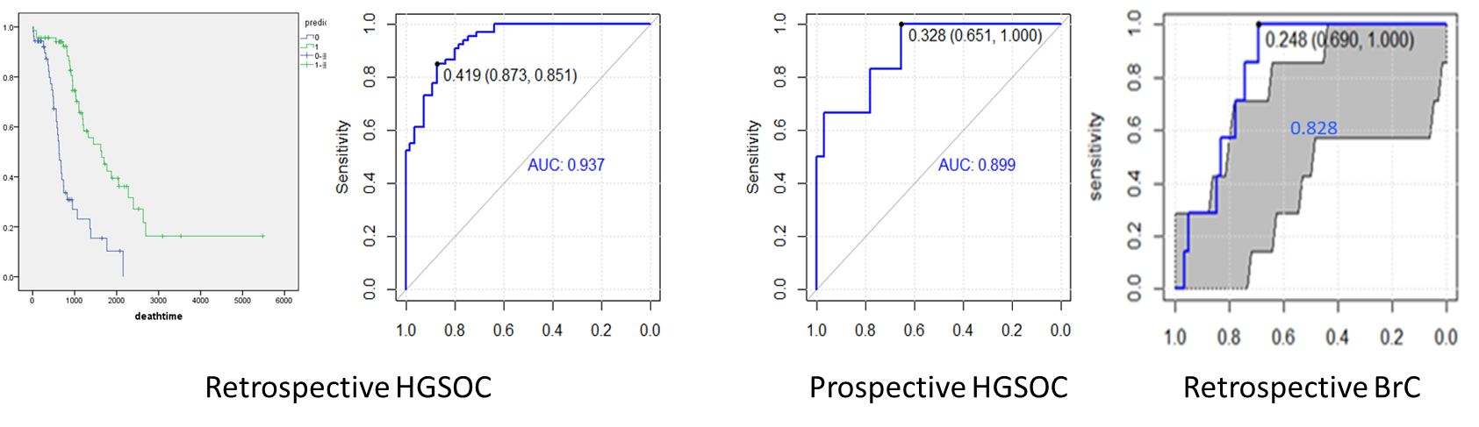
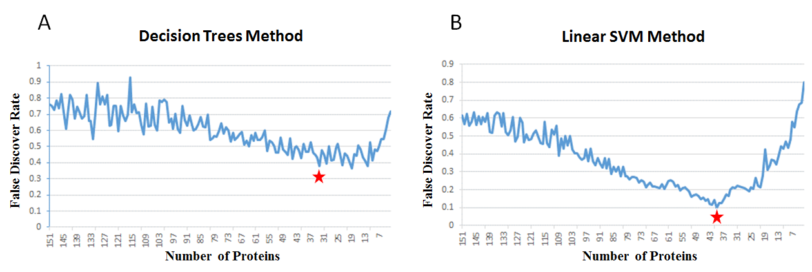
Identify protein signatures of high-risk population (HRD)
(Lida Xu)
CPTAC2 HGSOC retrospective data
CPTAC3 HGSOC prospective data
CPTAC2 BC retrospective data
Identified signature included HDAC1, BRG1, NOTCH3, ERBB2, EGFR, CDK4, etc.

Slide 15
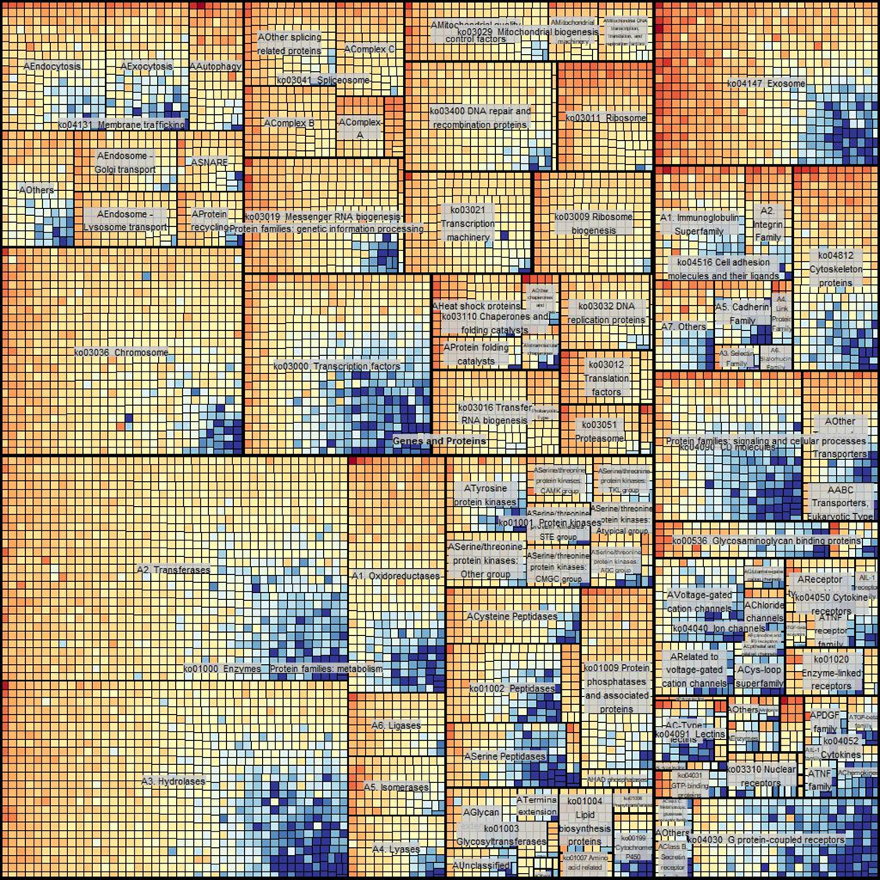
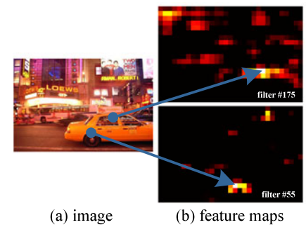
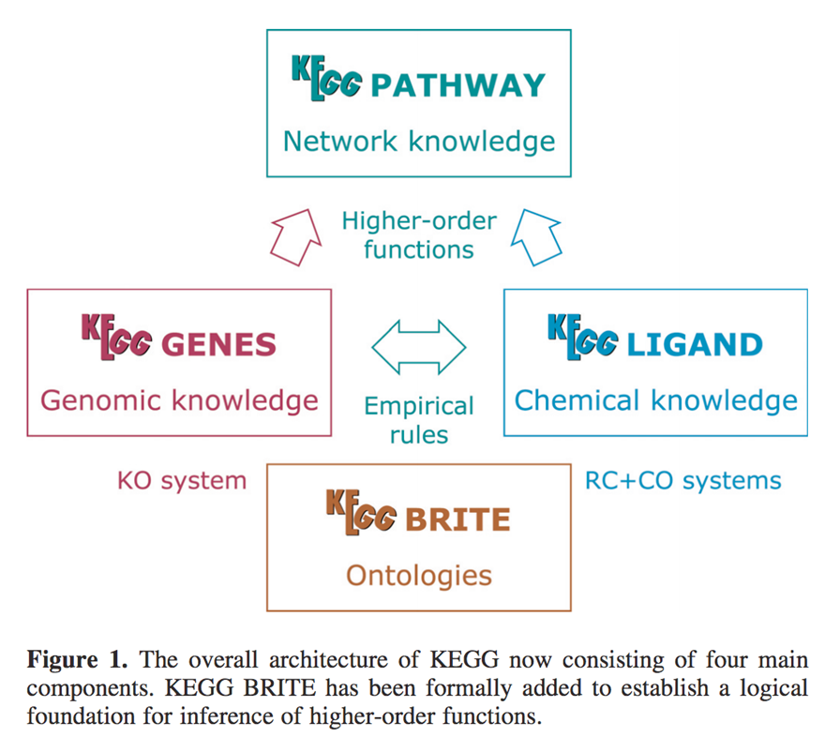
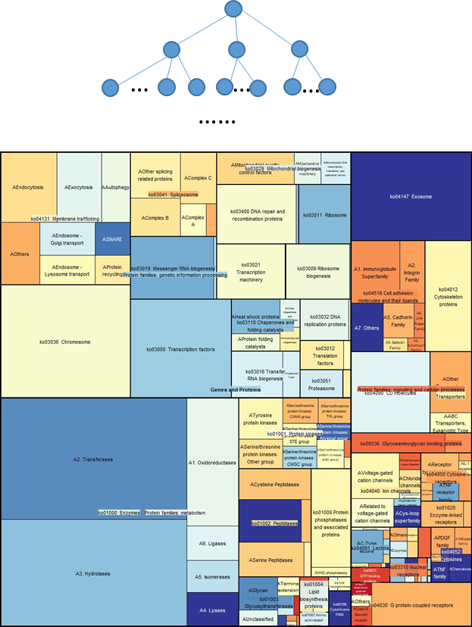
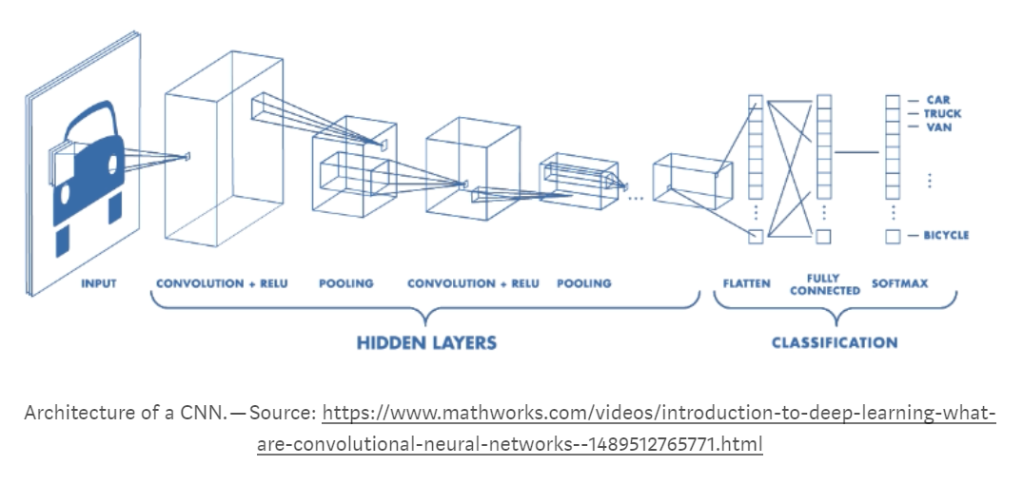
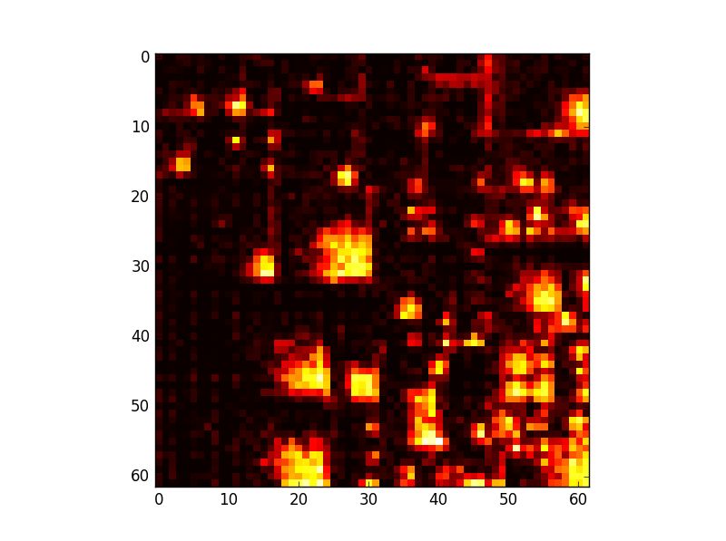
Use Deep Neural Network to discover HGSOC tumor specific proteins using paired tumor/adjacent normal tissues
(Felix Ma)
Omics of individual samples
Advantage of over univariate global significance test
Take advantage of progress in deep learning tools and frameworks

Slide 16
Next
Complete samples from NYU (Levine)
DIA/SWATH analysis with high-abundance protein depletion (glycoprotein analysis?)
IHC/TMA analysis of selected HGSOC specific proteins.
Development of targeted MS (e.g., MRM) assays for selected proteins.
Apply these assays to analyze of liquid biopsy specimens (CVF, uterine lavage from team project?) directly or through extracted exosomes.

Slide 17
Summary
Incidence of HGSOC/STIC is much higher than previously thought as evidenced by improved path procedures.
Methylation analysis identified tumor-specific alterations readily detectable in early precursor lesions with high accuracy.
Adding plasma ctDNA test to pap brush test improves sensitivity to 60+% yet increases FP to 1.3%. Sensitivity for early stage is relatively still low.
Using a statistically-principled proteomic analysis to identify candidate biomarkers that 1) are tumor specific, or 2) help to enrich prevalence. The selected candidates will be developed as targeted assays to be analyzed in CVS or UL to assess their ability as a part of IVDMIA to improve DNA-based liquid biopsy tests.

Slide 18
Acknowledgement
Members of JHU EDRN BDL for HGSOC.
Ce Wang, Ryan Cho, Lida Xu and other members of JHU Center for Biomarker Discovery and Translation.
D Levine of NYU.
EDRN PDs.

