Slide 1
Salient report from the Lung Collaborative group
EDRN steering committee meeting Boston, Sep 6 2018
Pierre P. Massion, MD
CVC laboratory
Vanderbilt University School of Medicine
Chair, Lung Collaborative group

Slide 2
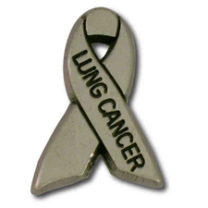
Lung Collaborative Group
Biomarker Development Laboratories
Avi Spira, Steve Dubinett, Marc Lenburg, Deni Aberle | BU, UCLA and Lahey Clinic
Louise Showe, Qihong Huang | Wistar Institute
Jim Herman, Jeff Wang, David Wilson, Brenda Hoegaarde | U of Pittsburgh, Hopkins
Harvey Pass, Haining Yang | NYU
Biomarker Reference Laboratory
Sanford Stass, Feng Jiang | University of Maryland
Clinical Validation Centers
Pierre Massion, Kim Sandler, Eric Grogan, Steve Deppen | Vanderilt
Bob Gillies, Matt Schabath | Moffitt CC
DMCC
Margaret Pepe, Jackie Dahlgren, Tracey Marsh | Fred Hutchinson CC
Program Officers
Lynn Sorbara | NCI DCP
Karl Krueger | NCI DCP
Notes:
8 institutions, 6 BDLs, 2 CVCs, 2 BRLs.

Slide 3
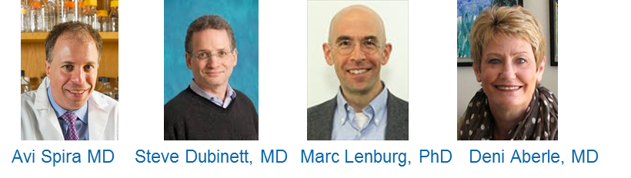
BU-UCLA
BDL
Steve Dubinett
Avi Spira
Marc Lenburg
Deni Aberle
Epithelial-based markers of lung cancer early detection

Slide 4
Developing nasal gene-expression signature in the indeterminate nodule setting via RNA-seq
The DECAMP Cohort
(Detection of Early Lung Cancer Among Military Personnel)
Inclusion Criteria:
Age >= 50
Pack years >=20
Pulmonary nodules ranges from 7 – 30 mm
Sample Collection at baseline enrollment:
Nasal brushings for epithelial cells
2-year follow-up for a final diagnosis of cancer
Total RNA Sequencing for transcriptomic profiles
Identify nasal gene expression differences for detecting malignant IPNs

Slide 5
Nasal Epithelium Gene Expression Signature Associated with Cancer Status
DECAMP I Cohort
Cancer
Benign
Generalized linear model:
Smoking status adjusted
37 differentially
expressed genes
FDR q<0.1
29 Up-regulated
Genes
8 Down-regulated
Genes

Slide 6
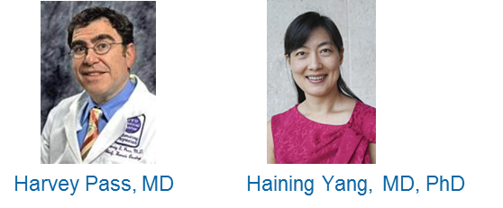
NYU BDL
Harvey Pass
Haining Yang
Blood-based biomarkers for early detection of mesothelioma

Slide 7
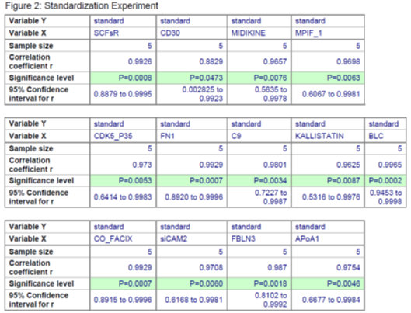
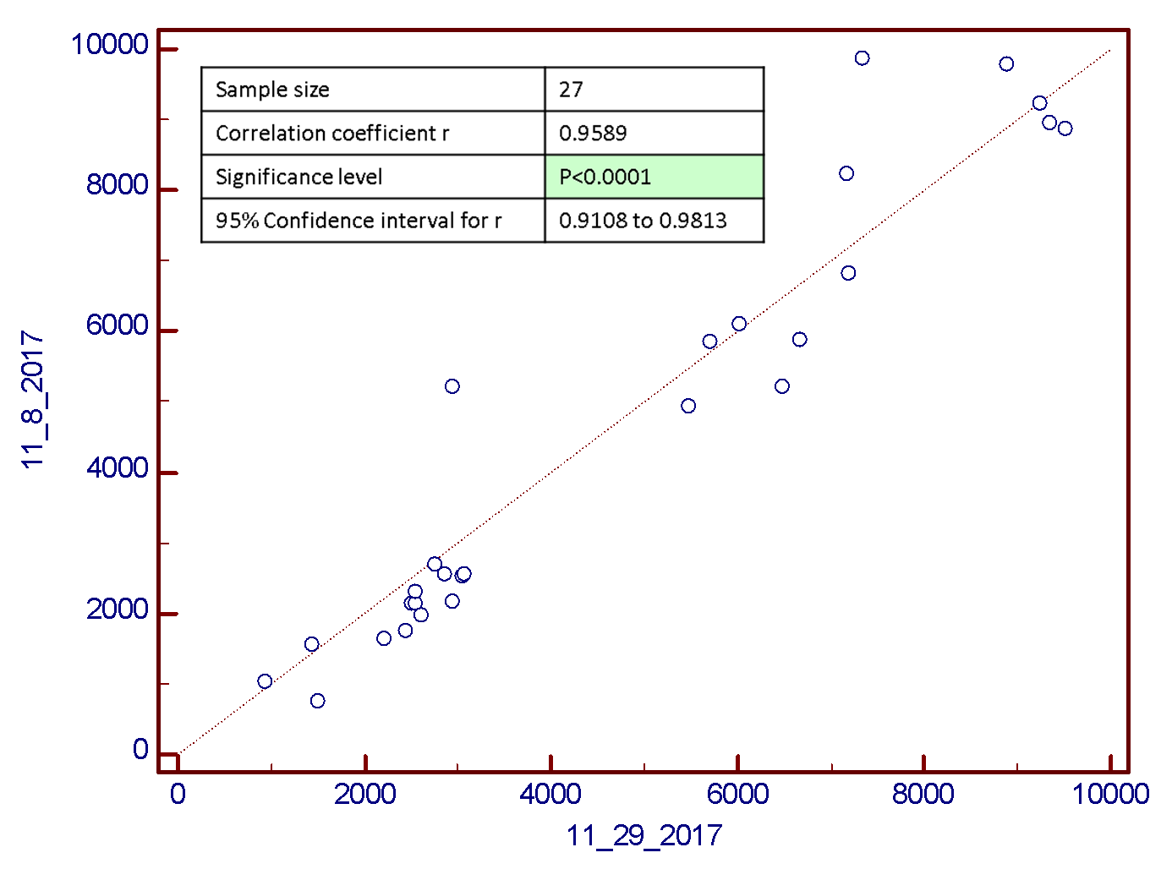
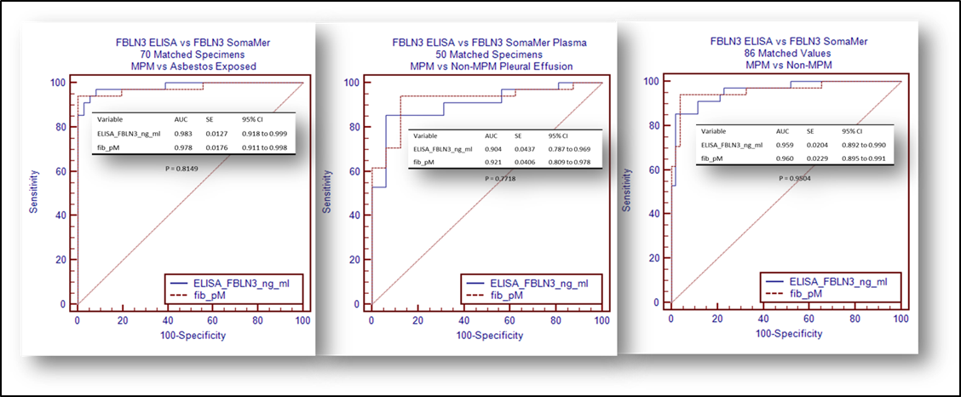
Update NYU/Hawaii Mesothelioma BDL
Aim 1: Develop a novel SOMAmer based proteomic platform in order to validate plasma and pleural effusion diagnostic and prognostic biomarkers
Fibulin-3 SOMAmer luminex based assay has been developed together with other 13 SOMAmer MPM test. And will compare whether the 14 SomaMer assay has better sensitivity and specificity than 13 SOMAmer or Fibulin-3 alone.
Fibulin 3 SOMA-Luminex Assay. Reproducibility Different Days showed excellent correlation.
Comparison of new assay to Old ELISA using matching
Specimens (2012 ELISA vs 2018 Assay)
Plasma MPM vs AE; Pleural Effusion MPM vs Non-MPM
Plasma MPM vs Non-MPM
Perfect correlations of SOMAmers to their Luminex
Beads based assay but NO non-specific binding was seen.

Slide 8
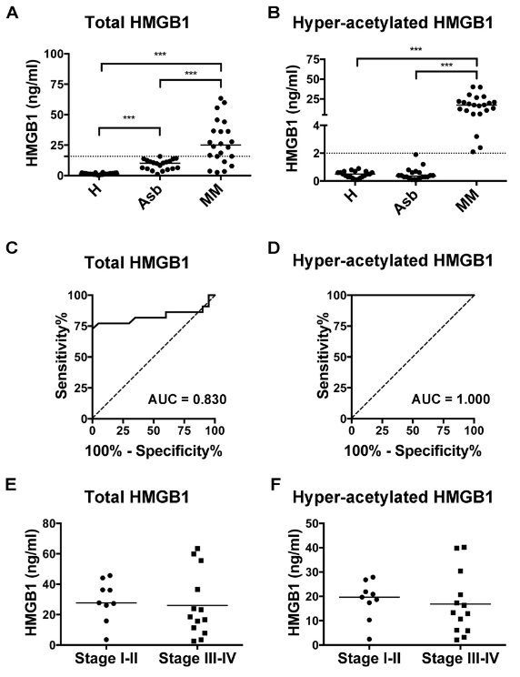
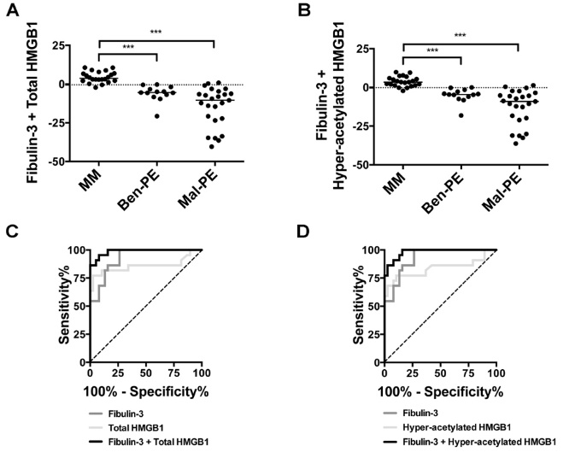
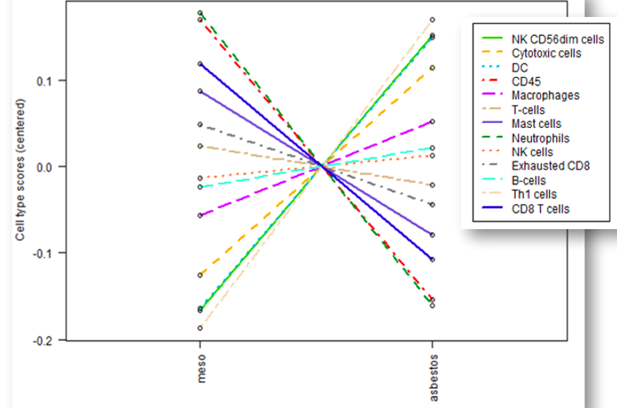
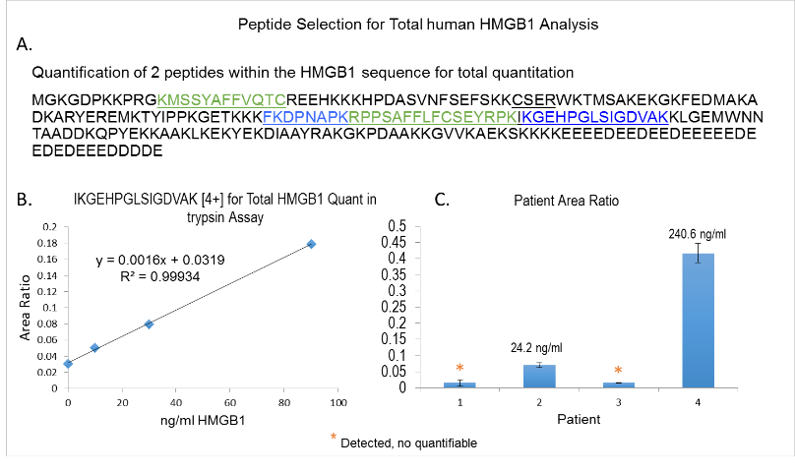
Update NYU/Hawaii Mesothelioma BDL
Aim 3: To determine whether immuno-oncologic RNA expression in buffy coat can define asbestos exposure and diagnose MPM
Aim 2: Investigate HMGB1 and its isoform in the diagnosis of MPM pleural effusion.
Progress:
Circulating microenvironment: MPM vs Asbestos exposed
Yang H et al, PNAS 2010;
Jube S et al., Cancer Res 2012
Napolitano A et al., Clin Cancer Res 2016
Set up Mass Spec assay for total HMGB1 and HMGB1 acetylated isoform measurement
Modeling Differences between MPM and AE BC Immunogenes. The discovery set using the modeling of the 20 significantly different genes with overall AUC of 0.93.

Slide 9

Wistar BDL
Louise Showe
Qihong Huang
PBMC mRNA-based markers for early detection of lung cancer

Slide 10
Performance of NanoString 41 Probe Classifier on 6-20mm IPN
Notes:
Figure 3. Performance of the 41 probe nPNC for BN and MN in the 6-20mm range. A. Compared to The Brock University, Mayo Clinic, and Veteran’s Affairs (VA) lung cancer risk clinical models. B. Compared to classification by nodule maximum diameter

Slide 11
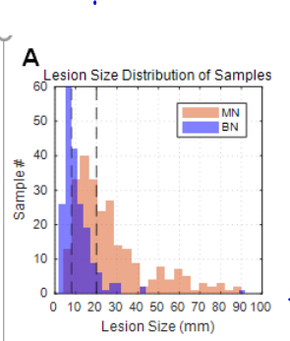
Performance of 300 Probe Classifier on IPN
LEFT: Nodule size distribution
Middle: 6-20 mm lesions (training and validation set samples): 117 cancers and 124 nodules
RIGHT: 8-20 mm lesions (training and validation set samples): 109 cancers and 99 nodules
mRNA is classification performed using top 300 genes

Slide 12

UPMC BDL
Jim Herman
Jeff Wang,
David Wilson,
Brenda Hoegaarde
Circulating methylated DNA-based biomarkers for early detection of lung cancer

Slide 13
Sensitivity and Specificity of DNA Methylation Detection
in Urine is Similar to Plasma from previous work
Gene methylation detection, Sensitivity, Specificity, PPV and NPV
 | Cancer (n= 33) |  | Control (n= 12)
Urine | n | Sensitivity | n | Specificity | PPV | NPV
CDO1 | 20 | 61 | 1 | 92 | 95 | 46
TAC1 | 21 | 64 | 1 | 92 | 95 | 48
SOX17 | 26 | 79 | 4 | 67 | 87 | 53
HOXA7 | 13 | 39 | 3 | 75 | 81 | 31
HOXA9 | 11 | 33 | 1 | 92 | 92 | 33
ZFP42 | 31 | 94 | 10 | 17 | 76 | 50
Abbreviations: positive predictive value: PPV; negative predictive value: NPV.

Slide 14
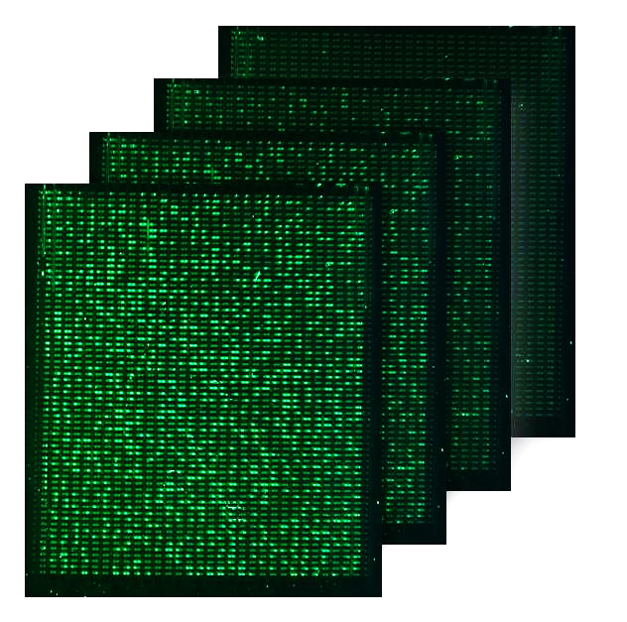
Digital Detection of DNA Methylation via DREAMing
24 Mpixel CMOS
50 mm Focusing Lens
LED array
Emission filter
Silicon wafer
Excitation filter
Microfluidic chip
Heat block adapter
Thermal cycler
Increasing temperate
(DNA Melting)

Slide 15

UMB- BRL
Sandy Stass
Feng Jiang
miRNA-based markers for early detection of lung cancer

Slide 16
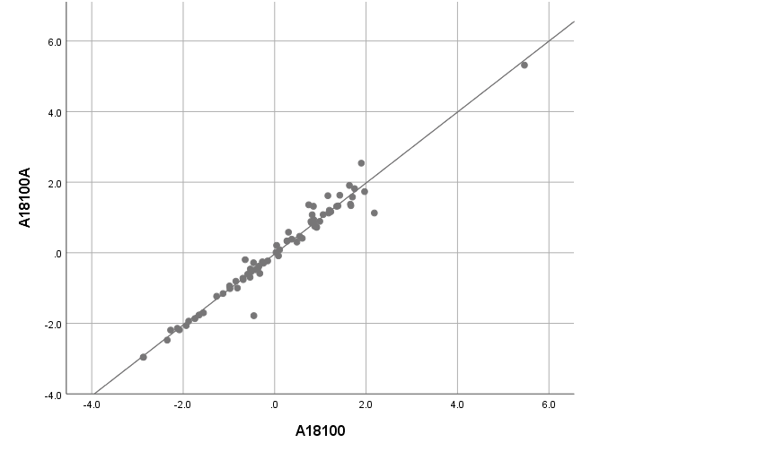
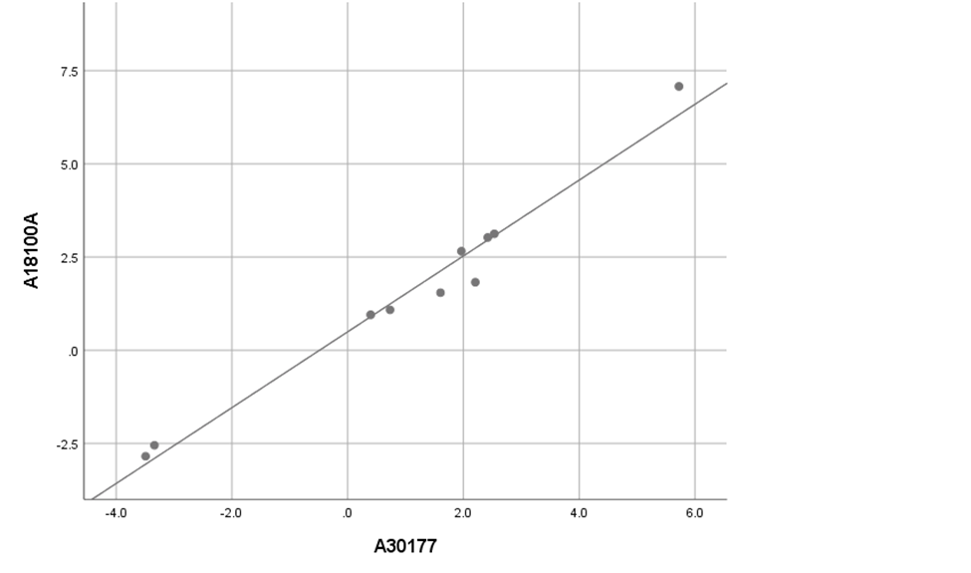
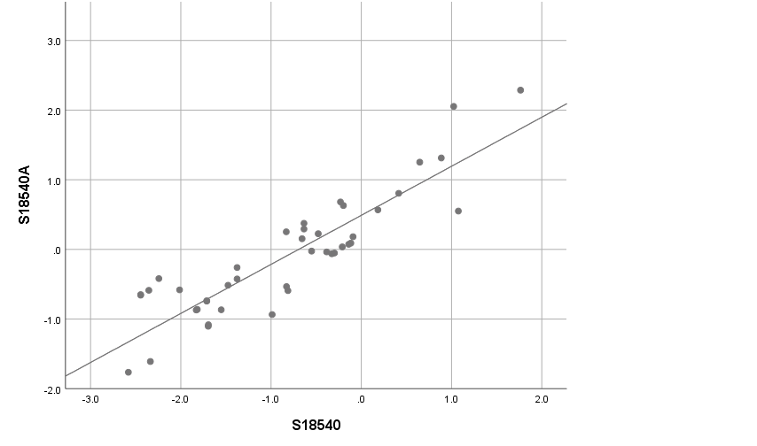
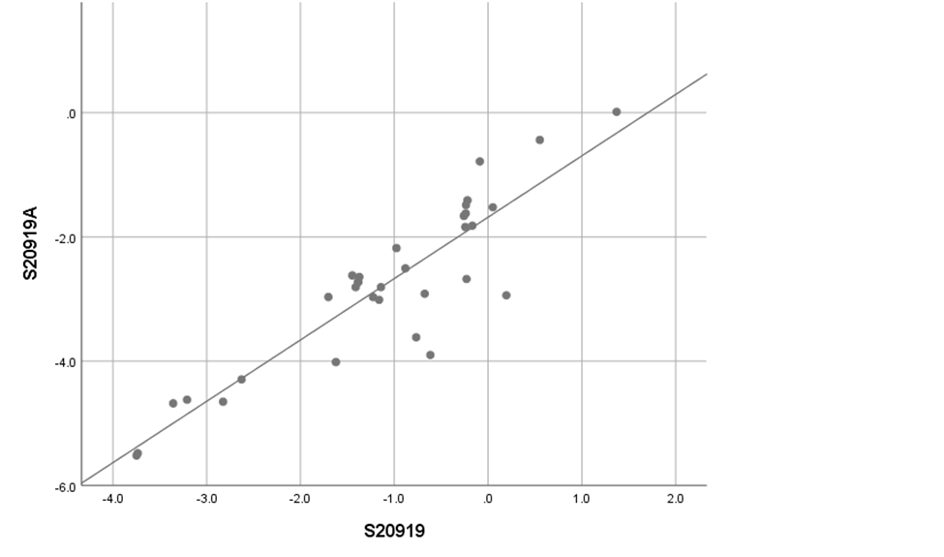
miRNA Expression in Non-Small Cell Lung Cancer
as an Early Detection Biomarker
Examples of Reproducibility

Slide 17
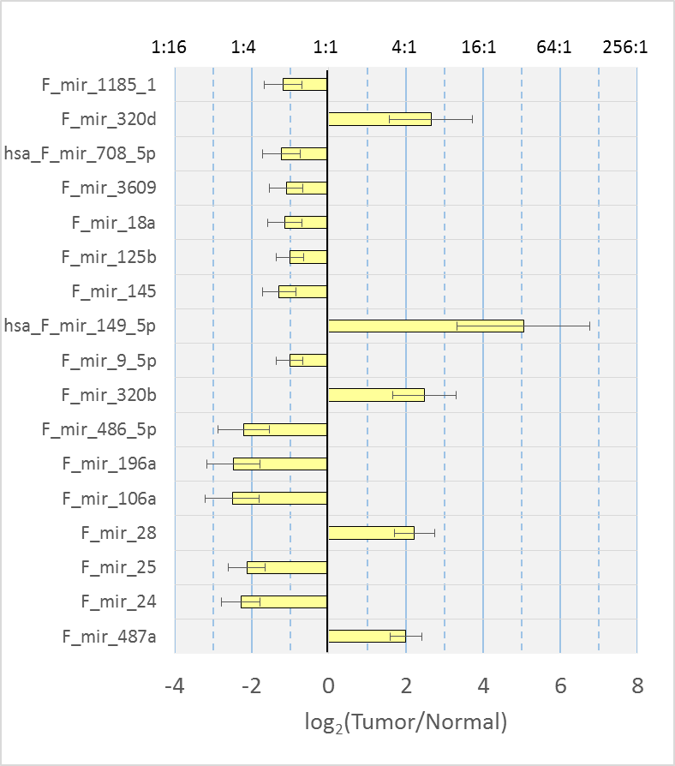
miRNA Expression in Non-Small Cell Lung Cancer
as an Early Detection Biomarker
52 NSCLC
52 ctls
17 miRNAs
Methodology validated
Clinical Validation pending
Moving into SPUTUM

Slide 18

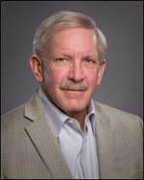
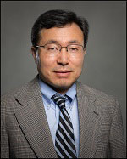
Moffitt CVC
Schabath
Gillies
Matt Schabath, PhD
Bob Gillies, PhD
Jae Lee, PhD
Applying Radiomics in Early Detection of Lung Cancer

Slide 19
Radiomics and Overdiagnosis
Multi-window radiomics exhibit improved capability to differentiate between indolent vs. aggressive growing tumors defined by volume doubling time
Conventional radiomics identified a highly vulnerable subset of early stage lung cancer patients have exhibit significantly poor PFS

Slide 20
Applying Deep Learning in Lung Cancer Screening
Question: Can Convolutional Neural Networks (CNN) ensembles constructed from baseline LDCT images (T0) predict who will develop lung cancer at follow-up screening intervals (T1/T2)?
  Three subsets of classifiers were created for different ensembles
  Subset 1: 3 CNN architectures
  Subset 2: Best CNN model, Coventional Radiomics, and Transfer Learning Models
  Subset 3: All 5 models
An ensemble approach significantly enhances the ability to predict which lung screening patients will develop lung cancer in 1 to 2 years after baseline
Accuracy of predicting who will develop lung in 1-2 years is nearly 90% with an AUC of 0.96
 | Subset 1 | Subset 2 | Subset 3
Accuracy | 86.91 | 83.96 | 89.02
P-value for compared to 76.79% from traditional features | P < 0.05 | P < 0.05 | P < 0.05
AUC | 0.94 | 0.93 | 0.96
P-value for compared to AUC 0.87 of CNN architecture 3 | P < 0.05 | P < 0.05 | P < 0.05

Slide 21
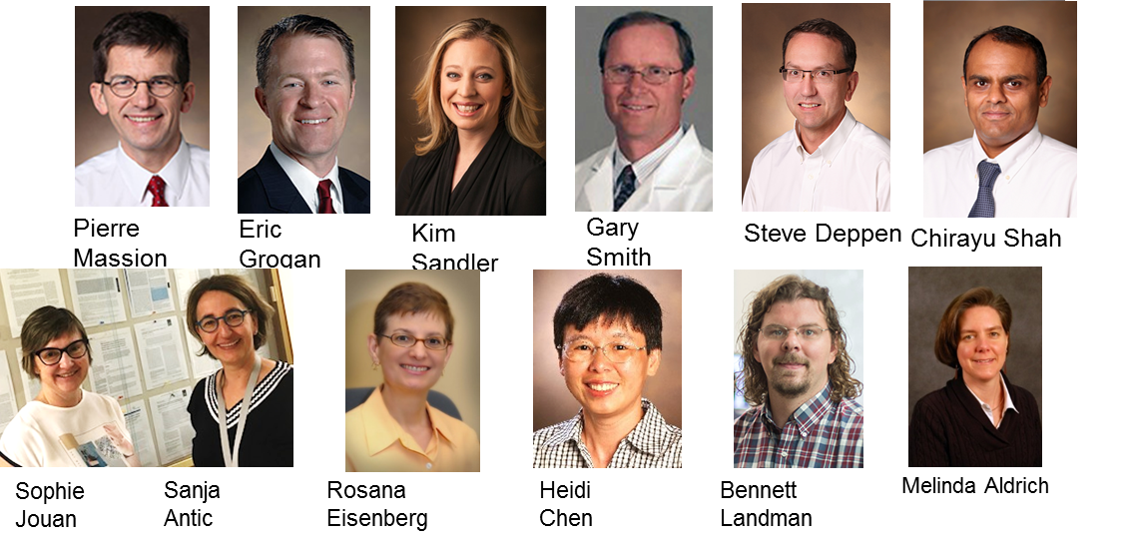
Vanderbilt
CVC
Pierre Massion
Eric Grogan
Steve Deppen
Chirayu Shah
Melinda Aldrich
Chirayu Shah
Management of Indeterminate Pulmonary Nodules

Slide 22
Biomarker Approach in IPNs
Clinical Predictors
Biomarker Probability Score
Imaging
Serum Biomarkers
Surgery
Integrated approach to IPN diagnosis

Slide 23
Specific Aims
Aim 1: Develop a Biomarker Probability Score (BPS) for lung cancer in patients with IPNs.
  300 participants VUMC biorepository
    6-30mm IPN with Mayo 15-80% cancer
  Clinical predictors, Histo IgG/IgM, CYFRA 21-1, ctDNA, CT Radiomics
  Goal: Improve AUC 0.7 to 0.85 compared to Mayo alone
Aim 2: Validate the BPS and evaluate its ability to reclassify IPNs
  250 participants, 15-80% probability of Ca
  Goal: BPS will reclassify 15% of the patients
LTP
(300)
250 IPNs
CanVFun
(50)
DECAMP2
(800)

Slide 24
Goal of LTP3

Slide 25
VUMC Biorepository prelim data
Imaging and Serum Biomarker profiles at all Mayo Clinic risk levels
 | Histoplasmosis¹ IgG+IgM | Histoplasmosis¹ IgG | CYFRA 21.1- BSI | CYFRA & IgG
Sample size | 331 | 331 | 197 | 179
Sensitivity % | 10² | 35² | 82⁴ | 81⁴
Specificity % | 100²* | 90² | 83⁴ | 89⁴
AUC MAYO model alone | 0.65 | 0.65 | 0.66 | 0.62
AUC Mayo + Biomarker | NC³ | 0.73 | 0.88 | 0.91
Notes:
¹ Diagnostic cutpoint from Miravista
² The values for Histoplasmosis are to diagnose fungal disease vs cancer.
³ Not calculated due to IgG + IgM being perfect predictors of benign disease.
⁴ Based on usual definitions of Sensitivity and Specificity using Youden’s Index derived cutoff for continuous biomarkers.
*300 patients with lung cancer were tested with EIA Histoplasmosis (including not reported patients with metastatic or larger than 30mm nodules) 0 were IgG + IgM positive. 10% of all participants with benign disease had IgG + IgM positive EIA test and all were benign.

Slide 26
Existing Biorepositories CVC resources
296 high risk including 11 cancers lung cancer
Unique patients
Repeated collections

Slide 27
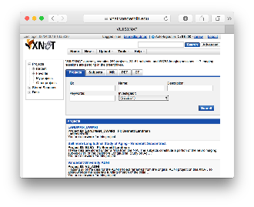
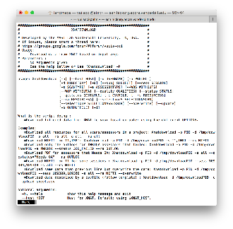
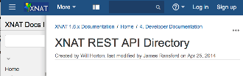

Vanderbilt Lung Imaging Repository 1100 annotated IPNs
Medical image Analysis and Statistical Interpretation lab, Bennett Landman, PhD
Contributing Sites
Repository Users
External Programs
External Web Browser / Computer
External File System
External PACS
External XNAT
Web portal
Vanderbilt Lung Repository
Q/A and
De-identification
DAX/XNAT
Command line tools
DAX: Neuroimage. 2016 Jan 1;124(Pt B):1097-101. doi: 10.1016/j.neuroimage.2015.05.021.
XNAT: Neuroimage. 2016 Jan 1;124(Pt B):1093-6. doi: 10.1016/j.neuroimage.2015.06.076.
Software API
Image Processing
PACS or XNAT
Notes:
Vandy, Moffitt, Stanford, U Pen,

Slide 28
Personalizing Risk assessment for lung cancer
Risk <0.1%
Risk 1.5%
General pop
Epidemiology
Risk 3.5%
With lung nodules
With + biomarker
Risk 9.0%
Lung Cancers
Lung cancers

Slide 29
Highlights
Highly collaborative team focused on Personalized lung cancer management.
Team project LTP2 164 enrollees. Improved accrual and distributions on going.
New team project LTP3 to get us closer to improved management of IPNs.
33 publications in the last year.
Basket biomarker evaluation beyond common clinical factors- using spectrum of biomarkers. cancer and benign blood and imaging.
We want to add value to current standard of care and proof of clinical utility.

Slide 30
Future directions.
Personalized lung cancer screening.
Screening in the underserved population.
Increase collaborators from high cancer regions.
Basket biomarker evaluation beyond common clinical factors- using spectrum of biomarkers. cancer and benign blood and imaging.
Proof of clinical utility.

Slide 31

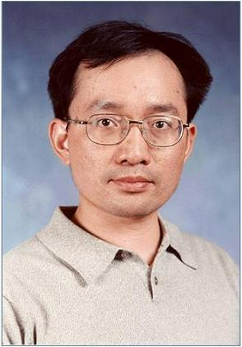
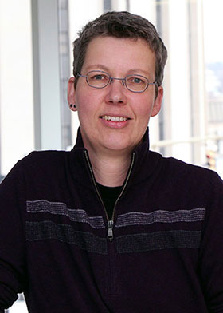

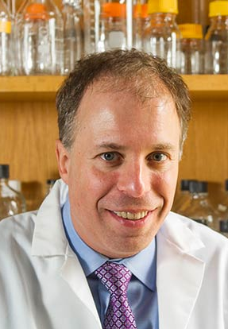


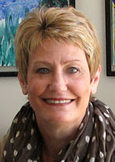


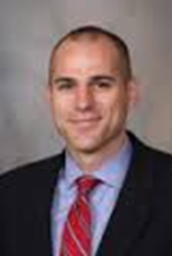


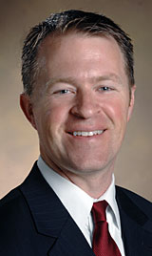
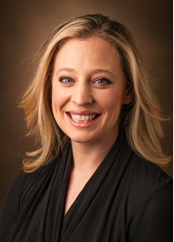

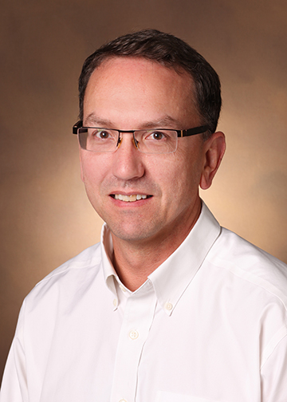


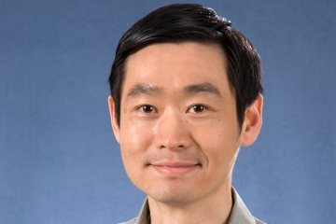


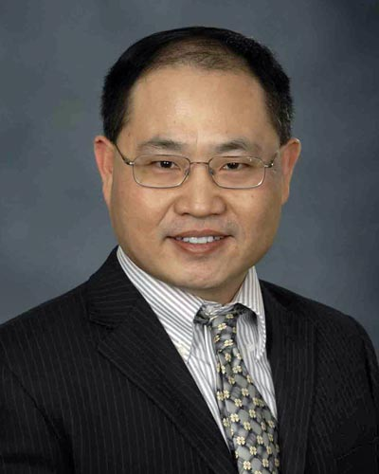
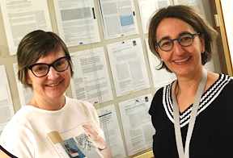
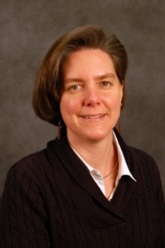
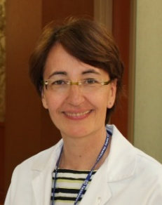



Matt Schabath, PhD
Bob Gillies, PhD
Jae Lee, PhD
Jim Herman,
MD
Jeff Wang, PhD
Brenda Diergaarde,
PhD
Lynn Sorbara, PhD
Avi Spira MD
Steve Dubinett, MD
Marc Lenburg, PhD
Deni Aberle, MD
Harvey Pass, MD
Haining Yang, MD, PhD
Karl Krueger, PhD
Louise Showe, PhD
Qihong Huang, MD, PhD
Pierre Massion
Eric Grogan
Kim Sandler
Gary Smith
Steve Deppen
Chirayu Shah
Tracey Marsh, PhD
Margaret Pepe, PhD
Sandy Stass
Feng Jiang
Sophie Jouan
Sanja Antic
Rosana Eisenberg
Heidi Chen
Bennett Landman
Melinda Aldrich

Slide 32
Critical questions
Risk stratification for lung cancer screening to enhance participation of the underserved population
How to assess risk of lung cancer among never smokers? Radon, familial risk, germline mutations.
How to best use up coming New technologies: imaging and AI and tissue/liquid based new discovery technologies: microbiomes, epigenetics…
Management of IPNs
Biomarkers predictive of indolent vs aggressive disease.
Who to screen? LDCT screening may detect 10% of all lung cancers. There is a lot of room for improvement.

Slide 34
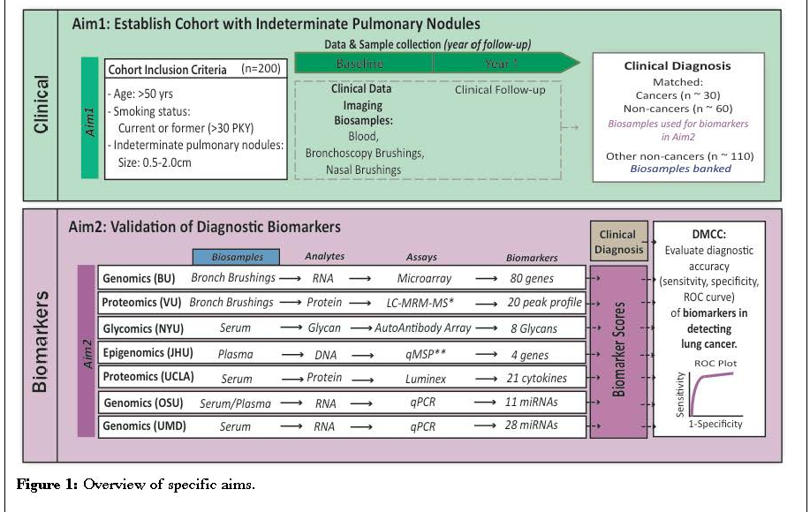
Lung collaborative project - LTP2

