Slide 1
Highlights of the EDRN Pancreas Collaborative Group
Mid-Cycle Steering Committee Meeting
Sept. 6, 2018
Boston, MA
CVC: MD Anderson; Maitra
CVC: Pitt and UNMC; Brand & Batra
BDL: VARI, Pitt and MSKCC; Haab, Brand & Allen
DMCC: Data Analysis by Ying Huang

Slide 2
Major Accomplishments
Team Project – blinded validation of PDAC biomarkers from six labs
Cyst Biomarker Validation Study underway
Pancreatic Cyst Fluid Reference Set almost complete

Slide 3

Blinded Test Set
Total of 183 samples were provided from both CVCs
PDAC Cases
Majority were resectable stage 1 and 2
Controls
Benign diseases of the pancreas, other pancreatic malignancies, healthy controls

Slide 4
Markers tested in the blinded analysis
Site | Investigator | Marker
VARI | Haab | CA19-9, CA199:sTRA, and MUC5AC:sTRA
MDACC | Hanash | TIMP1, LRG1, and CA19-9
UNMC | Batra | MUC5AC, MUC4
UPMC | Lokshin | CA19-9, angiotensin, and thrombospondin
FHRC | Lampe | PMS2 (protein) and DCD, PODXL and PAFAH1B2 (autoAb-Ag)

Slide 5
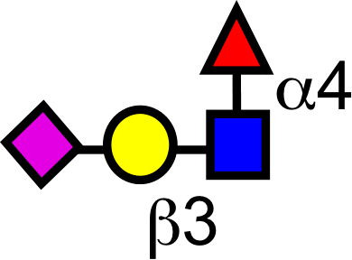


VARI
CA19-9
sTRA

Slide 6
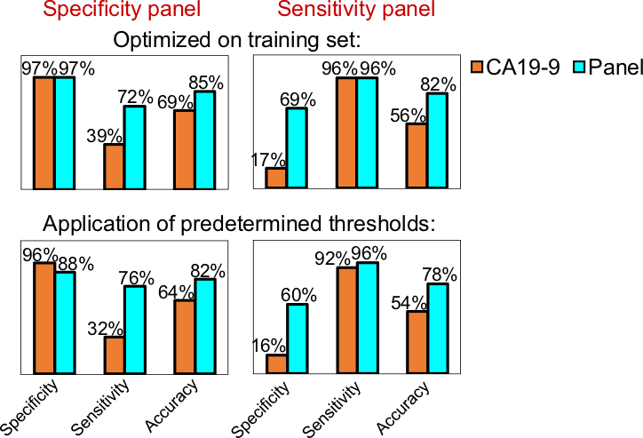
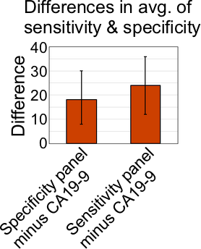
The panels improved on CA19-9 in the training and validation sets
Significance: P < 0.001
(1000-fold bootstrapping analysis)

Slide 7
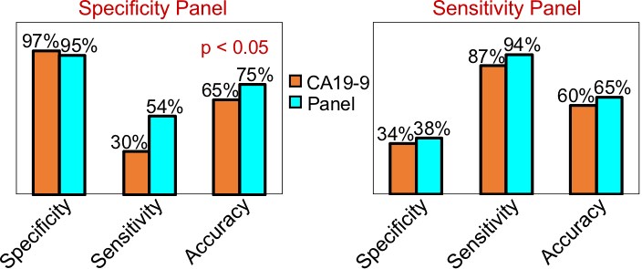
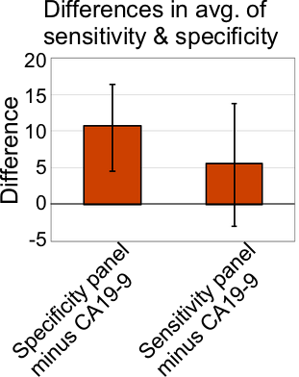
Application to the Blinded Test Set
p < 0.001
Specificity panel was significantly better than CA19-9 (p < 0.001, 1000-fold bootstrapping)

Slide 8
UNMC: MUC5AC and MUC4 in combination with CA19.9
RESEARCH HIGHLIGHTS
MUC4 AND MUC5AC IN COMBINATION WITH CA19.9 IMPROVES THE PERFORMANCE FOR DIFFERENTIATING
CHRONIC PANCREATIS FROM PDAC CASES
MUC5AC ABILITY TO IMPROVE PERFORMANCE OF CA19.9 AT ITS OPTIMAL CUT-OFF IS OBSERVED IN MULTIPLE SETS
TRAINING SET
VALIDATION SET
REFERENCE SET
BAKE-OFF SET
MUC4 distinguishes high-risk cystic lesions in pre-surgical EUS FNAs

Slide 9

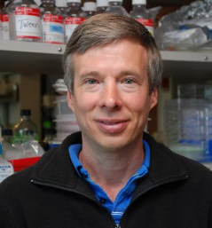
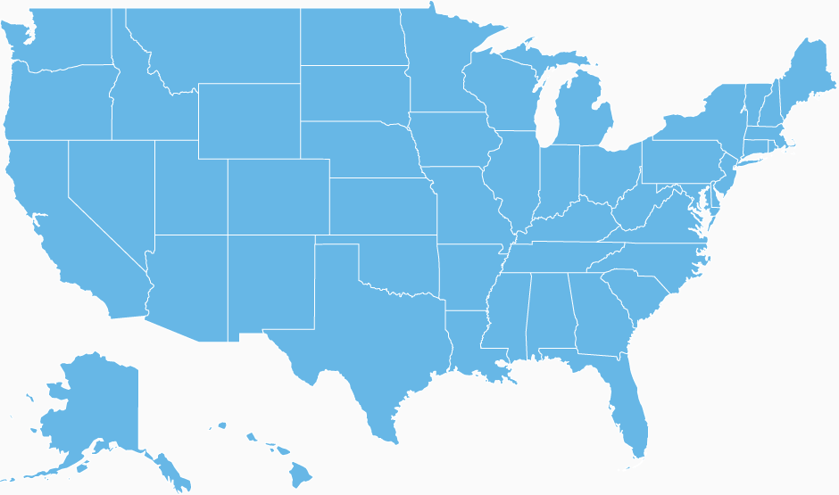

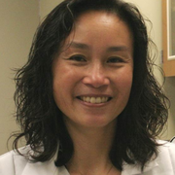


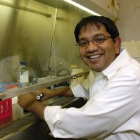

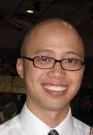
MDACC EDRN CVC Team
Paul Lampe, FHCRC
Sunil Hingorani, FHCRC
C. Max Schmidt, IU
Michele Yip-Schneider, IU
Sean Mulvihill. Utah
Matt Firpo, Utah
Anirban Maitra, MDACC (Overall PI)
Sam Hanash, MDACC
Eugene Koay, MDACC

Slide 10
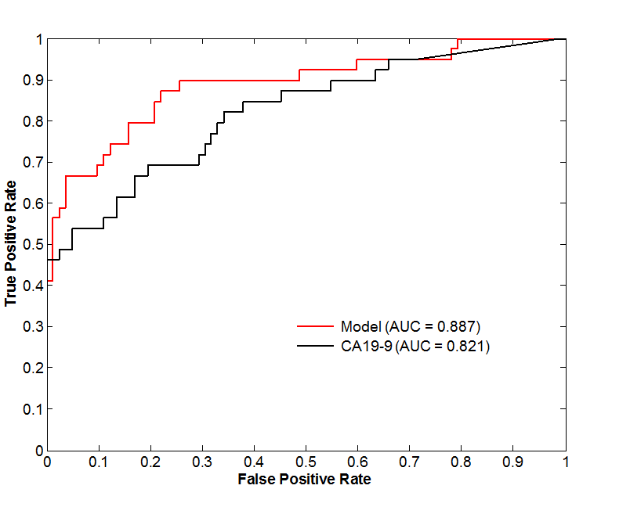
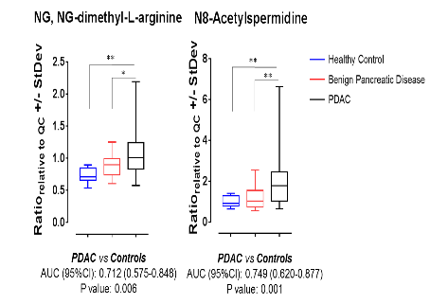
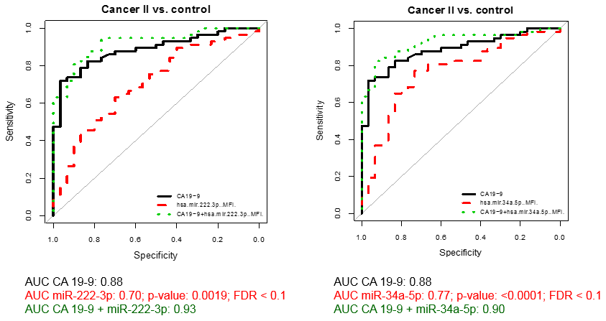
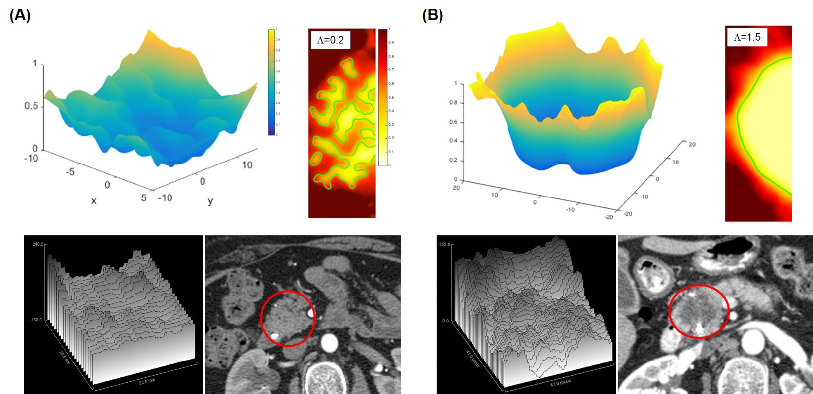
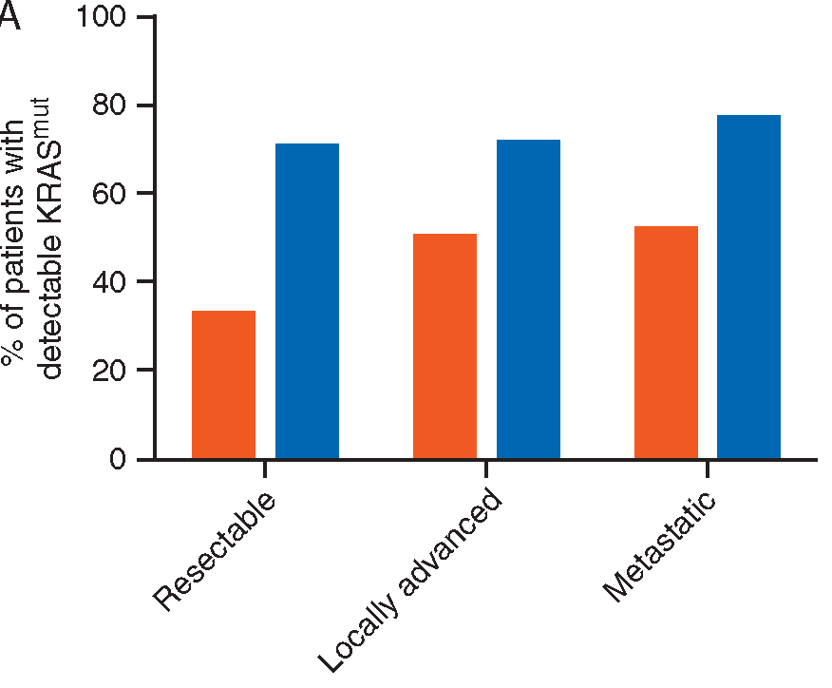
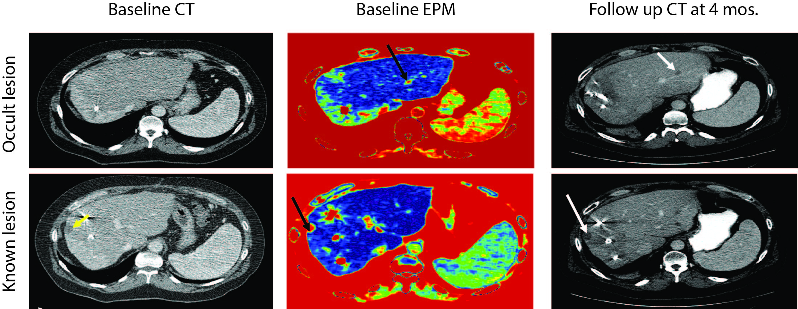
“Biomarker Bakeoff”
Proteins
Autoantibodies
Metabolites
miRNAs
Enhancement Pattern Mapping (EPM)
Integrated Panel
Cancer-specific exosomes + molecular barcoding

Slide 11
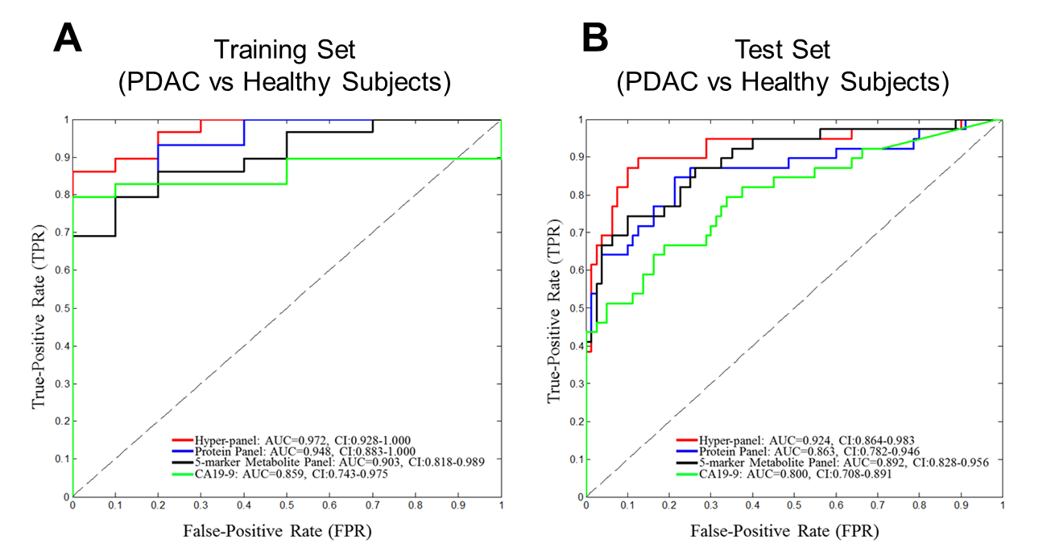
A Protein and Metabolite Hyper-Panel
Hyper-panel vs Protein Panel
P = 0.11
Hyper-panel vs Protein Panel
P = 0.02
Fahrmann JF et al, JNCI August 2018

Slide 12
Notable features of the team project:
To best of our knowledge, this was the most rigorously performed validation of multiple different biomarkers on the same set.
Entire project accomplished in one year – only possible with this structure
Addressed challenge of variability in sample processing and storage from different contributing sites
Statistically-significant improvements over CA19-9 were accomplished in the blinded validation

Slide 13







Pancreatic Cyst Biomarker Validation Study
Pancreatic Cyst Biomarker Alliance (PCBA)

Slide 14
Pancreatic Cyst Biomarkers
Telomerase & DNA Methylation (Hopkins)
Completion: 90%
Obstacles: Insufficient total protein/DNA
PancreaSeq (UPMC)
Completion: 40%
Obstacles: Insufficient DNA for ~10% of Cases
Gastricsin & Cathepsin E (UCSF)
Das-1 (WashU)
Glucose and Amphiregulin (Stanford)
Glycoproteins (Van Andel)
Completion: 10%
Obstacles: Fluid viscosity, insufficient protein and degradation issues

Slide 15
Pancreas Cyst Reference Set
Supported by EDRN Core Funds

Slide 16
EDRN Cyst Reference Set Participants
University of Pittsburgh (Brand)
University of Michigan (Kwon)
Memorial Sloan Kettering Cancer Center (Allen)
Thomas Jefferson University (Winter)
Stanford University (Park)
Vanderbilt University (Merchant)
Mt Sinai Medical Center (DiMaio)
Moffitt Cancer Center (Vignesh)
University of Nebraska Medical Center (Singh)
Johns Hopkins University (Lennon)
Georgetown University (Smith)
St. Michael’s Hospital (Marcon)
UCSF (Kirkwood)
Ohio State University (Conwell)

Slide 17
Current Status of Cyst Reference Set
Six sites currently enrolling subjects
Total enrollment of 407 subjects
231 of 270 surgical resections have been enrolled
176 of 180 EUS only (have not gone to surgery)

Slide 18
Other Highlights
~30 publications between the groups
Patient/licenses moving forward
sTRA method in patent review, discussions underway to establish in a clinical laboratory
Panel from FHCRC (Lampe): patent submitted
Licenses for development of kits for MUC4/MUC16 IHC and MUC4/MUC5AC/CA19.9 serum detection

