Slide 1
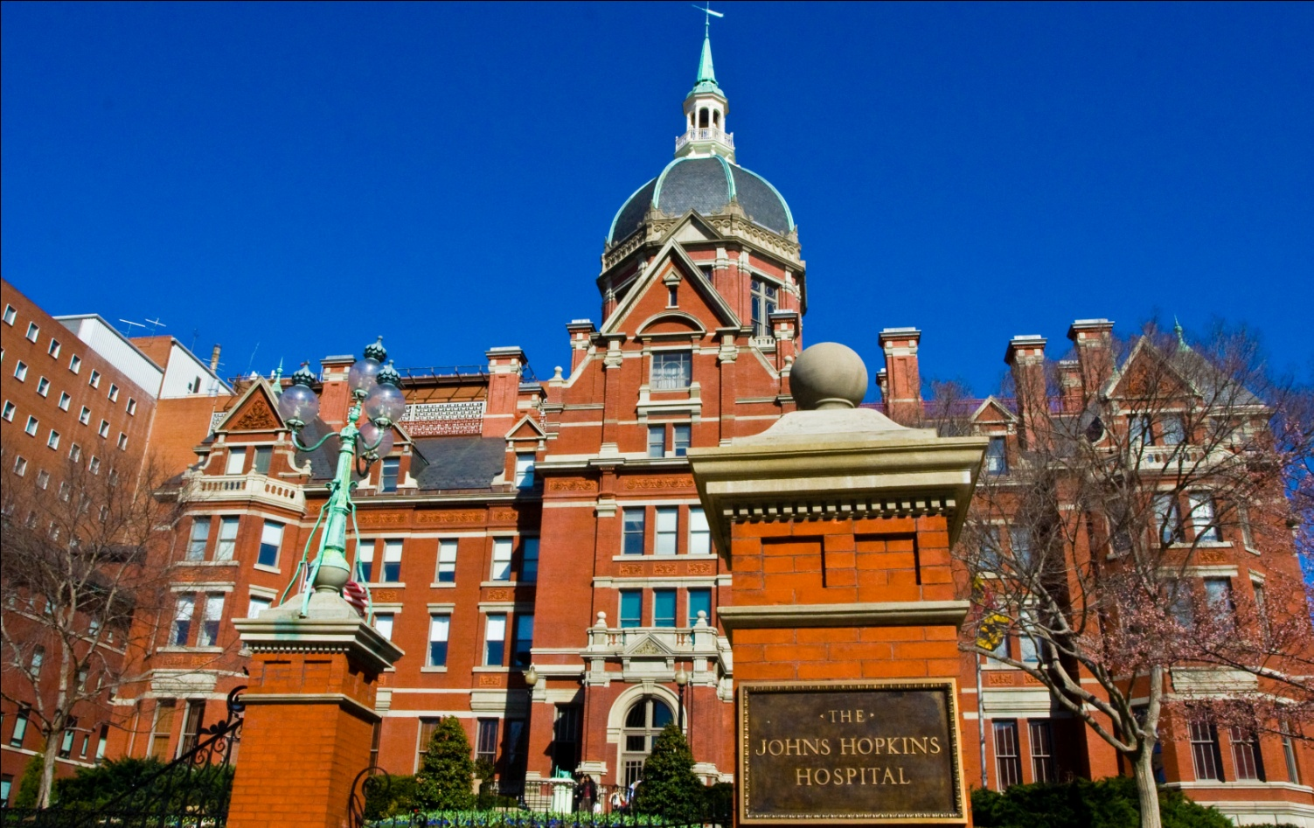


Blood-based Screening and
Monitoring of Colorectal Cancer
Ken Kinzler, Nicholas Papadopoulos, Brenda Diergaarde, Dan Normolle, Robert E. Schoen

Slide 2
ctDNA: Liquid Biopsy
As cancer cells turn over, release mutant DNA into adjacent media
Blood, stool, urine, pancreatic juice, cysts, cervical mucous, CSF, saliva, bronchial, etc.
Mutant DNA – somatic mutations within driver genes that are responsible for clonal growth
Normal cells do not clonally expand, rarely harbor these somatic mutations, and not in this concentration – exquisite specificity

Slide 3
Challenges
Technical: Can we develop tests of sufficient specificity and sensitivity?
Biological:
1) Are there detectable amounts of DNA from neoplastic cells present in the biological fluid (some tumors don’t release)?
2) Somatic mutations vary - panel
3) Mutations not specific to one cancer

Slide 4
Challenges
Biological:
Sensitivity – can be <1 mutant molecule/ml of plasma: requires large volume
Application: How to identify tissue of origin – same gene mutations drive multiple tumors

Slide 5
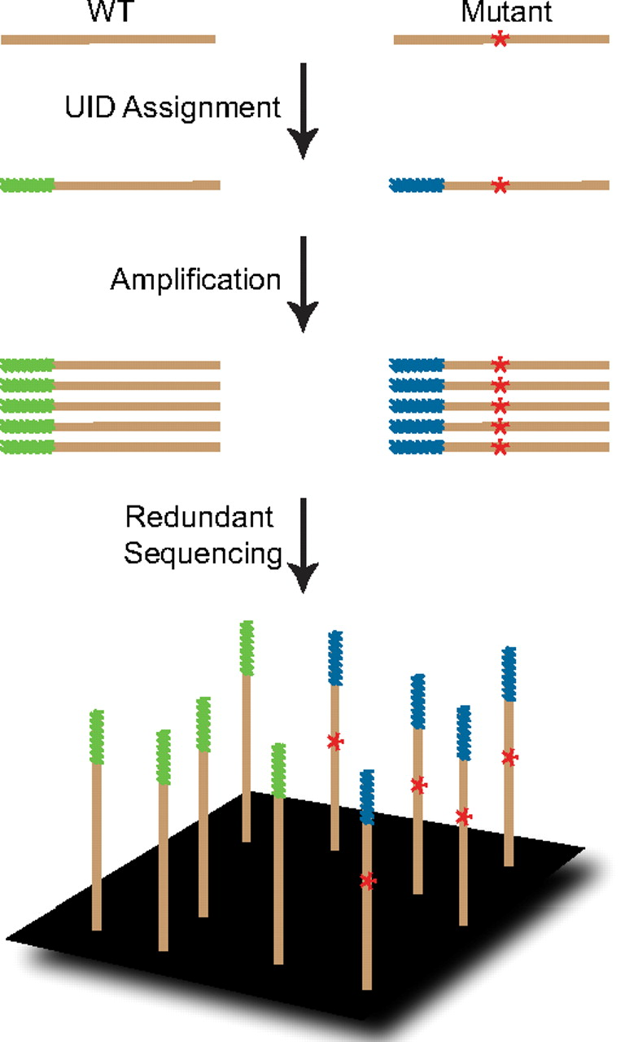
Safe-SeqS
Safe
Sequencing
System
Method for detection and quantification of rare mutations
Kinde I et al. PNAS 108:9530-9535, 2011

Slide 6
Amplification to Distinguish Replication Error vs. Mutation
Sequencing or Replication Error
vs. Legitimate
Mutation
*
This strategy can decrease error rates by 70-fold
*
Kinde I et al. PNAS 2011;108:9530-9535

Slide 7
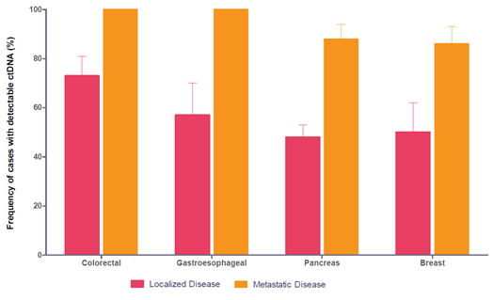
ctDNA: Resectable vs. Advanced Cancer
Colorectal: 73% (stage I-III)
Bettegowda et al. Sci Transl Med. 2014 Feb 19;6(224):224ra24.
Notes:
Fraction of patients with detectable ctDNA in localized (stages I to III) and metastatic (stage IV) colorectal, gastroesophageal, pancreatic, and breast cancers.
73% of subjects with localized CRC had detectable ctDNA

Slide 8
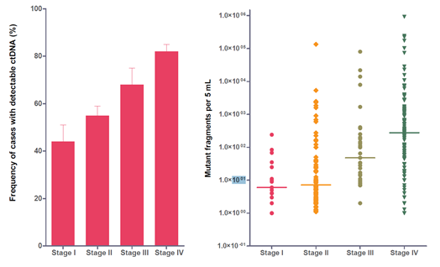
ctDNA in CRC by Cancer Stage
Bettegowda et al. Sci Transl Med. 2014 Feb 19;6(224):224ra24.
Notes:
(A) Fraction of patients with detectable ctDNA (colorectal, gastroesophageal, pancreatic, and breast cancers).(B) Quantification of mutant fragments in cancer cases categorized by stage. Error bars represent SEM.
Levels of ctDNA correlate with stage.
Among subjects with metastatic CRC, the number of mutant fragments ranged from 100,000 to 1 per 5 ml of plasma.

Slide 9
CancerSEEK Test
Must query sufficient # bases to detect large # of cancers
Must limit # bases queried → artifact
Must be cost effective, high throughput
61 Amplicon, avg 33 bp length,
in 16 genes, 2001 genomic positions

Slide 10
COSMIC Database: Proportion of Cancers that Could be Detectable with Increasing #’s Amplicons
Sensitivity Plateaus at ~ 60 Amplicons
Colored Dots are % Detectable with our Assay
Notes:
Catalog of somatic mutations in cancer

Slide 11
Protein Markers
ctDNA not sensitive enough proteins
Looked for sens >10%, spec >99%
41 proteins evaluated, 39 reproducible
Eight proteins useful

Slide 12
Protein Markers Used
in CancerSEEK
CA-125
CA19-9
CEA
HGF
Myeloperoxidase
OPN
Prolactin
TIMP-1

Slide 13
CancerSEEK Study
1,005 Cancer Patients
209 Breast
288 Colorectal
45 Esophageal
44 Liver
104 Lung
54 Ovarian
93 Pancreatic
68 Stomach
812 Healthy Controls
No Distant Metastases
20% Stage I
49% Stage II
31% Stage III
Median Age 64 years
Notes:
Selected 41 markers that were elevated in > 10% of at least one of the 8 cancer types with > 99% specfiicty. 39 could be reproducibly assayed in a multiplexed assay with Luminex Bead based assays on a Bioprad Bioplex 200 instrument.

Slide 14
Statistical Analysis
Logistic regression – to account for mutation (omega score), and protein biomarker data
Validated via 10-fold cross validations
ctDNA was single most informative marker

Slide 15
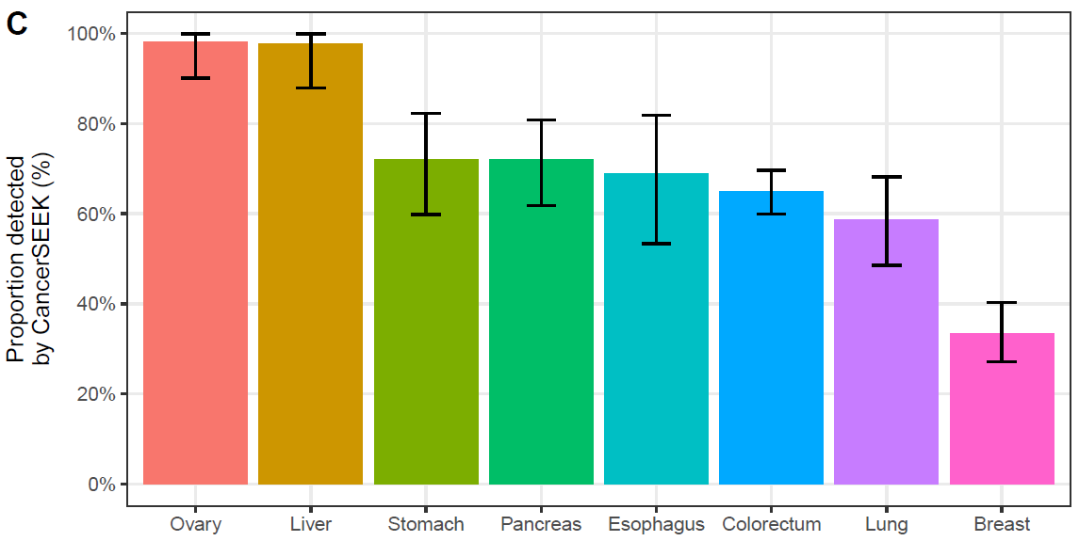
CancerSEEK Sensitivity
69% to 98%
70% Median Sensitivity (p < 10⁻⁹⁶ one-sided binominal)
>99% Specificity (7 of 812 Healthy Controls)
Range (33% to 98%)
Ovary
Liver
Stomach
Pancreas
Eso
Colon
Lung
Breast
Notes:
62% average
55% when adjusted for tumor distributions in populations.

Slide 16
62% (red point) average performance
at >99% specificity

Slide 17
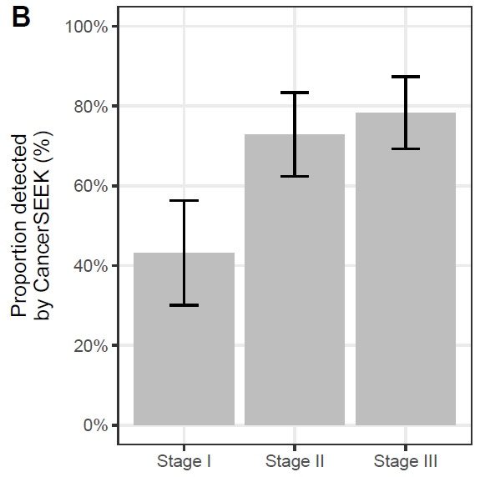
CancerSEEK Sensitivity by Stage
78%
73%
43%
Notes:
Stage 1 ranged from 20% for Eso to 100% for Liver
No independent test group
Most patients presented with symptoms
Need a prospective trial

Slide 18
Tissue Confirmation
N=153
Mutation in plasma identical to mutation in tumor in 138/153 (90%)
Concordance between plasma and tumor: present in all tumor types – ranging from 100% in ovarian/pancreas to 82% in stomach

Slide 19
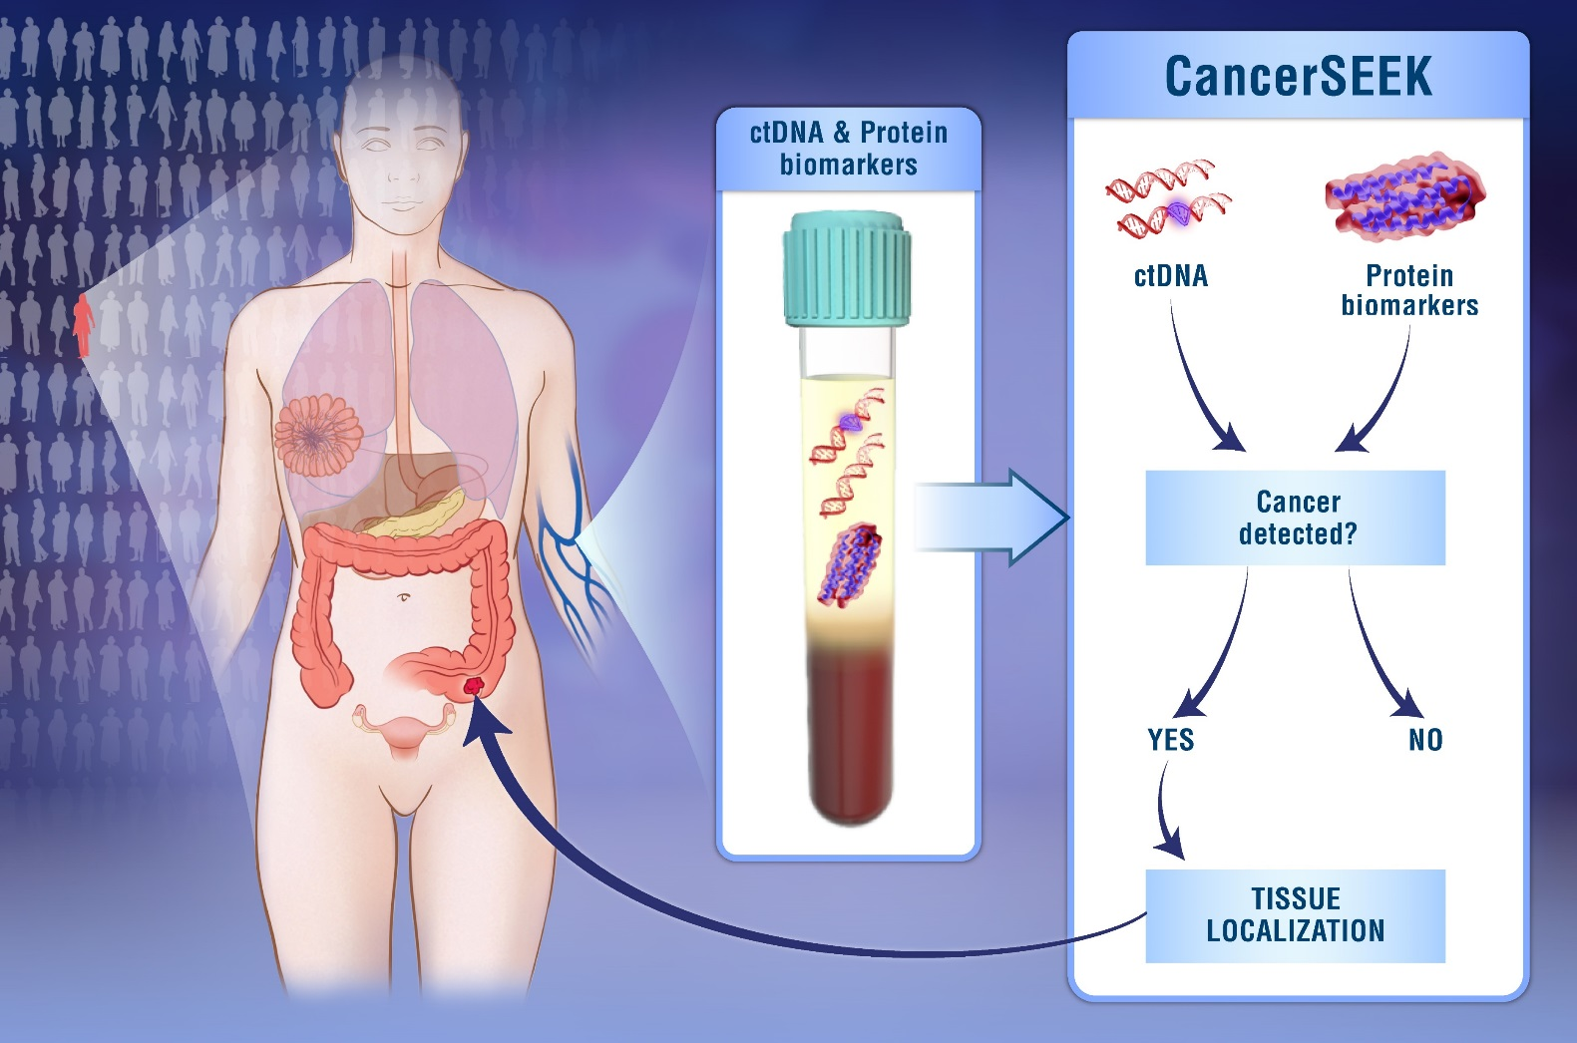
Positive Test - Now What?
YES

Slide 20
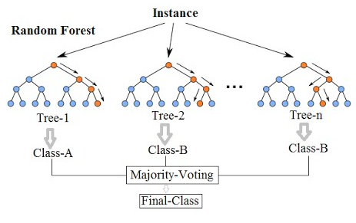
CancerSEEK: Site of Origin
Machine Learning (Random Forest) N=626
ctDNA data (gene level)
Protein data
Gender
Notes:
Trees and Forests. The random forest starts with a standard machine learning technique called a “decision tree” which, in ensemble terms, corresponds to our weak learner. In a decision tree, an input is entered at the top and as it traverses down the tree the data gets bucketed into smaller and smaller sets.
Why is it called random then?
Say our dataset has 1,000 rows and 30 columns. There are two levels of randomness in this algorithm:
At row level: Each of these decision trees gets a random sample of the training data (say 10%) i.e. each of these trees will be trained independently on 100 randomly chosen rows out of 1,000 rows of data. Keep in mind that each of these decision trees is getting trained on 100 randomly chosen rows from the dataset i.e they are different from each other in terms of predictions.
At column level: The second level of randomness is introduced at the column level. Not all the columns are passed into training each of the decision trees. Say we want only 10% of columns to be sent to each tree. This means a randomly selected 3 column will be sent to each tree. So for the first decision tree, may be column C1, C2 and C4 were chosen. The next DT will have C4, C5, C10 as chosen columns and so on.

Slide 21
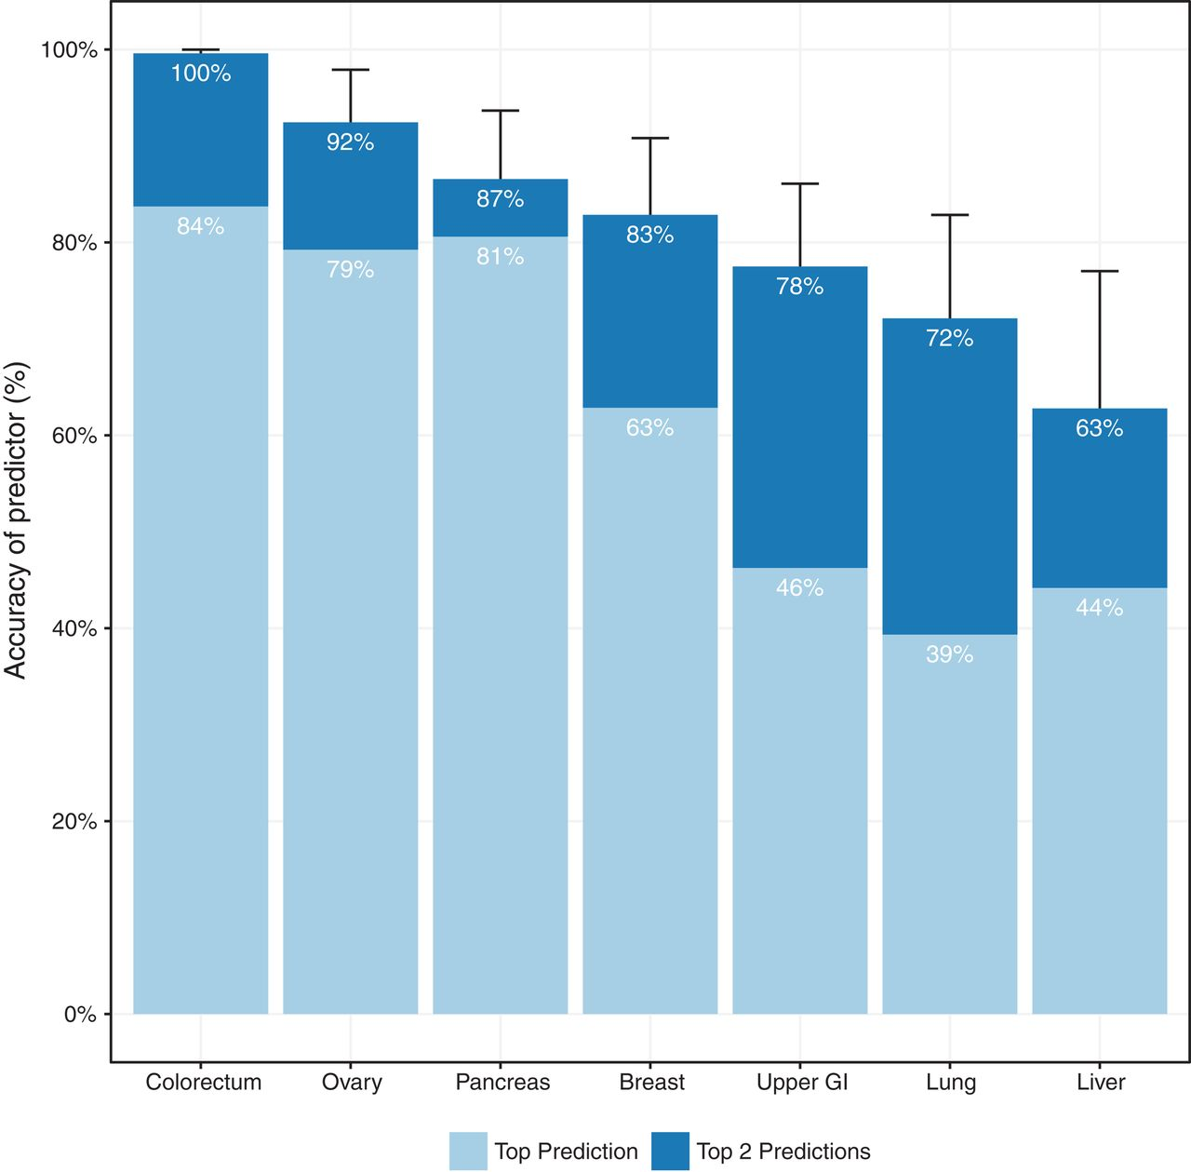
Top Prediction was correct in a median of 63% of the cases.
(p < 10⁻⁴⁷ one-sided binomial test)
Top 2 Prediction identified the site in a median of 83% of the cases.
(p < 10⁻⁷⁷ one-sided binomial test)

Slide 22
Limitations
Most patients in this study were diagnosed on the basis of symptomatic disease.
Controls for this study were limited to healthy individuals.
Ten-fold cross-validation was used for developing the algorithms - not separate validation cohort.
The proportion of cancers types was not representative of those in the United States.
Establishing the clinical utility of CancerSEEK will require multiple prospective studies.

Slide 23
August 8, 2018:
PapGene announced CancerSEEK received
FDA Breakthrough Device Designation

Slide 24
Advanced Adenoma Supplement
≈ 40 advanced adenomas, blood drawn prior to resection (large volume plasma)
DNA from adenoma isolated, mutations identified
Perfecting assay – multiple mutations

Slide 25
ctDNA for Monitoring

Slide 26
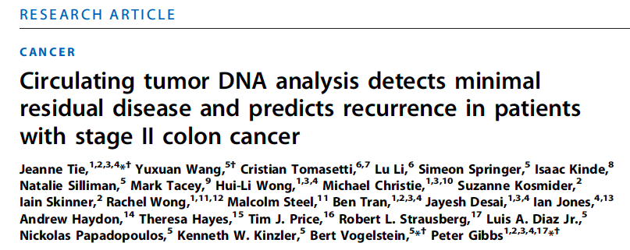
Sci Transl Med. 2016 Jul 6;8(346):346ra92
ASCO Annual Meeting, 2016, Abstract 3511

Slide 27
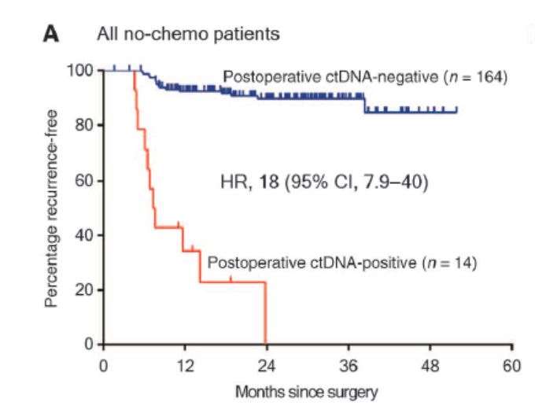

Recurrence Free Survival (RFS) in patients
not treated with adjuvant chemotherapy
Jeanne Tie et al., Sci Transl Med 2016;8:346ra92
Notes:
RFS in patients not treated with adjuvant chemotherapy. (A) Kaplan-Meier estimates of RFS for all patients not treated with adjuvant chemotherapy, stratified by postoperative ctDNA status. (B) Kaplan-Meier estimates of RFS in the same patients, stratified by clinicopathologic characteristics. (C) Kaplan-Meier estimates of RFS stratified by postoperative ctDNA status in patients with low-risk clinicopathologic characteristics. (D) Kaplan-Meier estimates of RFS stratified by postoperative ctDNA status in patients with high-risk clinicopathologic characteristics. The high-risk group is defined as those having mismatch repair–proficient (pMMR) tumors with at least one of the following poor prognostic features: T4, LN yield <12, LVI, and poor tumor differentiation. The low-risk group is defined as those with no poor prognostic features.

Slide 28
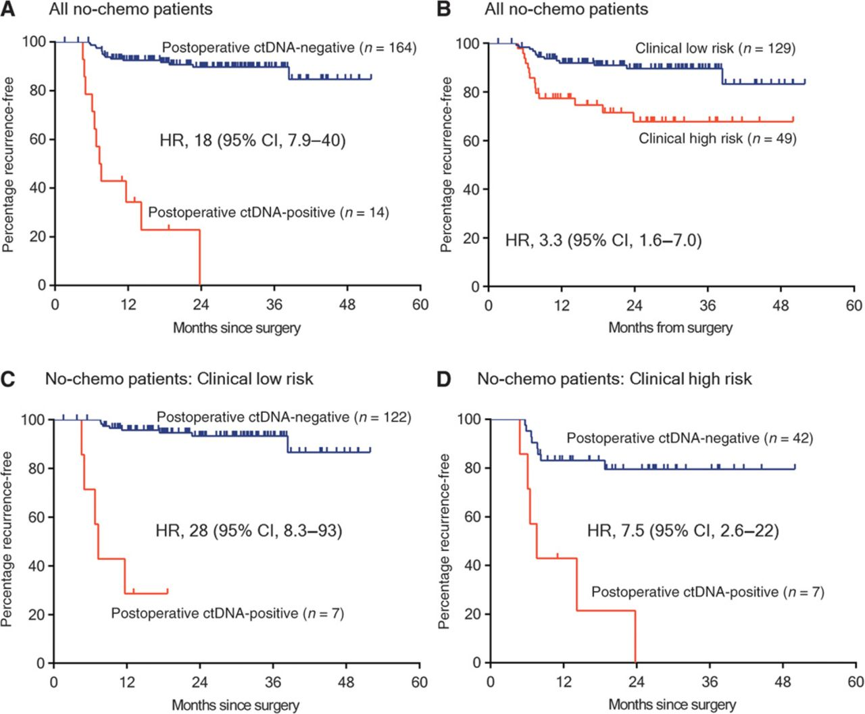
Recurrence Free Survival (RFS) in patients
not treated with adjuvant chemotherapy
Jeanne Tie et al., Sci Transl Med 2016;8:346ra92
Notes:
RFS in patients not treated with adjuvant chemotherapy. (A) Kaplan-Meier estimates of RFS for all patients not treated with adjuvant chemotherapy, stratified by postoperative ctDNA status. (B) Kaplan-Meier estimates of RFS in the same patients, stratified by clinicopathologic characteristics. (C) Kaplan-Meier estimates of RFS stratified by postoperative ctDNA status in patients with low-risk clinicopathologic characteristics. (D) Kaplan-Meier estimates of RFS stratified by postoperative ctDNA status in patients with high-risk clinicopathologic characteristics. The high-risk group is defined as those having mismatch repair–proficient (pMMR) tumors with at least one of the following poor prognostic features: T4, LN yield <12, LVI, and poor tumor differentiation. The low-risk group is defined as those with no poor prognostic features.

Slide 29
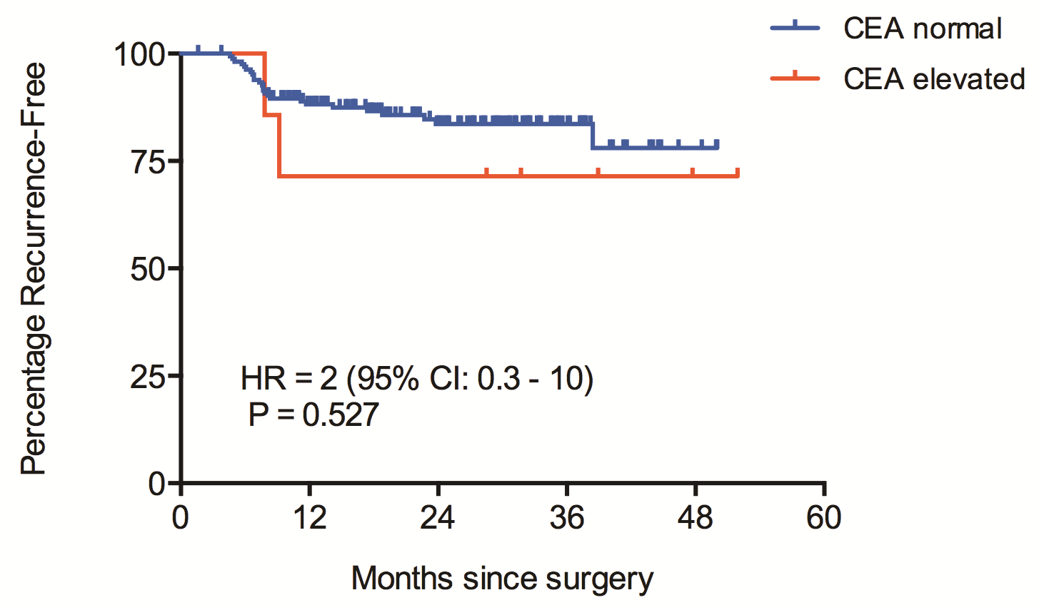
Recurrence Free Survival (RFS) in patients
not treated with adjuvant chemotherapy by CEA level

Slide 30
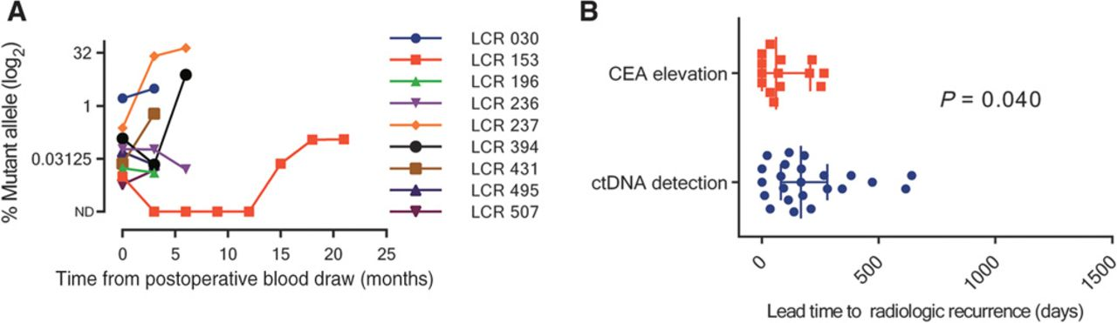
Lead Time to Radiological Recurrence:
ctDNA vs. CEA
Time from detection to recurrence:
ctDNA 167 days vs. CEA 61 days, p=.04
Notes:
Serial ctDNA status up to radiological recurrence. (A) Serial ctDNA measurements up to the time of radiological recurrence for the nine patients who were not treated with adjuvant chemotherapy and who were ctDNA-positive postoperatively. (B) Scatter plot of the lead time to radiological recurrence for ctDNA detection and CEA elevation, with the error bars representing the median and IQR.

Slide 31
Conclusions
ctDNA is an excellent marker for recurrence in patients with stage II CRC
ctDNA findings discriminate within clinicopathologic subgroups

Slide 32
Aims
To evaluate relationship between time course of ctDNA and progression free and overall survival in stage III CRC
To compare ctDNA to CEA in stage III CRC

Slide 33
Current Standard of Practice
Intensive surveillance to increase detection of asx recurrence
CEA q 3 months, years 1-3, q 6 months 4-5
CT scan q/year x 3

Slide 34
Basis for Current Practice
Meta Analysis (N=3283), asx recurrence seen more frequently in those under surveillance (45% vs 8%)
Intensive surveillance - higher incidence recurrent disease that is resectable (35 vs 21%)
Bruinvels, Ann Surgery 1994

Slide 35
Collection Protocol
Identify Stage III CRC prior to onset of chemoRx
Tumor block
Large volume plasma prior to Rx and q3 months x 3 years, q 6 months yrs 4-5
CEA (Quest) with each blood draw

Slide 36
screen failure | #VALUE! | #VALUE! | #VALUE! | #VALUE! | #VALUE! | #VALUE!
09/30/16 | 01/20/17 | 05/12/17 | 09/14/17 | 01/12/18 | 05/01/18 | 08/01/18
12/06/16 | 03/06/17 | 06/20/17 | 09/20/17 | 11/28/17 | 04/25/18 | 07/25/18
12/06/16 | 03/06/17 | 06/06/17 | 09/06/17 | 12/07/17 | missed | 06/29/18
12/28/16 | 03/22/17 | missed | 09/21/17 | 01/02/18 | 03/30/18 | 06/29/18
12/28/16 | 02/21/17 | 06/14/17 | 09/27/17 | missed | 05/08/18 | 08/08/18
01/09/17 | 04/09/17 | 07/13/17 | 10/13/17 | 01/16/18 | 03/27/18 | 07/13/18
01/11/17 | missed | 06/21/17 | 09/27/17 | 01/17/18 | 04/18/18 | 07/13/18
02/13/17 | 05/08/17 | 08/08/17 | missed | 02/12/18 | 06/04/18 | 09/04/18
03/06/17 | 06/06/17 | 09/20/17 | 12/20/17 | 03/21/18 | 06/20/18 | 09/20/18
02/28/17 | patient is deceased | #VALUE! | #VALUE! | #VALUE! | #VALUE! | #VALUE!
03/06/17 | 06/06/17 | 09/06/17 | 11/21/17 | 02/21/18 | 05/15/18 | 08/15/18
03/14/17 | 06/27/17 | 09/27/17 | 12/05/17 | 04/24/18 | 07/11/18 | 10/11/18
03/16/17 | 06/20/17 | 09/27/17 | 12/19/17 | 04/09/18 | 07/02/18 | 10/02/18
04/05/17 | 06/28/17 | 09/20/17 | 12/01/17 | 02/28/18 | 06/20/18 | 09/20/18
05/08/17 | 08/14/17 | 11/08/17 | missed | 05/23/18 | 08/23/18 | 11/23/18
06/05/17 | 09/20/17 | 12/27/17 | 03/31/18 | 06/30/18 | 09/30/18 | 12/30/18
05/25/17 | missed | 10/12/17 | 02/13/18 | 05/08/18 | 08/08/18 | 11/08/18
05/31/17 | 09/18/17 | missed | 02/19/18 | 05/19/18 | 08/19/18 | 11/19/18
Baseline | 3 month | 6 month | 9 month | 1 year | 15 months | 18 months
06/06/17 | 09/11/17 | 12/18/17 | 03/26/18 | 06/01/18 | 09/01/18 | 12/01/18
07/26/17 | 10/18/17 | 02/28/18 | 05/18/18 | 08/18/18 | 11/18/18 | 02/18/19
07/31/17 | 12/13/17 | missed | 06/14/18 | 07/12/18 | 10/12/18 | 01/12/19
08/03/17 | 11/03/17 | 02/14/18 | 05/23/18 | 08/23/18 | 11/23/18 | 02/23/19
09/28/17 | 12/21/17 | 03/01/18 | 06/07/18 | 09/07/18 | 12/07/18 | 03/07/19
09/19/17 | 12/12/17 | 03/06/18 | 06/05/18 | 09/05/18 | 12/05/18 | 03/05/19
09/11/17 | 01/09/18 | 03/22/18 | 06/14/18 | 09/14/18 | 12/14/18 | 03/14/19
09/18/17 | 12/18/17 | 03/08/18 | 06/07/18 | 09/07/18 | 12/07/18 | 03/07/19
10/05/17 | 01/02/18 | 05/07/18 | 08/18/18 | 11/18/18 | 02/18/19 | 05/18/19
10/09/17 | 01/22/18 | 04/19/18 | 07/19/18 | 10/19/18 | 01/19/19 | 04/19/19
10/09/17 | 02/12/18 | 05/07/18 | 08/07/18 | 11/07/18 | 02/07/19 | 05/07/19
10/06/17 | 02/09/18 | 04/17/18 | 07/10/18 | 10/10/18 | 01/10/19 | 04/10/19
11/01/17 | 01/24/18 | 04/23/18 | 07/23/18 | 10/23/18 | 01/23/19 | 04/23/19
11/14/17 | 02/15/18 | 05/15/18 | 08/15/18 | 11/15/18 | 02/15/19 | 05/15/19
12/12/17 | 03/21/18 | 06/19/18 | 09/19/18 | 12/19/18 | 03/19/19 | 06/19/19
02/14/17 | 05/16/18 | 08/16/18 | 11/16/18 | 02/16/19 | 05/16/19 | 08/16/19
02/27/18 | 05/23/18 | 08/23/18 | 11/23/18 | 02/23/19 | 05/23/19 | 08/23/19
02/28/18 | 06/06/18 | 09/06/18 | 12/06/18 | 03/06/19 | 06/06/19 | 09/06/19
03/20/18 | 06/12/18 | 09/12/18 | 12/12/18 | 03/12/19 | 06/12/19 | 09/12/19
03/13/18 | 06/05/18 | 09/05/18 | 12/05/18 | 03/05/19 | 06/05/19 | 09/05/19
03/16/18 | 06/16/18 | 09/16/18 | 12/16/18 | 03/16/19 | 06/16/19 | 09/16/19
03/15/18 | 05/31/18 | 08/31/18 | 11/30/18 | 02/28/19 | 05/28/19 | 08/28/19
03/16/18 | 06/08/18 | 09/08/18 | 12/08/18 | 03/08/19 | 06/08/19 | 09/08/19
03/21/18 | 06/20/18 | 09/20/18 | 12/20/18 | 03/20/19 | 06/20/19 | 09/20/19
04/23/18 | 07/16/18 | 10/16/18 | 01/16/19 | 04/16/19 | 07/16/19 | 10/16/19
04/25/18 | 07/25/18 | 10/25/18 | 01/25/19 | 04/25/19 | 07/25/19 | 10/25/19
05/07/18 | 08/07/18 | 11/07/18 | 02/07/19 | 05/07/19 | 08/07/19 | 11/07/19
5/25/2018 | 08/25/18 | 11/25/18 | 02/25/19 | 05/25/19 | 08/25/19 | 11/25/19
5/9/2018 | 08/09/18 | 11/09/18 | 02/09/19 | 05/09/19 | 08/09/19 | 11/09/19
05/21/18 | 08/21/18 | 11/21/18 | 02/21/19 | 05/21/19 | 08/21/19 | 11/21/19
05/25/18 | WITHDREW CONSENT | #VALUE! | #VALUE! | #VALUE! | #VALUE! | #VALUE!
06/04/18 | 09/04/18 | 12/04/18 | 03/04/19 | 06/04/19 | 09/04/19 | 12/04/19
07/09/18 | 10/09/18 | 01/09/19 | 04/09/19 | 07/09/19 | 10/09/19 | 01/09/20
07/16/18 | 10/16/18 | 01/16/19 | 04/16/19 | 07/16/19 | 10/16/19 | 01/16/20

Slide 38
Critical Question
Blood Test for Cancer Screening – Is that Holy Grail?
Shouldn’t the goal be blood test for Advanced Adenoma?
Don’t we really need a test/prediction rule that successfully predicts colonoscopy outcomes – to triage colonoscopy use for screening and surveillance?

Slide 39
Serial ctDNA: Patients Treated with Chemotherapy
Last
Follow-Up
Last
Follow-Up
Chemo
Chemo
Chemo
Responder
Recurrence
Detected
Recurrence
Detected
Chemo
Chemo
Chemo
Non-Responder

Slide 40
“DYNAMIC” Study
Circulating Tumour DNA Analysis Informing Adjuvant Chemotherapy in Stage II Colon Cancer

Slide 41
“DYNAMIC” Study
Study Design
Randomised multi-centre biomarker-driven adjuvant treatment study
Primary end-points
Number of patients treated with adjuvant chemotherapy
Recurrence-free survival

Slide 42
DYNAMIC
Study
Stage II Colon Cancer (n = 450)
Post-op ctDNA
2:1 Randomization
Stratification: T-stage, Type of hospital (metro vs regional)
Arm A
Biomarker Driven Group
(n = 300)
Arm B*
Standard Management Group
(n = 150)
Post-op ctDNA
Positive
Post-op ctDNA
Negative
Adjuvant chemo
No adjuvant chemo
Monthly ctDNA during chemo
Follow-Up for Recurrence and Survival
*Blinded to ctDNA results

Slide 43
Aims: EDRN Renewal
Can ctDNA be used as a primary screening modality?
Test panel of mutations (PlasmaSeq)
Can ctDNA in Stage III CRC be used as predictor of disease free and overall survival?
Compare CEA to ctDNA
Evaluate ctDNA as prognostic marker

Slide 44
SafeSeqS
Assignment of unique molecular barcodes to template molecules
Amplification of each UiD template molecule to create UiD families
Redundant sequencing to amplify: PCR fragments with same UiD are truly mutant if 95% contain identical mutation

Slide 45
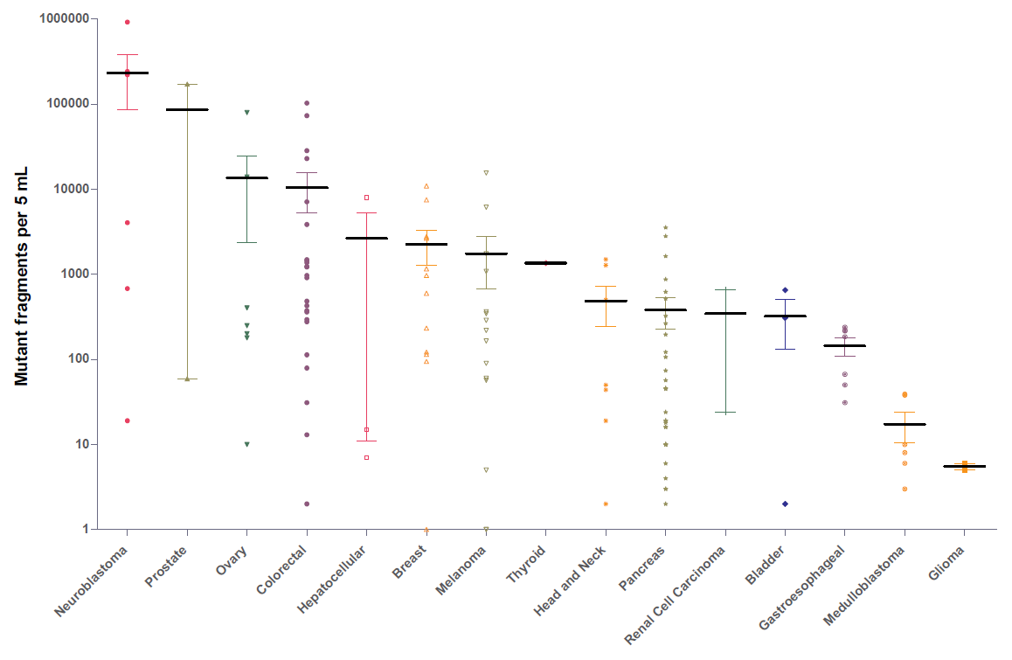
ctDNA in Advanced CRC

Slide 46
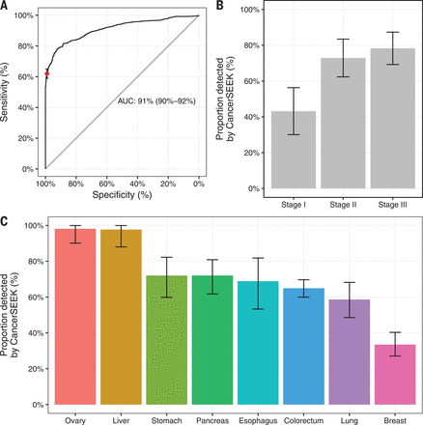

Slide 47
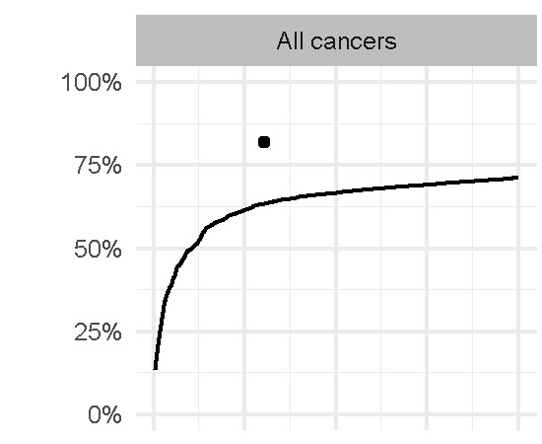
Fraction of Cancers Detected with CancerSEEK Panel
82% of Tumors had at least one detectable mutation
Proportion Detected (%)

Slide 48
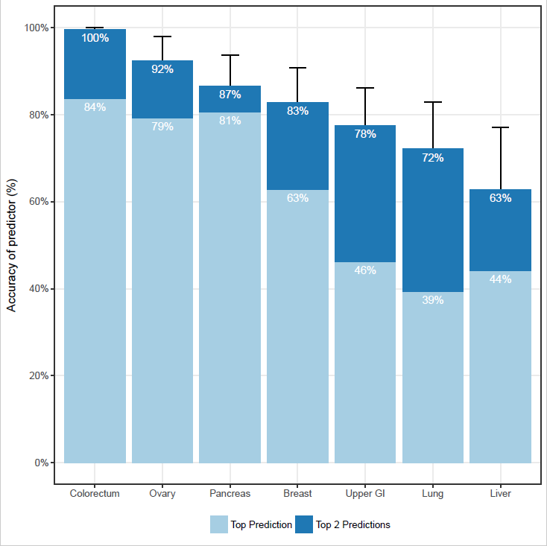
CancerSEEK Localization Accuracy
Accuracy of Prediction (%)
Top Prediction was correct in a median of 63% of the cases.
(p < 10⁻⁴⁷ one-sided binomial test)
Top 2 Prediction identified the site in a median of 83% of the cases.
(p < 10⁻⁷⁷ one-sided binomial test)
Top Prediction
Top 2 Predictions
Colon
Ovary
Panc
Breast
Upper
GI
Lung
Liver
Notes:
626 patients who tested positive
Used all 39 Protein Markers, ctDNA and gender
Grouped Gastric and esophageal together

Slide 49
Survey of ctDNA in Human Cancer
410 Patients of Various Tumor Types
136 Patients with Metastatic Cancer
41 Patients with Primary Brain Tumors
223 Patients with Localized Disease
Bettegowda. Sci Trans Med 2014:6

Slide 50
Cancer Site of Origin?
Machine learning – 626 patients with positive test
Uses ctDNA, protein biomarker, gender

Slide 51
ctDNA in Stage II CRC
N=250, post-op and serial plasma
23% adj chemo Rx at clinician direction
Targeted 15 genes using safe-SeqS
20/231 +ctDNA post op (9 p53, 8 APC, 3 KRAS)
Median f/u 27 mo
34 (14.8%) radiologic recurrence
27/178 (15%) no chemo Rx
7/52 (13%) with chemo Rx
Tie, Science Trans Med 2016

Slide 52
ctDNA and 8 protein markers
ctDNA
Waterfall plot of each individual’s performance by test
Cancers
Normals
Notes:
Waterfall plot of each individual patients performance . We used log ratios to evaluate mutations (omega scores) and incorporated them into Logistics Regression algorithm that incorporated the mutation data and the 8 protein markers indicated. Specificity and sensitivity we evaluated using 10 iterations of a 10-fold cross validation.

